Slide 1
Randomized Clinical Trials
Pediatrics Resident Research Course
Stephen Wilton, MD
Associate Professor, Cardiac Sciences and Community Health Sciences
November 3, 2023

Slide 2
Objectives
Why randomized clinical trials (RCT) are so important
  Strengths and Weaknesses
Principles of RCT design
  Asking the right study question
  Choosing a study population
  Reducing bias
  Analysis methods
Exercise – Design an RCT

Slide 3
Why Randomized Trials?

Slide 4
Clinical Trial Definition
Experimental Human Study
Textbook Definition:
‘A prospective study comparing the effects and value of intervention (s) against a control in human beings.’

Slide 5
Essential Components
Statement of purpose
Specified interventions (test & control)
Treatment plan
Pre-specified recruitment goals
Bias-free procedure for Treatment assignment
Procedures for bias control
Plan for data collection & follow-up
Prespecified, measurable outcome(s)

Slide 6

Limitations of Observational Data
Selection bias
  Comorbidities, socioeconomic factors
Measurement or Reporting Bias
  Claims data may not be accurate
  Outcomes not strictly defined
  Dosing often not reported
  New drugs are more likely to have AE’s reported (Weber effect)
  Missing information on comparator
  Bandwagon (secular) effect
Confounding
  Limited information on co-morbidities that impact on outcomes
  Co-interventions
Southworth et al. NEJM 2013. 368: 1272; Larsen et al. JACC 2013; 61: 2264.

Slide 7

Limitations of Observational Data

Slide 8
Observational Data for Treatment Decisions: What could go wrong?
Antiarrhythmics to prevent SCD: CAST
Hormone replacement therapy: WHI, HERS
Intensive control of BP, glucose and lipids in DM2: ACCORD trials
Hydroxychloroquine for COVID-19
. . .

Slide 9
The Magic of Randomization
Eliminate selection bias
Balance arms with respect to prognostic variables
Forms basis for statistical tests
Essential tool for testing the efficacy of the treatment

Slide 10
Limitations of Clinical Trials
“Between measurements based on RCTs and benefit … in the community there is a gulf which has been much under-estimated”
A L Cochrane, 1971
“At its best a trial shows what can be accomplished with a medicine under careful observation and certain restricted conditions. The same results will not invariably or necessarily be observed when the medicine passes into general use.”
Austin Bradford Hill, 1984
Rothwell. Lancet 2005; 365:82

Slide 11
RCTs: Potential Limitations
Population too highly selected
Too strict admissibility criteria → poor generalizability
Too expensive & time consuming
Large populations → impractical
Long duration → impractical
Comparison of interest may not be possible
Ethical considerations may prevent it
Human behavior (Hawthorne Effect)
Artificial environment modifies the occurrence relation
Compliance over-estimated

Slide 12
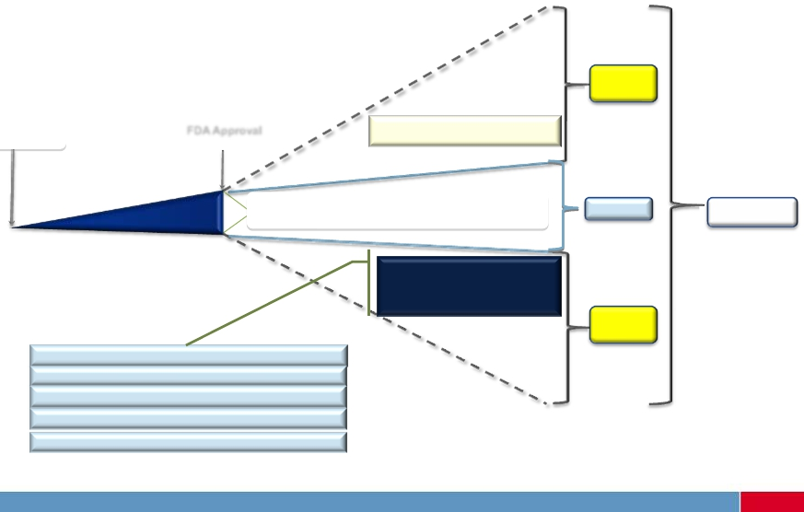
From RCT to clinical practice
No
Evidence
Beginning of
Human Testing
FDA Approval
Clinical Trials
Off-label indications
Post-Marketing Studies
Evidence
Evidence
Utilization
Variances in population
characteristics from what
was studied
No
Evidence
Differing age groups – elderly, pediatrics
Other diversities (race, ethnicity)
Unstudied co-morbid conditions
Differing concomitant medications
Varying levels of compliance – i.e. < 80%
2

Slide 13
Limitations of RCTs
“It has been said that democracy is the worst form of government, except all the others that have been tried.”
-Sir Winston Churchill
the clinical trial
study

Slide 14
Phases of Clinical Trials
Classification comes from pharmaceutical trials
I. Dose-finding / ranging
II. Preliminary Safety & Efficacy
  No randomization
  Randomization
III. Comparative RCT
    Definitive outcomes
IV. Post-marketing surveillance
intermediate
outcomes

Slide 15
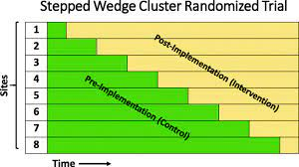
Common RCT Designs
A
A
Parallel
R
R
B
B
C
A
A
Crossover
B
B
X
Y
A
A
X
A
Y
Factorial
B
B
X
B
Y

Slide 16
Prototype: Phase 3 RCT
Large sample size
Multiple sites to reach recruitment goal
Long periods of recruitment & follow-up
Follow-up extends well beyond the close of patient recruitment
Svennberg, Lancet (2021): https://doi.org/10.1016/S0140-6736(21)01637-8

Slide 17
Study Question and Population

Slide 18
Primacy of the Research Question
Where do questions come from?
Experience
Theory
Literature
State the Research Problem

Slide 19
Define/Refine a Research Question
Research Problem
Timing
Sexy
Research Question
Feasibility
Colleagues
Literature

Slide 20
Elements of a Research Question
Population
Intervention
Control
Outcome
(Timeframe)
Notes:
Emphasize the importance of having this crystal clear.

Slide 21
From Question to Study Population
Who to study exactly?
How many of these patients are there?
Can they be recruited?
Is there equipoise?

Slide 22
Physiological Statistics
Confidence ≈ confidence interval
Signal: observable treatment effect
Noise: random variation in outcome
Sackett, Clinical Epi., 3rd Ed.

Slide 23
Determinants of Signal
Baseline risk (absolute event rate in controls)
Potency of treatment / intervention
Responsiveness of selected group
Completeness of outcome ascertainment
Number of outcomes, not number of patients

Slide 24
Baseline Risk
 | RCT 1 |  | RCT 2 |  | RCT 3
 | All Patients N = 240 |  | Only High Risk N = 120 |  | Only Low Risk N = 120
 | Control | Exper. | Control | Exper. | Control | Exper.
Events (y/n) | 60 / 60 | 45 / 75 | 48 / 12 | 36 / 24 | 12 / 48 | 9 / 51
CER | 50% |  | 80% |  | 20%
EER | 37.5% |  | 60% |  | 15%
RRR | 25% |  | 25% |  | 25%
ARR | 12.5% |  | 20% |  | 5%
95%CI | (0, 25%), p=0.07 |  | (4,36%),p=0.03 |  | -8.5, 18.5%), p=0.63
Sackett, Clinical Epi., 3rd Ed.

Slide 25
Minimizing Noise
Strategy | Tactic
Validate eligibility | Do all patients have the target disease?
Crossover trial | Perfect control of confounding
Homogenize | Restrict to single risk-response group
Minimization, Stratification | Ensuring balance in prognostic factors
Maintain compliance | Similar and high rates in groups
Specificity of events | Avoid competing causes
Ascertain all events | Complete follow-up
Sackett, Clinical Epi., 3rd Ed.

Slide 26
What about Sample Size?
Increasing it is last resort
Least powerful effect (exponential)
Increased risk of including low risk, low responsiveness patients

Slide 27
Signal to Noise Ratio
Likelihood of Outcome |  | Likelihood of Treatment Response
 |  | High | Low
 | High | Ideal! | Too sick to benefit? Caution
 | Low | Too well for treatment? Caution | Avoid!
Sackett, Clinical Epi., 3rd Ed.

Slide 28
Efficacy versus Effectiveness Trial
Efficacy
  can the intervention work (in the ideal world)?
Effectiveness
  does the intervention work (in the real world)?
Most study designs lie somewhere between the two extremes

Slide 29
Pragmatic vs. Explanatory Clinical Trials
Explanatory
Does it work?
How does it work?
Pragmatic (or Management)
Does it work in real life?
EFFICACY
EFFECTIVENESS

Slide 30
 | Pragmatic | Explanatory
Eligibility | Broad | Narrow
Intervention delivery | Flexible | Rigid protocol
Interveners | All clinical settings | ‘Experts’ only
Control therapy | Usual practice, open label | Placebo, blinding
Follow-up intensity | Standard care | Frequent, ++ data
Primary outcome | Objective, clinically important | Surrogates, adjudication
Patient compliance | Not measured | Critical
Practitioner compliance | Not measured | Critical
Analysis | As randomized, ITT | ITT plus per-protocol
Signal:Noise | Low | High

Slide 31
Study Population - Practicalities
Feasibility is almost always overestimated
  Finding candidates
  Clinician engagement
  Fitting criteria
  Getting consent
  Availability of staff to enroll
  Cost: N we need >> N we can afford?

Slide 32
Reducing Bias in RCTs

Slide 33
Methods of Bias Reduction
Design
Randomized treatment allocation
Allocation concealment
Blinding/Masking
Completeness of data collection
Completeness of follow-up
Analysis
Intention to treat versus per protocol

Slide 34
Randomization
Good randomization = balanced participant characteristics
  Accounts for measured and unmeasured confounding
  Unpredictable - E.g. coin toss, concealed envelopes using randomization matrix
  Reproducible - State methods clearly
  Free from manipulation

Slide 35
Sampling Designs
All children with a rare genetic disorder in Alberta
Probabilistic (random) designs
  Simple random sampling
  Systematic sampling
  Cluster sampling
  Stratified sampling

Slide 36
Allocation Concealment
Avoid selection bias introduced when investigators can guess the next treatment allocation
  Investigator-blinded design
  Permuted block randomization

Slide 37
Rationale for blinding / masking
Placebo / standard treatment / no treatment
  Allows for quantification of actual treatment effect size
70
60
Treatment effect
50
Placebo effect
Placebo effect
40
30
Hawthorne effect
Hawthorne effect
20
10
Spontaneous improvement / worsening condition
Spontaneous improvement / worsening condition
0
-10
-20
Control group
Treatment group

Slide 38
Blinding
No blinding = “open-label”
  E.g. surgical intervention
  E.g. standard treatment w/ different schedule
IDEALLY blinding of:
  Participants
  Caregivers / attending clinician
  Data (outcome, other) collection personnel
  Outcome adjudicators, data analysts
Prevent performance bias!
Prevent detection bias!

Slide 39
Follow-up and loss-to-follow-up (LTFU)
Length of follow-up → appropriate for outcome
Loss-to-follow-up (LTFU)
  How might LTFU participants differ from those who remain?
  Not missing at random
Poor compliance to treatment
  Including cross-over (known or unknown to study personnel)
  How might these participants differ from others?
Sensitivity analyses (e.g. best vs worst case scenario)

Slide 40
Analysis of RCTs

Slide 41
Statistical Analysis of RCTs
Write a statistical analysis plan before hand!
Specify:
Hypothesis
  Superiority, non-inferiorty, or equivalence
Sample size calculation (based on hypothesis)
Outcome definitions
  Adverse events monitoring
  Stopping rules
Model choice and variables to include
  Intention to treat (ITT) versus per-protocol analysis (PPA)
Subgroup analyses
Sensitivity analyses

Slide 42
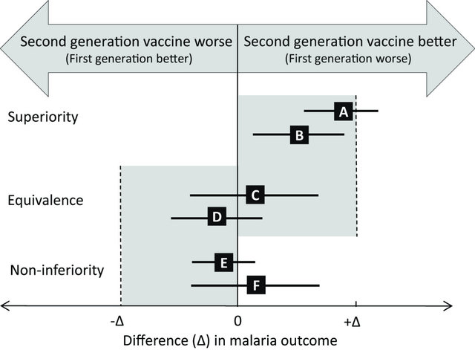
Understanding Superiority vs Non-inferiority
Fowkes et al. BMC Medicine 2013, 11:232

Slide 43
RCT Statistical Analysis - Outcomes
Outcome definitions
  Quantitative change in condition: e.g. % virus cleared, increase in ALT, change in quality of life
  Events-based: negative (.e.g. death, disease progression), positive (e.g. remission, ‘undetectable virus’)
  Poorly defined outcomes = threat to study validity
Adverse event monitoring
  Related or not-related to study treatment
  Severe (SAE) vs non-severe (AE) adverse event
Stopping rules: based on interim analysis (clear superiority or inferiority) or adverse reactions

Slide 44
RCT Statistical Analysis – Intention to Treat or Per Protocol
Intention to Treat (ITT)
  Participants are analyzed within the group (treatment vs control) that they were randomly allocated to
    Regardless of protocol violations
      Protocol violations = took no treatment (ineligible, early drop-out), cross-over or contamination, loss-to-follow-up
    How to consider missing outcomes?
      Imputation (fancy methods, treatment failure), as missing
  Conservative, gold standard (maybe not in non-inferiority trials)

Slide 45
RCT Statistical Analysis – ITT vs PPA
Per protocol analysis (PPA)
  Compliant participants are analyzed
    Protocol violations are excluded
      Regardless of initial randomization = As Treated (AT)
    How to consider missing outcomes?
      Complete case analysis
  Biased, especially if high % protocol deviations, BUT often used → can be appropriate as a sensitivity analysis

Slide 46
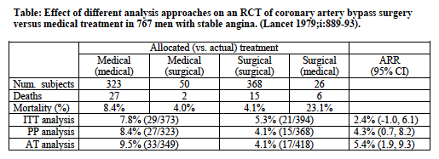
ITT vs PPA: Example
Comparison of surgical treatment with medical (standard of care, no surgery) among 768 men with stable angina pectoris. Only 767 received treatment.
AT= as treated analysis, ARR = absolute risk reduction

Slide 47
RCT Statistical Analysis – Measures of Effect
Benefit of RCTs – simple and robust analysis
  Risk ratio (RR) –Relative effect
    Risk of outcome in treatment group
    Risk of outcome in control group
  Risk difference (RD) – Absolute effect
    Risk of outcome in treatment group - Risk of outcome in control group
  Hypothesis testing
    Comparison of two independent samples proportions (dichotomous outcome) : Chi-square or Fisher’s exact

Slide 48
RCT Statistical Analysis – Other
Subgroup analyses
  Is there a difference in effect by gender? sex? age? --> Stratify!
  Pre-specify in statistical analysis plan
  Sensitivity analyses
  Intention-to-treat versus modified intention-to-treat versus per-protocol
  Various types of imputation for missing data

Slide 49
Exercise
Design a Randomized Clinical Trial in 15 minutes

Slide 50
Exercise – Option 1
Warfarin substantially reduces the risk of stroke in selected patients with non-valvular atrial fibrillation. However, warfarin has a narrow therapeutic window, requires intermittent dose monitoring and adjustment, and is associated with a significant increased risk of hemorrhage.
Recently, newer anticoagulant medications have become available that allow for stable dosing. In early trials (Phase 1 and 2) one such medication called ‘Stroke-be-gone’, a once daily oral medication, has been found to be well-tolerated and may be associated with a reduced risk of bleeding compared with warfarin.
Design a phase 3 trial to determine the efficacy of Stroke-be-gone in preventing stroke.

Slide 51
Exercise – Option 2
The success of the COVID-19 vaccine depends on mass participation. However, approximately 10% of population X is hesitant to receive the COVID-19 vaccine. Current public health messaging about vaccines and vaccine safety may not be effective.
Design a trial to determine the effectiveness of varying public health messaging strategies (e.g. types of information, ways of giving information) to reduce COVID-19 vaccine hesitancy in participants.

Slide 52
Exercise – What to Include
Specific Research Question (PICO-T)
Setting (sample population)
  Inclusion and exclusion criteria
Intervention and Control conditions
Randomization strategy
Blinding – to what extent?
Length of follow-up, primary outcome definitions
Analysis (optional) - what type of hypothesis? What effect measure would be most interesting / best for communicating your results

Slide 53
Summary

Slide 54
Objectives
Why randomized clinical trials (RCT) are so important
  Strengths and Weaknesses
Principles of RCT design
  Asking the right study question
  Choosing a study population
  Reducing bias
  Analysis methods
Exercise – Design an RCT

Slide 55
Not covered today
Ethics and Good Clinical Practice
Assessing feasibility – pilot studies
Novel RCT Designs
Details of Analysis methods, early stopping rules
Clinical trial management
Grant-writing for success
Critical appraisal

Slide 56
Opportunities to Learn and be Involved
Formal training – MDCH 641: Introduction to Clinical Trials
SPOR Pragmatic Clinical Trials Program
Contribute as a learner to ongoing studies
Observership on grant review panels
Journal Clubs, Twitter,

Slide 57
Thanks!
sbwilton@ucalgary.ca

