Slide 1
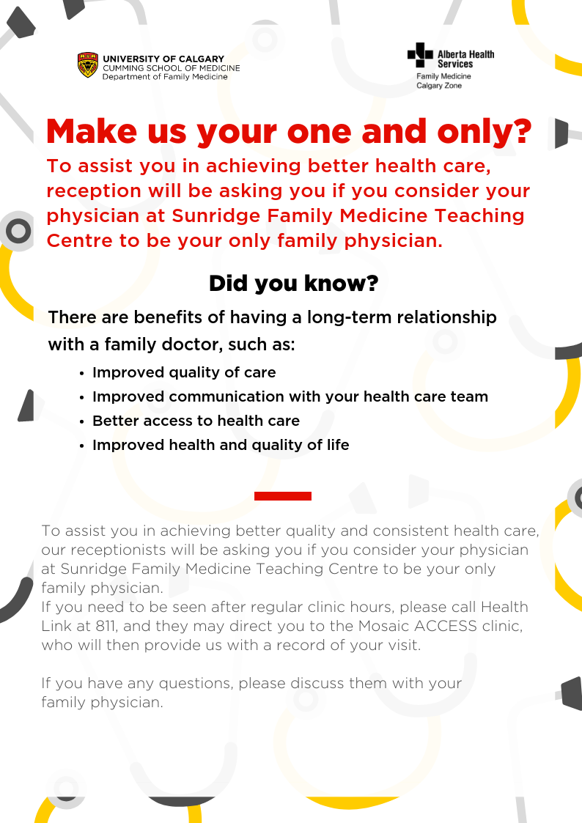
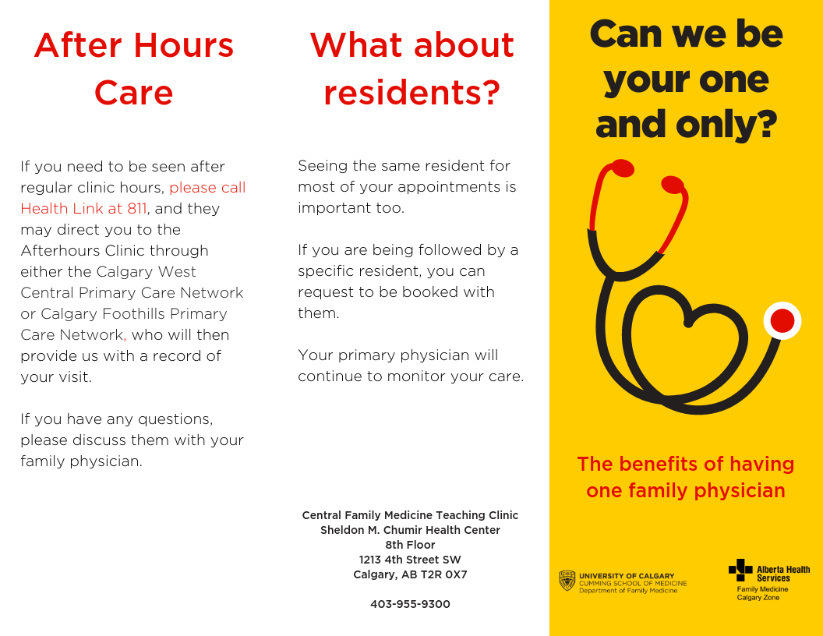
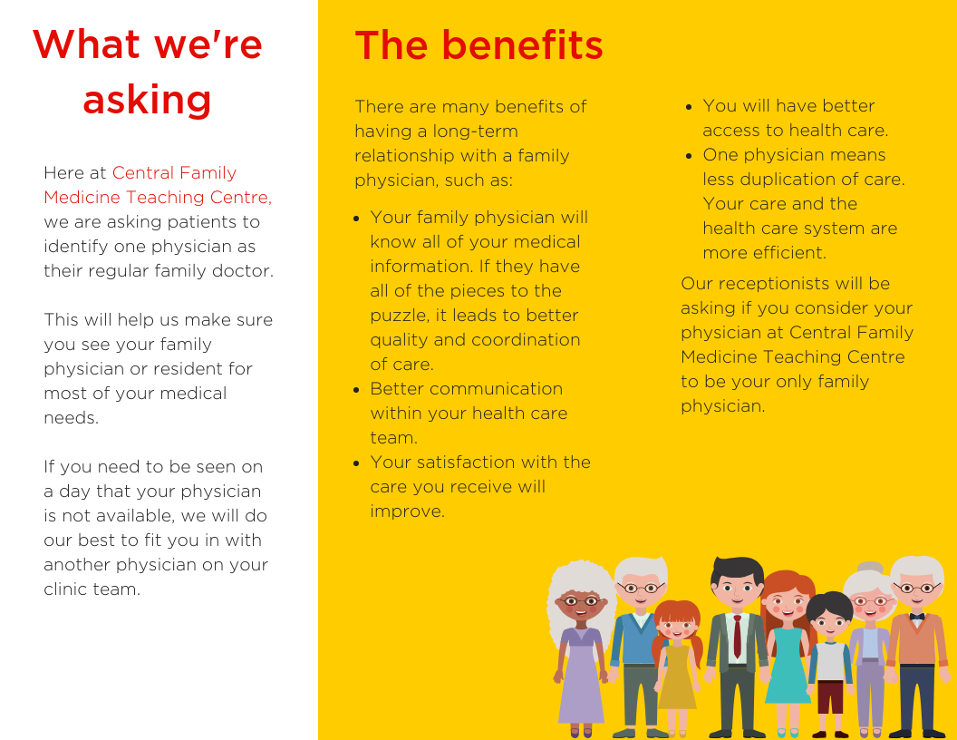
Communicating About Continuity
‘Can we be your one and only?’
Nowry, C MD CCFP, A. Adelugba MLT PhD, F. Gashi, J. Wilson, K. Zamanpour MD CCFP, N. Hermann, T. Fowler, T. Stainbrook, L. McIntyre, S. Mitchell, and Philips, N. BN CPCC ACC
BACKGROUND
In December 2017 the need was identified for a coordinated approach between the three University of Calgary Academic Teaching Clinics in the Department of Family Medicine, in preparation to participate in the Central Patient Attachment Registry (CPAR)
The three clinics, located in NW, NE and SW Calgary, currently have over 25 000 panelled patients
CPAR is a provincial project, with the objective of identifying one primary care provider for every patient, in order to support improved continuity of care
TIMELINE
January 2018:
Working group launched
Identification of panel administrators at each site
Developed understanding of current state for panelling processes at each site
February 2018:
Webinar about CPAR delivered to the working group
Identified areas to improve current panel clean-up process; including a review of use of patient status in the EMR
March 2018:
Developed a standard definition for “demographics validated”
Created a script for reception to confirming patient attachment to their primary provider
April - May 2018:
Initial draft of patient education poster and pamphlet developed
Patient feedback received regarding reception script and educational materials
June 2018:
Lunch and learn information sessions on CPAR held at each site
September –October 2018:
Finalized patient education posters and pamphlets
November 2018:
Launched confirmation of attachment workflows
Initiated collected of demographic validation rates
REFLECTIONS
STEPS TOWARDS IMPROVED CONTINUITY
A unified approach allowed for learning from the experiences of all three sites
Development of patient education materials that were patient-informed and reflected the uniqueness of our clinics was a critical step in the process
Review of current panelling processes
Agreement on a standard definition of “Demographics validated”
Development of a workflow for confirming provider attachment
Staff and physician education about the importance of continuity
Development of patient education that supports relational AND information continuity, as well as resident-patient continuity
Encouraging conversations between patients and their primary care providers around the importance of continuity
Collecting patient feedback on barriers to attachment with one primary provider
NEXT STEPS
Regular review of validation rates
Preparation for management of mismatch and conflict reports
Solicit and reflect on patient feedback to help identify opportunities to further support both relational and informational continuity
Contact Information
Email: name@ucalgary.ca
Web: www.calgaryfamilymedicine.ca

