Slide 1




Major Depressive Disorder in the Adolescent
Iliana Ortega MD, FRCPC
Academic Lead Child and Adolescent Psychiatry
Clinical Associate Professor
University of Calgary
iliana.ortega@ucalgary.ca

Slide 2

I would like to take this opportunity to acknowledge the traditional territories of the people of the Treaty 7 region in Southern Alberta, which includes the Blackfoot Confederacy (comprising the Siksika, Piikani, and Kainai First Nations), as well as the Tsuut’ina First Nation, and the Stoney Nakoda (including the Chiniki, Bearspaw, and Goodstoney First Nations). The City of Calgary is also home to Métis Nation of Alberta, Region 3.

Slide 3
Objectives
To describe the epidemiology and disease-burden of depression in young people
To enhance competency in diagnosis and use of best evidence in treatment of depression in adolescents
To summarize the treatment options including psychological and pharmacological interventions including off label practices.
To Improve mental health care for young people

Slide 4

Disclosure about this presentation
All pharmacological interventions presented are considered off-label as Health Canada has not approved the use of antidepressants in children and youth. However, all the information contained in this presentation follows Canadian, American and NICE Clinical Guidelines and uses best available evidence.

Slide 5
Adolescence
  Adolescence marks a transition from childhood to adulthood (11 to mid-20’s).
  It is a time of both disorientation and discovery.
  Contrary to common beliefs, most adolescents have an easy time adjusting during this period of change.
  Experiencing significant changes in mood and behavior is NOT a normal part of adolescence.

Slide 6
Adolescent Brain Development
The brain continues to develop throughout adolescence and into young adulthood.
Pre-frontal cortex is one of the latest parts to develop.
Notes:
The maturation of the prefrontal cortex is crucial because this region of the brain supports higher-order cognitive and emotional regulation skills that are necessary for independent, adaptive functioning.

Slide 7
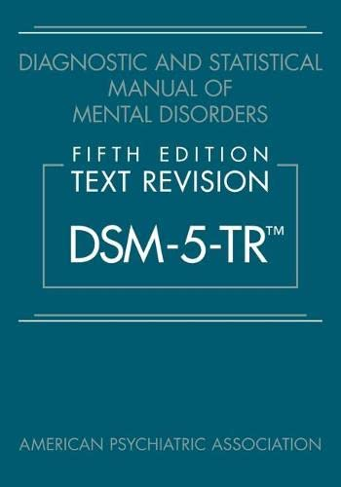
Depressive Disorders in the DSM-5
  Disruptive Mood Dysregulation
  Major Depressive Disorder
  Persistent Depressive Disorder (Dysthymia)
  Premenstrual Dysphoric Disorder
  Substance Induced Depressive Disorder
  Depressive Disorders due to Medical Condition

Slide 8
Depression
Incidence &
Prevalence
Depression can be a debilitating and often chronic disorder and frequently has an onset in adolescence.
The prevalence of depressive disorders:
Pre-pubertal children 1-2%
Adolescents (15 to 24) 8.2 %
Lifetime prevalence of 15 - 20%
Female : Male (1:1 pre-puberty, then 2:1)
Onset before age 12 has been linked to poor functioning, more lifetime depression episodes, suicide attempts, and psychiatric comorbidity
Lewandowski, R. E., Acri, M. C., Hoagwood, K. E., Olfson, M., Clarke, G., Gardner, W., Scholle, S. H., Byron, S., Kelleher, K., Pincus, H. A., Frank, S., & Horwitz, S. M. (2013). Evidence for the management of adolescent depression. Pediatrics, 132(4), e996–e1009. https://doi.org/10.1542/peds.2013-0600

Slide 9
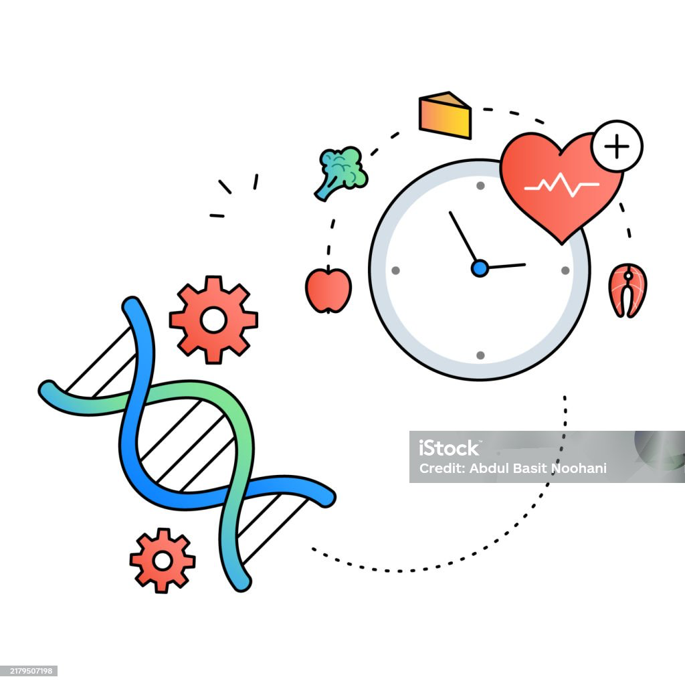
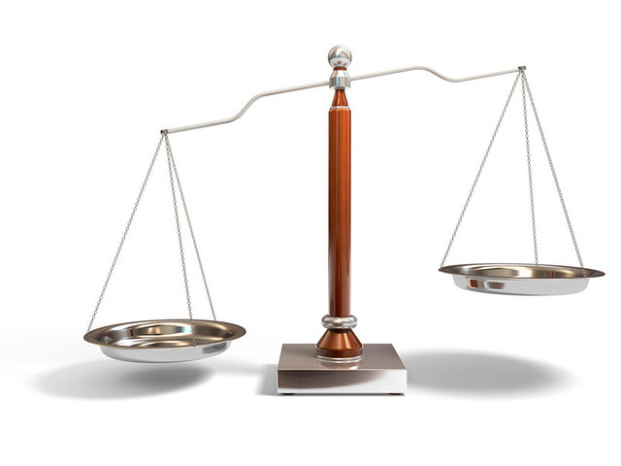
Risk factors – they have a cumulative effect
Family history of depression, or any other mood disorders
Personal history of depression (previous depressive episode)
Other psychiatric disorders (anxiety, ADHD, conduct disorder)
Substance use
Trauma and other psychosocial adversity
Medical/Chronic Illness
40 % 60 %
genes environment
Notes:
They have a cumulative effect

Slide 10
Duration of Depressive Episode
In community samples, a depressive episode in youth typically ranges from 2 to 6 months.
In referred samples episode usually lasts 6 - 9 months
Factors associated with chronicity include:
  Severity
  Comorbid conditions
  Suicidal ideation
  Parental history
  Age at onset

Slide 11
Duration and Recurrence
Effects of depression
Adolescent depression is associated with:
  Short and long-term impact on school and work performance, family dynamics, friendships, substance use and suicide
Depression is associated with an increased risk of chronic medical conditions (cardiovascular diseases, diabetes, others).
20 - 60% recurrence 1 – 2 years after remission.
70% recurrence after 5 years and can persist throughout life.

Slide 12
5 out of 9 for a period of at least 2 weeks
Depressed mood most of the day, nearly every day. In children and adolescents, this may be characterized as an irritable mood.
Markedly diminished interest or pleasure
Significant weight loss or weight gain (more than 5% of body weight in a month).
Insomnia or hypersomnia
Psychomotor agitation or retardation
Fatigue or loss of energy
Feelings of worthlessness or excessive or inappropriate guilt
Diminished ability to think or concentrate, or indecisiveness
Recurrent thoughts of death, and recurrent suicidal ideation with or without a specific plan
Criteria - Mayor Depressive Disorder

Slide 13
Challenges identifying depression in young people
Similarity in presentation of distress and disorder.
Severity may be an indicator but not a very good one.
Personality and “teen-stage” issues complicate the diagnosis.
Developmental aspects especially family, peers and school should be taken into consideration when providing a diagnosis in adolescents.

Slide 14
Adolescent Depression: clinical presentation
Diagnostic criteria for MDD are the same regardless of age, except for irritable mood
Clinical presentation of depression in young people:
More irritability than sad mood
More hypersomnia
Fewer changes in appetite and weight
Symptoms tend to be more reactive to environment

Slide 15
Sleep problems in young people with depression
Adolescents frequently experience problems with sleep hygiene
Sleep disturbance is one of the diagnostic criteria for depression:
    Delayed sleep onset
    Interrupted sleep
    Hypersomnia
    Early morning awakening or difficult morning awakening
Sleep in depressed youth is characterized by decreased REM latency and increased sleep latency.

Slide 16
Treating sleep problems in depressed teens
  Regular bedtime/arising time including weekends.
  Decrease consumption of caffeinated drinks and avoid them after dinner.
  Limit liquid intake before bedtime.
  30 to 45 minutes of quiet time prior to going to sleep.
  Avoid exercising before bedtime.
  No TV in the room/no cell phones during the night.
  Make worry list before bed – may be useful in people who have high anxiety
Notes:
Good sleep hygiene is an important part of healthy development for all young people but also for those not so young.
The quality and quantity of sleep are affected by certain behaviour; and improving both quality and quantity of sleep has a significant positive effect in our health and quality of life.
I am going to tell you the story of James a 12 years old boy who was brought to my office with a query of depression,
he was referred by his school counselor as James was displaying some symptoms that looked like depression such as irritable mood, social withdrawal and dropping grades,
also there were frequent complains from James teacher due to his poor school work and attention.
When James came to my office and I started gathering a detailed story of his current presentation, I also inquired about his sleep habits and I found out that for the last few weeks James was staying up until pass midnight playing in his computer.
His mom was really concern and was wanting to start treatment for depression right away,
I suggested to initiate with some behavioural interventions including modification to his sleep hygiene and to recheck in one week time.
When James and his mom came back a week later I found out that all the symptoms that James were complaining of were gone.
Now I am going to tell you, what does a good sleep hygiene include.
To have a regular bedtime
Having a dark and cool bedroom with good ventilation
Decrease the consumption of caffeinated drinks such as pops, tea or energy drinks during the day , and completely avoid them after dinner.
Limit the amount of liquids before bedtime,
To have 30 to 45 minutes of quiet time before bed.
Avoid active exercise should before bedtime, instead they can do some relaxation exercises including stretching or breathing exercises.
It is very important to keep TV, computer and phones out of the room during night.
*Make worry list before bed, can be particularly helpful for those who struggle with anxiety
Those dealing with mental disorders require greater attention to sleep hygiene due to the disturbances of sleep commonly associated.

Slide 17

Assessment
Information obtained from multiple sources: child, parents, teachers, other health care professionals
Review of psychiatric history
Review of medical history
Review of developmental history
Review of academic history
Review of family psychiatric history

Slide 18
Confidentiality
It’s essential to address it from the beginning.
  Teens may want confidentiality with regards to parents, school and peers.
  Parents may want confidentiality with regards to children, the other parent and school.
Cultural norms and expectations may impact what is expected.
Know the legal parameters in your jurisdiction.
Self-harm and harm to others are deal-breakers.

Slide 19
Suicidality
As many as 1 in 5 teens report suicidal ideation in one year.
Suicide is the 2nd leading cause of death among Canadians aged 15 – 24
First Nations youth suicide rate is 5 to 6 times > non-Aboriginal youth.
Suicide attempt rate girls > boys.
Completed suicide rate in boys > girls.

Slide 20
Assessing Suicide Risk
Suicide risk should be assessed at baseline and throughout the treatment period.
Gently inquire about:
  Family history of suicide
  Parent/youth reports of self harm behaviors
  Inquire if age is appropriate for suicidal ideation, suicidal plan and access to means
Notes:
Assessment of Suicide Risk In Children
Suicide in children is rare and the assessment of suicide risk in children is not well developed nor
well standardized. Research into pre-pubertal suicide is limited. It is useful however to screen for
suicide ideation and plans if the clinical situation warrants it.
A family history of suicide or parent/child reports of self-harm behaviours or substantial depressive symptoms could suggest
that the clinician gently inquire about suicide. This must be done in an age appropriate manner.
Here is a suggested approach:
When you are feeling this way do you ever wish that you were dead?
Can you tell me what you mean by being dead?
Have you thought of doing something that would make you dead?
Can you tell me about what you are thinking or planning?
If the answer to the first question is positive, it is essential to probe to understand what the child
means by dead. If the child does mean death then further questions are needed. If there is
doubt about child suicide risk, the parents need to be informed and given simple suggestions
about what to do (remember that anxious children often have anxious parents so do not stoke the
fires of parental anxiety over this issue) and immediate referral should be made to a specialty
child mental health service provider.

Slide 21
Substance use and depression
Adolescence is the time during which most individuals first experience exposure to alcohol or other substances.
Screening for substance use should be part of general health assessments for adolescents who present with mood or behavioral changes.
The abuse of substances can resemble clinical depression.
The chronic use of illicit substances can cause secondary depressive symptoms.

Slide 22
Depression Severity Measures
Clinician Rated Measures:
Children’s Depression Rating Scale – Revised (CDRS-R)
Hamilton Rating Scale for Depression (HAM-D)
Montgomery-Asberg Depression Rating Scale (MADRS)
Self-Report Measures:
Patient Health Questionnaire (PHQ-9 A)
Quick Inventory of Depressive Symptomatology (QIDS-SR)
Mood and Feelings Questionnaire (MFQ)
Children’s Depression Inventory (CDI)
Beck Depression Inventory (BDI)
Kutcher Adolescent Depressive Scale (KADS)

Slide 23
Adolescent Report vs.
Clinician Rating and
Parents/teachers reports
Adolescents tend to report themselves as slightly worse overall than clinicians report.
Clinicians scores tend to be more pathological than adolescent ratings for concentration, self-view, and restlessness/agitation.
Parents and teachers are less able to identify emotional distress than they can identify behavioral disturbances.

Slide 24
Differential diagnosis
Depression symptoms due to medical illness
Prodromal symptoms of Psychosis
Substance use
Adjustment Disorder with mood symptoms
Evolving personality disorder
Depressive symptoms secondary to an eating disorder
Bipolar Depression
Persistent Depressive Disorder
Side effects of a medication

Slide 25
Treatment of depression in young people

Slide 26
Response, Remission, Recovery, Relapse, Recurrence
Full Remission
Recovery
Relapse
Recurrence
Partial Remission
Symptoms
Response
Symptoms
Treatment Phases
Acute
Continuation
Maintenance

Slide 27
Treatment should be tailored based on age and severity
Mild Depression - Supportive clinical care may be sufficient to reduce symptoms.
Moderate Depression – Psychotherapy and pharmacotherapy should be offered.
Severe Depression - Pharmacotherapy should be considered as a first-line intervention.

Slide 28
Evidence based treatments for depression in adolescents
Non-Pharmacological Interventions:
    Nonspecific interventions
    Psychological treatments

Slide 29
Nonspecific intervention
  Supportive clinical care may be sufficient to reduce depression symptoms of mild to moderate severity.
        Psychoeducation
        Lifestyle advice:
              Sleep hygiene
              Healthy eating
              Exercise
              Avoid drugs
              (CANMAT)

Slide 30
Evidence based treatments for depression in Adolescents
    Psychological treatments
      CBT
      IPT
      Family therapy – Family based interventions
      ACT

Slide 31
Treatment | Evidence strength (children/adolescents) | Typical format / dosing (usual study/practice) | Key findings (efficacy)
Cognitive Behavioral Therapy (CBT) | Strong — multiple RCTs & meta-analyses support benefit for mild–moderate MDD | Weekly individual or group sessions (10–20 sessions) internet-CBT also studied | Consistent, clinically significant reductions in depressive symptoms vs control. Similar effectiveness to medication on average for adolescents.
Interpersonal Psychotherapy (IPT) | Moderate — RCTs support efficacy comparable to CBT for adolescents | Weekly sessions (12–16) | Demonstrates significant symptom reductions; recommended as a first-line psychotherapy option
Family therapy / family-based interventions | Moderate — evidence supports benefit, especially in younger adolescents / family-conflict contexts | Family sessions focused on communication and problem solving; variable duration | Can reduce depressive symptoms and improve engagement and family dynamics

Slide 32
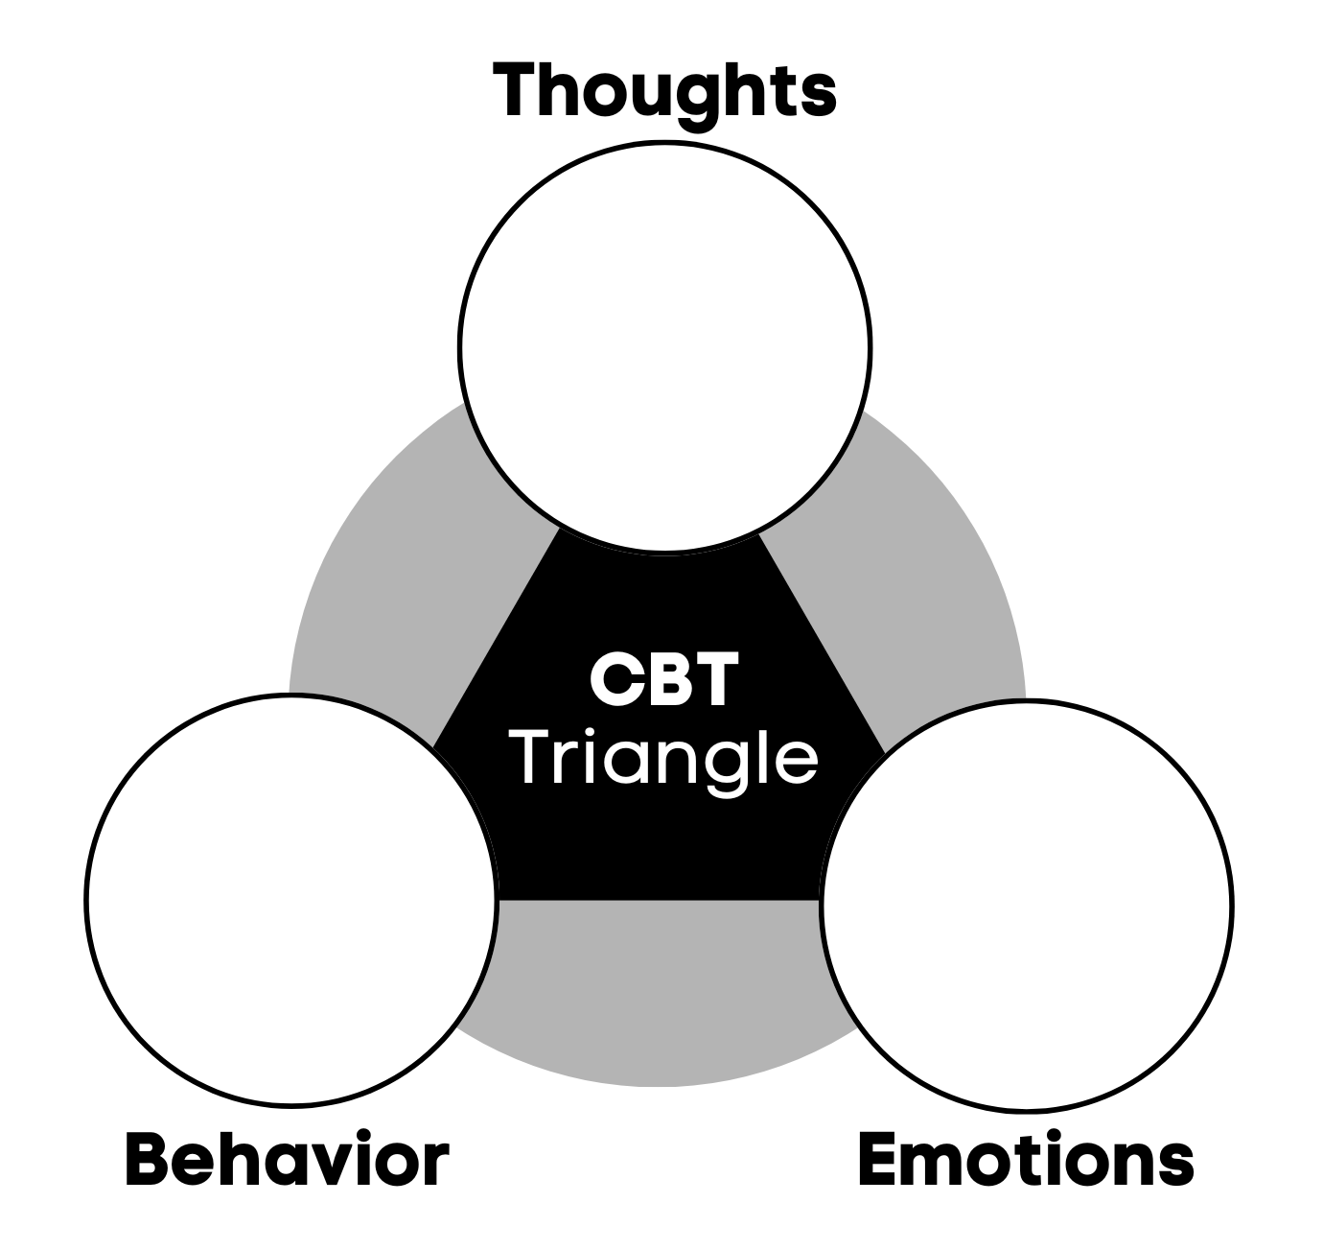
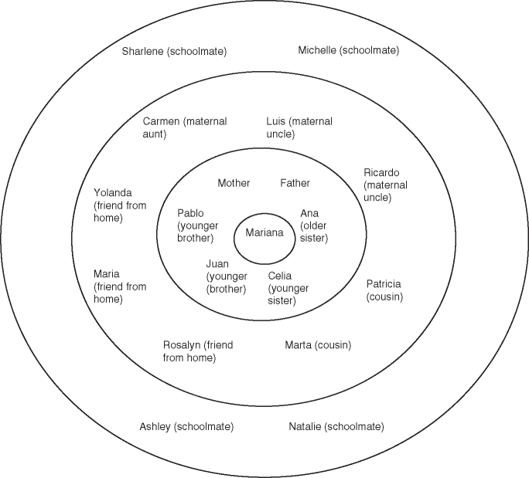
CBT vs IPT
Cognitive | Thought monitoring, cognitive distortions, restructuring
Behavioral | Activation, exposure,, coping skills
Emotional Regulation | Relaxation, grounding
Problem Solving | Planning, breaking tasks down, evaluating outcomes
Initial | 1–3 | Psychoeducation, interpersonal inventory, problem area selection
Mid | 4–10 | Skills practice, communication analysis, role play, problem solving, behavioral activation
Final | 11–12+ | Consolidation, relapse-prevention, maintenance plan
Notes:
Communication analysis (identifying patterns, misunderstandings, nonverbal cues)
Affective expression coaching (naming feelings → expressing feelings → requesting needs)
Role-play and rehearsal (practicing conversations, boundary setting, or negotiation)
Problem-solving interpersonal conflicts
Developing new relationship roles, routines, or social supports
Behavioral activation in interpersonal context

Slide 33
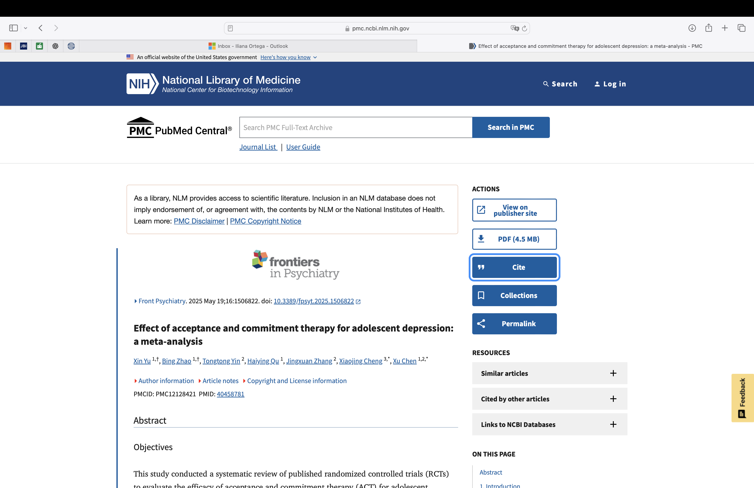
Acceptance and Commitment Therapy (ACT)
ACT has shown promising, medium-sized effects for reducing depressive symptoms in youth vs inactive controls.
Evidence comparing ACT directly with CBT in adolescents is limited but suggests similar symptom reductions in many small trials
Six core processes
  Acceptance
  Cognitive Defusion
  Present-Moment
  Awareness (Mindfulness)
  Observer Self
  Values

Slide 34
Pharmacological treatments for depression in youth
    SSRI:
      Fluoxetine
      Sertraline
      Escitalopram
      Fluvoxamine
    Non-SSRI
      Venlafaxine
      Duloxetine
      Bupropion
      Vilazodone
      Vortioxetine

Slide 35
Treatment | Evidence strength (children/adolescents) | Typical format / dosing (usual study/practice) | Key findings (efficacy)
SSRIs Fluoxetine | Strongest evidence in pediatrics population; FDA-approved for MDD (8+) | Fluoxetine oral: commonly 10–60 mg/day | RCTs show superiority to placebo for adolescent MDD; often first-line pharmacotherapy when meds indicated.
Other SSRIs Escitalopram / Sertraline / Fluvoxamine | Moderate evidence | Escitalopram/sertraline oral dosing varies by age/weight | Escitalopram has effectiveness data and is used in adolescents Sertraline shows benefit in some pediatric studies (esp. for comorbid anxiety/OCD).
Other antidepressants ( SNRIs, TCA) | Limited / mixed evidence; not first-line | SNRIs have some pediatric data TCAs mostly studied historically | Generally, less favorable risk/benefit than SSRIs in youth; not first-line for uncomplicated pediatric MDD.

Slide 36
Combined treatment
Treatment | Evidence strength (children/adolescents) | Typical format / dosing (usual study/practice) | Key findings (efficacy)
Combined treatment (CBT + SSRI) | Strong — RCTs show combination often superior for moderate–severe cases | Concurrent therapy + medication (e.g., fluoxetine + CBT) | Combination may produce faster/greater response and greater functional improvement for more severe cases.

Slide 37
Study | Population | Key Finding
TADS (2007) Treatment for Adolescents with Depression Study | Adolescents with moderate–severe MDD Fluoxetine (FLX) CBT Combination (FLX+CBT), Placebo | Combination therapy (Fluoxetine + CBT) showed the highest response rates and the fastest improvement. Fluoxetine alone outperformed CBT alone and placebo in the early phase. CBT alone showed slower and more modest effects.
TORDIA (2008) Treatment of SSRI-Resistant Depression in Adolescents | Adolescents who did not improve after an adequate SSRI trial | Adding CBT to the medication switch significantly improved response rates (approx. 55% vs. 41%). Medication switch alone: No major difference between switching to another SSRI vs. venlafaxine. Venlafaxine group had higher rates of increased blood pressure and heart rate. Suicidality was high across groups, but CBT was protective.

Slide 38
Evidence based Treatments for depression in teens
Other interventions
      rTMS
      ECT
      Ketamine /esketamine

Slide 39
Treatment | Evidence strength (children/adolescents) | Typical format / dosing | Key findings (efficacy)
Transcranial Magnetic Stimulation (TMS / rTMS) | Emerging evidence — recent reviews/meta-analyses suggest safety & potential efficacy in adolescents | Repetitive TMS protocols (HF-rTMS over left DLPFC) over multiple sessions (daily for several weeks) | Early data indicate benefit for some adolescents, especially treatment-resistant cases.
Electroconvulsive Therapy (ECT) | Limited but effective in severe, treatment-resistant or life-threatening cases | Hospital-based ECT under anesthesia; typical course 6–12 treatments | Considered effective and rapid for severe depression / suicidality when other treatments fail.
Ketamine / Esketamine | Very limited pediatric data; small trials suggest acute benefit for suicidality | Most pediatric studies used IV ketamine 0.5 mg/kg single infusion; esketamine only approved for adults | Small RCTs/open-label studies show rapid, short-term symptom reduction (days–weeks).

Slide 40
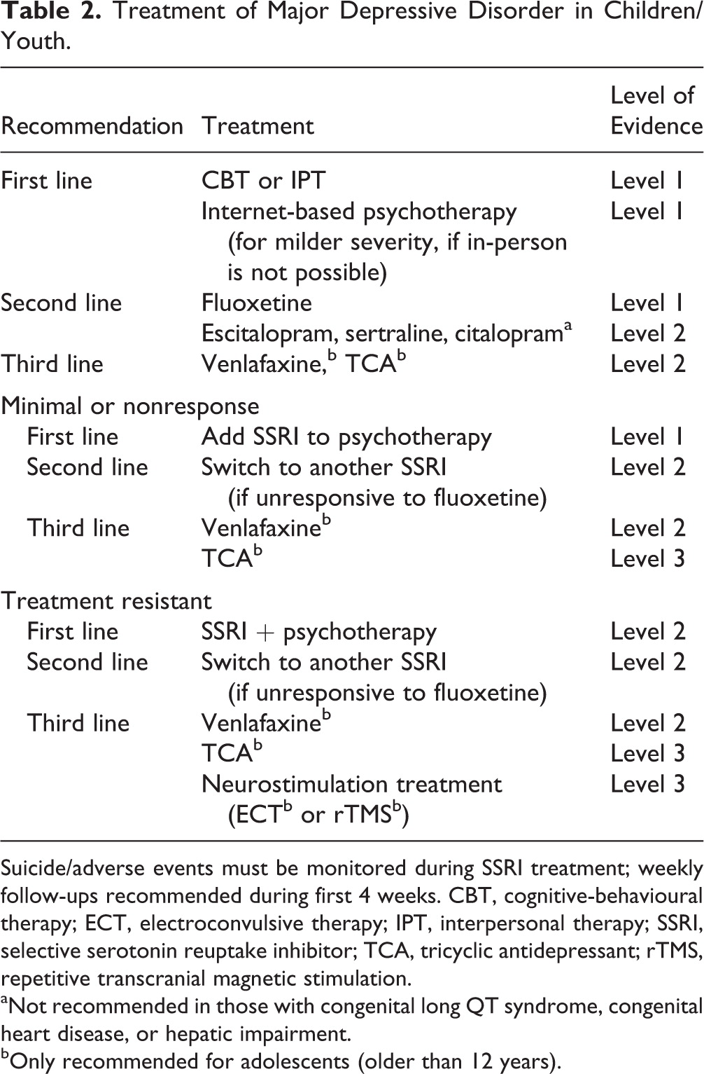
Treatment of Major Depressive Disorder in Youth
Published in: Glenda M. MacQueen; Benicio N. Frey; Zahinoor Ismail; Natalia Jaworska; Meir Steiner; Ryan J. Van Lieshout; Sidney H. Kennedy; Raymond W. Lam; Roumen V. Milev; Sagar V. Parikh; Arun V. Ravindran; The Canadian Journal of Psychiatry 61, 588-603.

Slide 41
What are the safety concerns for the use of antidepressants in young people?
No antidepressants are approved by Health Canada for use in individuals younger than 18.
Fluoxetine is the only antidepressant approved by the FDA for preadolescent (8 years and older). Escitalopram is FDA approved for adolescents 12 and older.
FDA issued a black box warning in 2003 for the use of SSRIs in people younger than 24 years. Other regulatory agencies including Health Canada followed suite. That was a result of an increase in suicidal thoughts/behaviors (NO DEATHS FROM SUICIDE REPORTED).
Antidepressants increase suicidality risk ideation and behavior (OR = 2.39) when compared with placebo.
The benefit of taking antidepressant is greater than the risk of suicide in teens.

Slide 42
SSRIs
Fluoxetine – Gold standard, long half life, very useful in teenagers!
Escitalopram – Good option when patients are sensitive to medication or experience activation with Fluoxetine.
Sertraline – Great option if patient struggles with severe anxiety or comorbid anxiety.
Paroxetine – Statistically different but higher suicidality experienced with this medication.
Citalopram – Has not shown statistically different response when compared with placebo, also it is associated with prolonged QT.

Slide 43
INITIATING PHARMACOLOGICAL TREATMENT
Beginning medication is not an emergency – discuss risks and benefits of medication use, monitor for suicide risk.
START LOW AND GO SLOW!
Advise on the best available evidence of treatment choices – CBT and Fluoxetine.
Monitor response, severity and side effects frequently (every 2 weeks).
Ensure target dose is maintained for at least 4 weeks before adjusting.
Don’t stop medication or change medication if the young person has a bad day or a bad week.

Slide 44
When to refer to a child and adolescent psychiatrist
  When the youth has a suicidal ideation with intent and plan, they should be refereed to Emergency Department.
  If the youth suffers depression with psychotic symptoms (delusions or hallucinations).
  Depression with other comorbid disorders such as substance use; complex family or social issues, eating disorders, OCD, etc.
  Patient has a direct family member with a diagnosis of Bipolar Disorder - higher risk of switching to mania with the use of antidepressants.
  In case of treatment resistant depression after adequate treatment trial.
Notes:
Referral Flags
Referral of the child with an anxiety disorder to specialty mental health services can occur at
three different points. The following referral points are suggestions only. Each first contact care
provider must identify their own comfort level with treatment and management of childhood
anxiety disorders and act accordingly.
MCFD - Ministry of Children and Family Development: http://www.mcf.gov.bc.ca/mental_health/index.htm
These suggestions are:
Emergency Referral (prior to treatment initiation by first contact care provider):
• Suicidal ideation with intent or suicide plan
• Major depressive episode with psychosis (presence of delusions and/or hallucinations)
• Presence of delusions or hallucinations

Slide 45
Take away points
Non-pharmacological interventions should be the first line treatment for mild to moderate depression.
Antidepressants should be cautiously used in youth and limited to patients with moderate-to-severe depression.
Fluoxetine is the medication that has shown the biggest efficacy in younger people and the one that has been studied the most.
Antidepressants have, on average, a small to moderate therapeutic effect and a high placebo response.

Slide 46
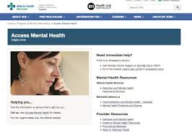


ACCESS MENTAL HEALTH
403-943-1500
Specialist LINK
The Summit
Marian & Jim Sinneave
Centre for Youth Resilience

Slide 47

Questions
Comments
Discussion

