Slide 1
ACHIEVE Project
Mobile Stroke Unit: An innovative approach to pre-hospital treatment for Stroke
August 31, 2015
QUICR Research Day
Shy Amlani
Stroke Program, Edmonton Zone

Slide 2
Agenda
Background
Early experiences – Germany & Cleveland
ACHIEVE Design
Activity to Date
Next Steps
Questions

Slide 3
Important Demographics
6500 new strokes every year (> 55% Edmonton catchment area)
35,000 stroke survivors
Annual cost to Alberta $ 300-400 million (mostly for long-term care)
1000 patients admitted with acute stroke (30% from outside of Edmonton)
Thrombolysis in only 12% of patients

Slide 4

Time is Brain
 | Neurons Lost | Synapsis Lost | Accelerated Aging
Per Stroke | 1.2 billion | 8.3 trillion | 36 years
Per Hour | 120 million | 830 billion | 3.6 years
Per Minute | 1.9 billion | 14 billion | 3.1 weeks
Per Second | 32 000 | 230 million | 8.7 hours
Stroke 2006; 37:263-6

Slide 5
Time to Treatment and Benefit of IV-TPA
Pooled Analysis of 6 IV TPA Trials (Lancet 2004)
mRS 0-1 at day 90
Adjusted odds ratio with 95% confidence interval by
stroke onset to treatment time (OTT) (2776 subjects)
4.0
3.5
< 3 h
3 - 4 h
> 4 h
3.0
2.5
2.0
Adjusted Odds Ratio
1.5
1.0
0.5
0.0
60
90
120
150
180
210
240
270
300
330
360
Stroke Onset to Treatment Time (OTT) [min]
Notes:
5
Brott presented a new meta-analysis of the NINDS, ECASS I and II and ATLANTIS studies in San Antonio at the American Stroke Association meeting. They divided the time interval to treatment in 90-minutes intervals (0-90, 91-180, 181-270, 271-360) and analyzed the ratio of patients with a favourable outcome (mRS 0-1) in 2776 patients. They found a significant correlation of outcome with time from symptom onset. The odds ratios for the favourable outcome were 2.83, 1.53, 1.4 and 1.16 respectively with the last OR missing statistical significance. The lower confidence interval intersects with 1.0 at 285 minutes after symptom onset.¹³⁸

Slide 6
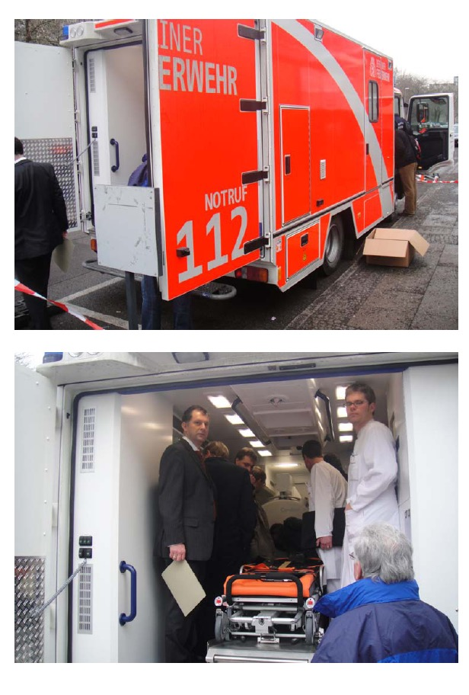
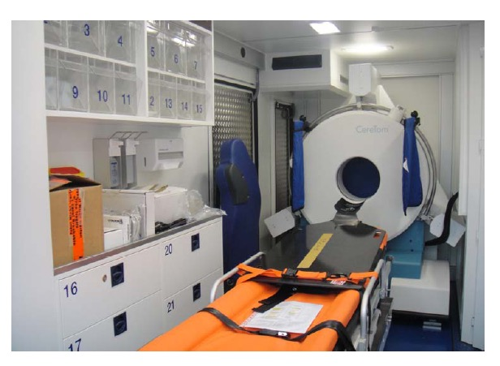

Slide 9
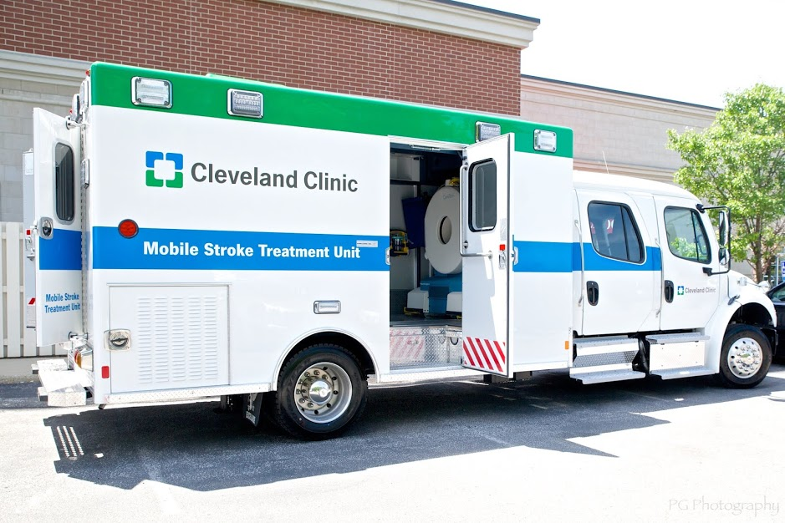

Slide 10
911 Call to Scene
National Target time of 911 call to ED Arrival
Data as of 9/18/2014

Slide 11
Door to Drug
National Target
ED Arrival to Drug
Data as of 9/18/2014

Slide 12
911 Alarm to Drug Administion
National Target for Drug Administration
60
52
32
Data as of 9/18/2014

Slide 13
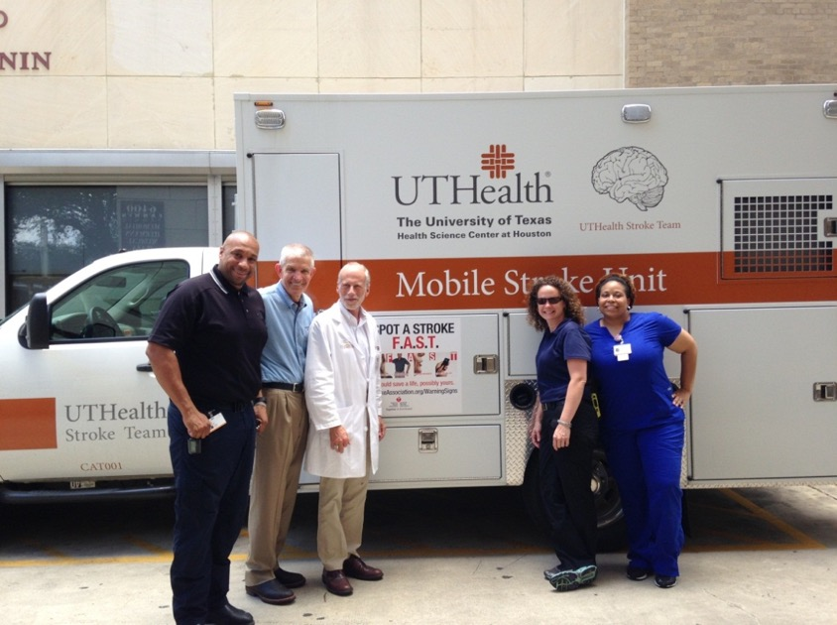
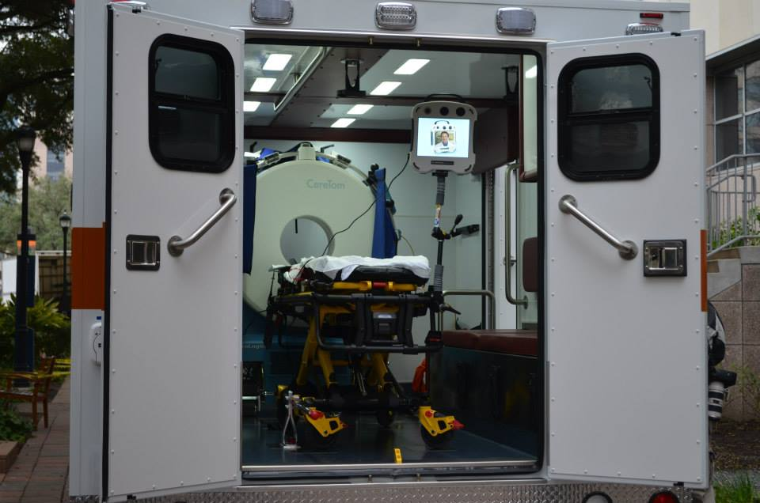
Mobile Stroke Unit
Vascular Neurologist, RN, CT tech
Paramedic
Standard 12 foot ambulance
Diagnostic Equipment
  Portable CT scanner (CereTom)
  Point-of-care laboratory
  Teleradiology/Teleneurology
  connection
All management is S.O.C.

Slide 14
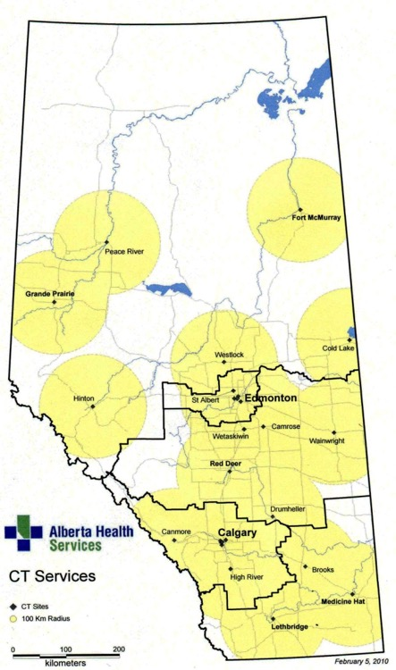

Slide 15
Proposal - November 2014
Focus on Rural Stroke Model:
MSU rendezvous with ambulance transporting patients to UAH
Vehicle is not an ambulance but a mobile CT scanner
Staff in the vehicle included a driver, a radiation technologist and a stroke fellow

Slide 16

ACHIEVE STUDY
Patient comes to the local hospital with stroke symptoms
Patient transferred to UAH by ambulance
CCT equipped moble unit with stroke fellow dispatched towards the local hospital
The CT mobile meets ambulance at predetermined location
Blood work done at local hospital and report sent over to UAH
Physician on duty attends and contacts stroke expert at UAH through Rapid North. Obtains consent
CCT completed in the field
ICH ruled out, meets inc/exc criteria, NIHSS, mRS
UAH
Telestroke
communication
rt-PA therapy initiated in the ambulance
Repeat assessment after 24 hr (CCT, NIHSS, mRS, Barthell Index)
Follow up after 7, 30 and 90 days (Follow up on phone if patient is discharged)
Stroke physician at UAH, collects the information and advises on recruitment and dispatches CT mobile unit
Patient arrives at UAH for continued care
CCT, NIHSS, mRS,
Data collected and processed

Slide 17
Budget - November 2014
Total Project Cost:
  $1.765M
  $665K in offsets
  $1.1M net ask
100 activations per year

Slide 18
Foundation Recommendation
November 2014
Consideration of additional funds for fully functioning ambulance with expanded scope to include service to Edmonton Zone

Slide 19
Proposal – Expanded Scope
Vehicle is a fully functioning ambulance with CT scanner and Telehealth capability
Three Phase Project:
  Rural stroke model – remains focus of project
  Evaluation & treatment of patients from hospitals in Edmonton Zone without access to CT
  Transport of patients from hospitals within Edmonton Zone to UAH for endovascular care

Slide 20
Project Timeline
Custom Vehicle Build: 8 - 12 months
  Will be the first Mobile Stroke Unit in Canada
Staff Training: 3 months prior to vehicle delivery
Enrollment: 1 month after vehicle delivery
Phase 1: Month 0 to study completion
Phase 2: Month 6 to study completion
Phase 3: Month 8 to study completion

Slide 21
Timeline Update

Slide 22
Budget – Expanded Scope
Budget Additions for Fully Functioning Ambulance
Budget Addition | Cost
Staff
Paramedic 1.0 FTE | $307,283
Paramedic/Transport Nurse 1.0 FTE | $307,283
EMS Clerk IV 0.2 FTE | $3,500
Vehicle
Custom Manufactured Ambulance | $470,000
Equipment & Supplies | $70,000
Consumables (disposable supplies/equipment/oxygen) | $45,000
Maintenance/fuel | $90,000
Scanner | $812,340
Total Budget | $3,988,071
QUICR | $210,000

Slide 23
Update
March 25: Project approval by the University of Alberta Hospital Foundation
March 27: CT Scanner purchased
June 1 – 4: Site visits complete
June 10: Demonstration of videoconferencing equipment
Vehicle Specification Working Group
  June 24, 2015 – Vehicle Specification Document (draft)
  July 31, 2015 – Mock-Up & Simulations

Slide 24
Update
June 23: Draft Vehicle Specification Document
July 15: Decision - RFP not required
July 29: Connect with Donor for chassis
August 13: Patient Compartment Mock-Up Simulation
August 25: Vehicle Specification Document stakeholder sign-off

Slide 25
Edmonton Mobile Stroke Unit
 | Known Features:
Chassis | Freightliner International Quad Cab
Compartment Size | 14 Foot
Layout | Human Factors & EMS Simulation Mock-up Design
Team Location for CT | Inside Compartment
Levelling System | Yes
MSU Team | Stroke Fellow, 2 Paramedics (1 Transport RN), CT Tech
Hours | 0800 – 1600 Mon - Fri

Slide 26
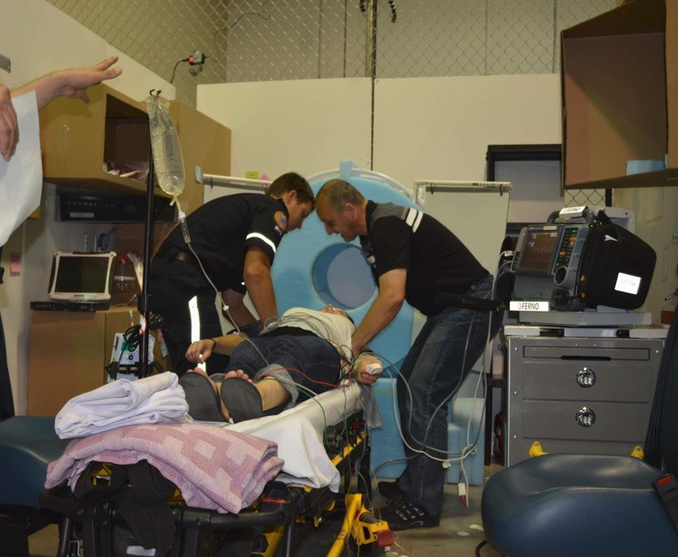
Mock Up: Standardized Patient

Slide 27
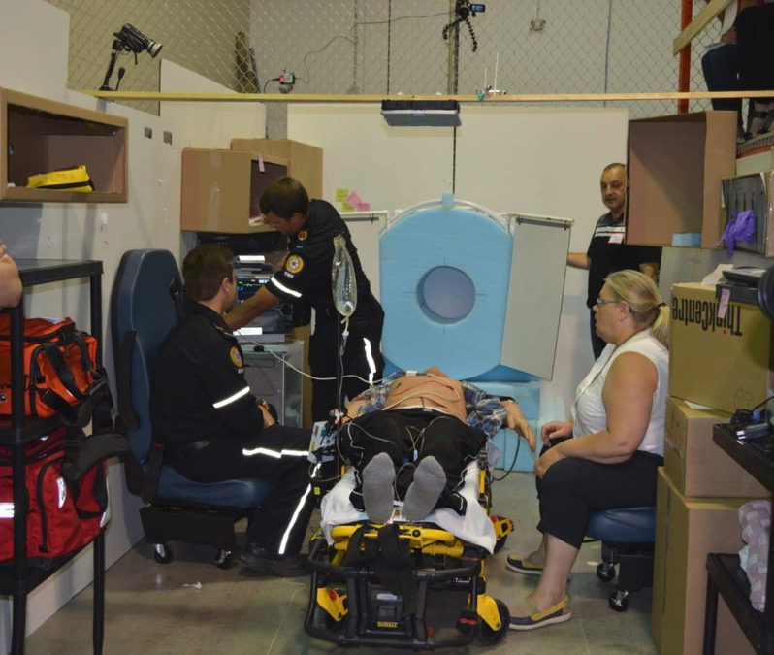
Mock-Up: Patient Simulator

Slide 28
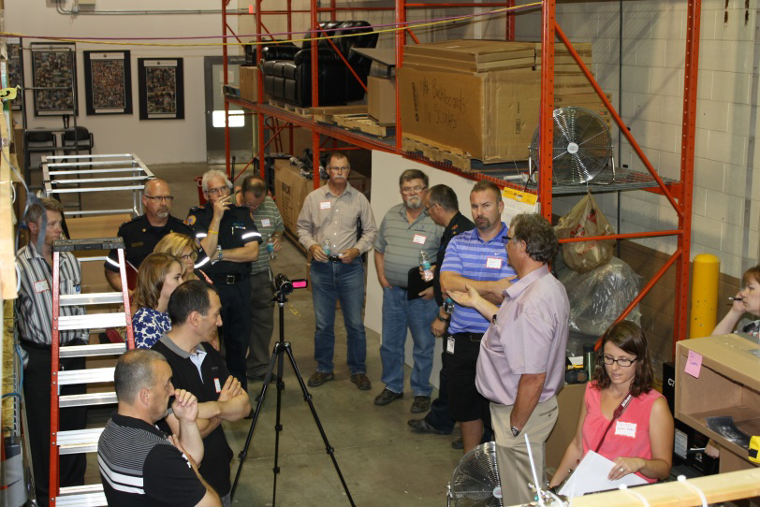
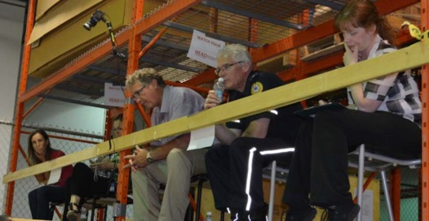
Collaboration

Slide 29
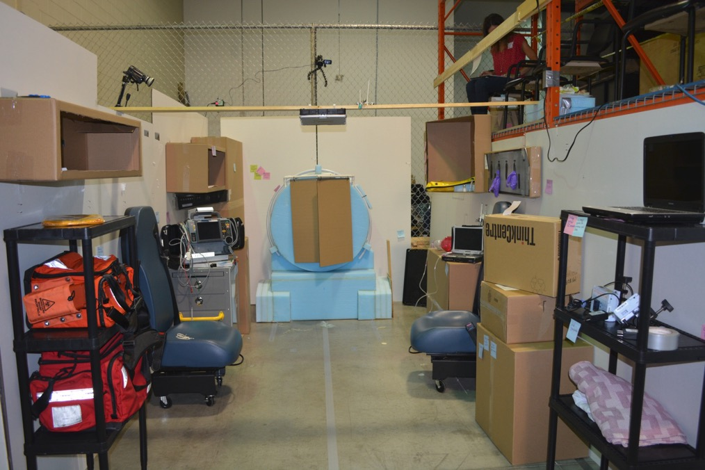
Mock-Up: Final Layout

Slide 30

Next Steps
Videoconferencing system: Mid-September
Information Technology Working Group
RAAPID & EMS Dispatch Working Group
Clinical Process Algorithm Working Groups
Finalize job descriptions

Slide 31

Questions?

Slide 32
Thank you!

