Slide 1
HOW TO… Navigate CSM Legal for your Clinical and Non-Clinical Research Agreements
Sarah Menzies
Legal Counsel, CSM Legal
October 24, 2022
Notes:
HOW TO… Navigate CSM Legal for your Clinical and Non-Clinical Research Agreements
Learning Objectives:
New changes and improvements to the CSM Legal department!
Who is on the CSM Legal team and what do they do?
Tips for researchers to facilitate faster agreement turn-around times.

Slide 2
(1) New Improvements
New Website:
Better guidance and information provided to researchers
Easy access to agreement submission portal and forms portal
See our wait times
Increased Resources
Two new lawyers added last week – welcome Patrick and Katherine
More outreach to / education for researchers and their teams
Streamlining processes
Better contract precedents and templates
Specialized staff members (NIH matters, GDPR compliance)
Intake and signature processes improved

Slide 3
(2) CSM Legal Team – What do we do?
Stephen Harris – Senior Legal Counsel, Manager
Manjari Shukla – Senior Contracts Administrator
Courtnee Coulter – Contracts Administrator, Executions
Farzana Gohar – Contract Specialist, Clinical Trials
Agnieszka Kular – Contract Specialist, Non-Clinical Trials
Sarah Menzies – Legal Counsel
Jordan Kinson – Legal Counsel
Aleks Gvozdenovic – Legal Counsel
Patrick Ouellette – Legal Counsel
Katherine Newton – Legal Counsel
Ches Zi – Law Student (1L)
Danielle Weiss – Law Student (2L)
Kayla Ellison – Law Student (3L)
Notes:
Clinical Team vs. Non-Clinical Team

Slide 4
(2) CSM Legal Team – What do we do?
Amendments
Confidentiality Agreements
Clinical Trial Agreements
Non-Clinical Research Agreements
Research Grant Agreements
Sub-Grant/Sub-Contract Agreements
Data and/or Material Transfer Agreements
Services Agreements
Letters of Indemnity

Slide 5
(2) CSM Legal Team – What do we do?
Facilitate Research Contracts from conception to signature for researchers appointed to the Cumming School of Medicine.
Review / revision
Drafting
Negotiations
Signatures
Clinical vs. Non-Clinical Research Agreements
AHS Liaison
AHS Legal Counsel
Collaborate with various parties
Principal Investigator and team
CCCR Finance
Sponsor
UCalgary Risk Management
AHS Health System Access
Notes:
Some contracts can take a significant amount of time, based on various factors.
The more external parties are involved, the longer negotiations take.
The more external parties are involved, the longer signatures take.
Sometimes we email CP or PI team and receive slow response
Sometimes an Agreement is a good draft, sometimes it’s not. Sometimes it’s based on foreign laws / jurisdiction / practices, sometimes it’s local.

Slide 6
(3) Tips! How can researchers speed up the process?
Prior to submission, review the agreement yourself.
Put any questions / concerns you have for us in the margins of the Word-document (use “New Comment” in Word)
Make edits! Insert your address/phone/email, change any dates that are wrong (use “Track Changes” in Word)
Make sure the contact provided is the person responsible for and with authority to engage in legal negotiations.
After Sharepoint indicates your contract has been sent to the Counter-Party for negotiations, follow up regularly with the Counter-Party yourself
Respond to emails from CSMLegal promptly
Limit “follow up emails” and direct your emails to the correct team member
Ensure your CSMLegal file number is in every e-mail

Slide 7
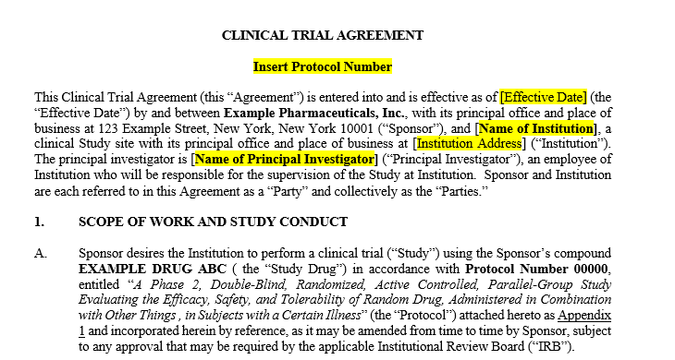
Make your own edits

Slide 8
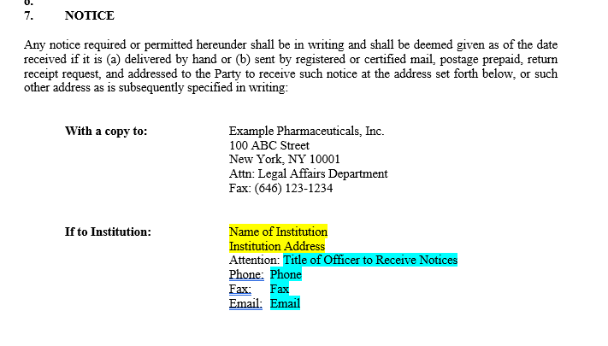
Make your own edits

Slide 9
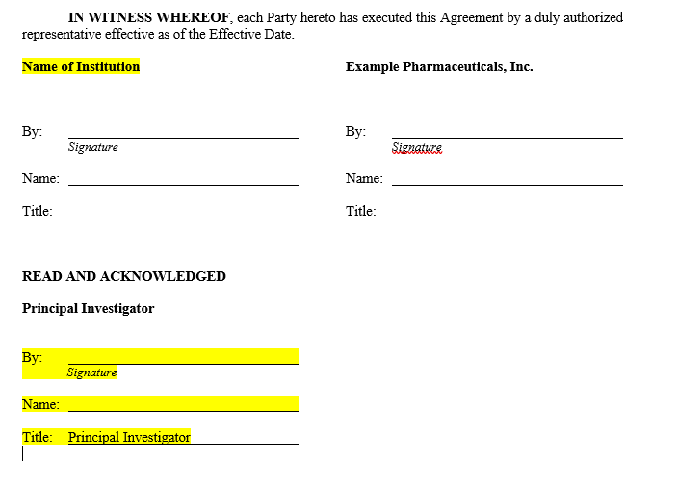
Make your own edits

Slide 10
(3) Tips! How can researchers speed up the process?
Prior to submission, review the agreement yourself.
Put any questions / concerns you have for us in the margins of the Word-document (use “New Comment” in Word)
Make edits! Insert your address/phone/email, change any dates that are wrong (use “Track Changes” in Word)
Make sure the contact provided is the person responsible for and with authority to engage in legal negotiations.
After Sharepoint indicates your contract has been sent to the Counter-Party for negotiations, follow up regularly with the Counter-Party yourself
Respond to emails from CSMLegal promptly
Limit “follow up emails” and direct your emails to the correct team member
Ensure your CSMLegal file number is in every e-mail
Notes:
Sometimes we are provided, through our Sharepoint portal, with a contact at the counter-party who is not a part of that entities’ legal team. It might be a PI or a Research Coordinator. We really need the name of the person who has authority to make edits / approve our edits.
Sharepoint indicates what stage your contract is at. If it is still in Triage, you can check your dates to see when it might move to the “review” or “negotiations” stage. It will also show you who is the contract reviewer or who the file is currently assigned to in Sharepoint. –next slide-

Slide 11
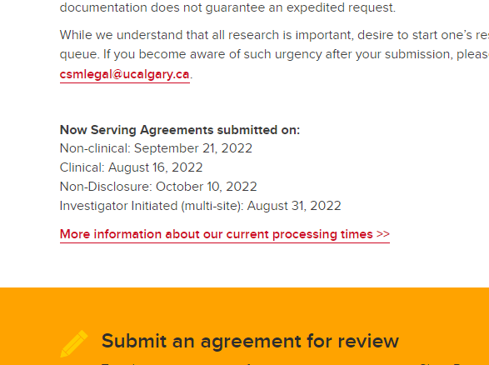
Website – check your dates
https://cumming.ucalgary.ca/research/csm-legal/home
Getting Agreements Signed – The Process
Notes:
We often receive follow up emails asking us when a contract will move into review stage. You can check that here.
It’s super helpful!!!

Slide 12
Emailing the correct team member
If your agreement is still in “Triage” (has not been assigned to be processed) direct all inquiries to csmlegal@ucalgary.ca
Manjari, our Administrator, is in charge of all files that are waiting in the queue.
If your agreement has moved to “Review” or “Negotiations” check who it is Assigned To in Sharepoint.
Our individual email addresses are listed on the website (About Page). Email the team member who is managing your file directly.
If your agreement is in “Execution” direct all inquiries to csmlegalsigning@ucalgary.ca
Courtnee, our Executions Administrator, is in charge of all files that have moved for signatures.
Notes:
We often receive emails to the wrong address, which creates delays as we try to hunt down where the file is and who is responsible for it.
We hope that streamlining our email addresses this way makes it easier for you to get answers faster!

Slide 13
(3) Tips! How can researchers speed up the process?
Prior to submission, review the agreement yourself.
Put any questions / concerns you have for us in the margins of the Word-document (use “New Comment” in Word)
Make edits! Insert your address/phone/email, change any dates that are wrong (use “Track Changes” in Word)
Make sure the contact provided is the person responsible for and with authority to engage in legal negotiations.
After Sharepoint indicates your contract has been sent to the Counter-Party for negotiations, follow up regularly with the Counter-Party yourself
Respond to emails from CSMLegal promptly
Limit “follow up emails” and direct your emails to the correct team member
Ensure your CSMLegal file number is in every e-mail
Notes:
Finally, please do ensure that your CSMLegal file number (project code / eRSO number) is in every email you send us.
- We can not search for your file based on the name of your research project
- We can not search for your file based on your REB number
So this is everything I have prepared to share with you, I would be happy to answer questions.

Slide 14
Questions?
Sarah Menzies
Legal Counsel
CSM Legal – Research
Notes:
Feel free to ask me any general questions about CSM Legal – Stephen is also on the call and is available to answer questions if I don’t know the answer.
Before asking anything, I just ask that you please do not ask questions specific to your research, the clauses in your agreement, or your specific files as I won’t be able to answer those without referencing your file. You may direct any file-specific questions to whomever your file is assigned to (reference Sharepoint) or to Manjari at csmlegal@ucalgary.ca if your file has yet to be submitted / is still in triage.

