Slide 1
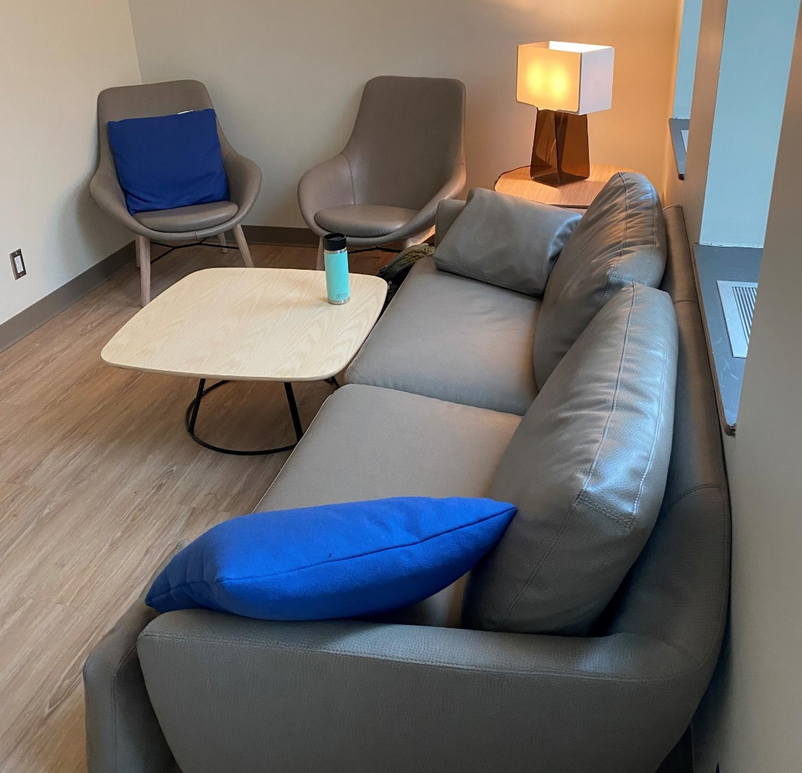
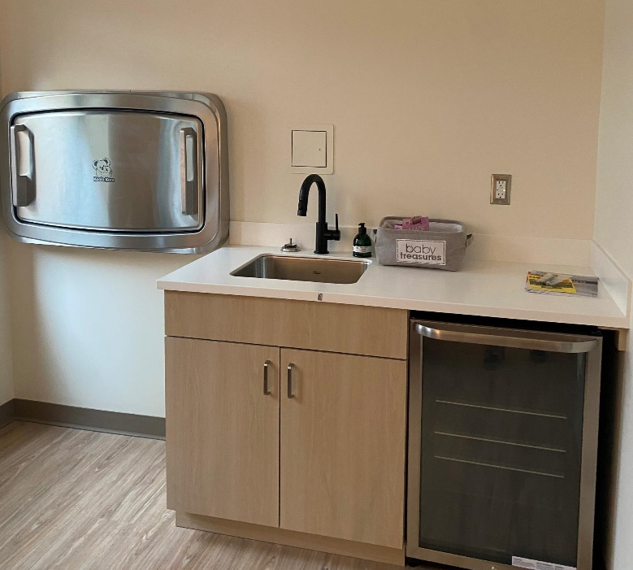
Lockable Lactation Space, Foothills Campus
Lockable lactation space located within the student lounge (G730) with a sink, fridge and microwave and comfy seating - open to staff, faculty, and learners.
Process for access:
Email irrooms@ucalgary.ca for access to the space. Please include name & UCID.
Email sawhub@ucalgary.ca for the door code to the lactation space
* If you require assistance during office hours, please visit Student Advocacy and Wellness Hub’s office (G740)

