Slide 1
Provincial virology lab services: making it easier and smoother
Carmen Charlton PhD FCCM D(ABMM)
Clinical Microbiologist
Public Health Laboratory

Slide 2
HCV cascade of care
Screen
HCVAB
Confirm
2nd HCVAB
HCVRNA
Treat
Link to Specialist
Rx
SVR
Notes:
232,000 HCVAB
Roughly 1250 are new cases (0.5%)
9600 HCVRNA

Slide 3
HCV cascade of care
Screen
HCVAB
Confirm
2nd HCVAB
HCVRNA
Treat
Link to Specialist
Rx
SVR
December 2019
Notes:
5 clinic visits saved

Slide 4
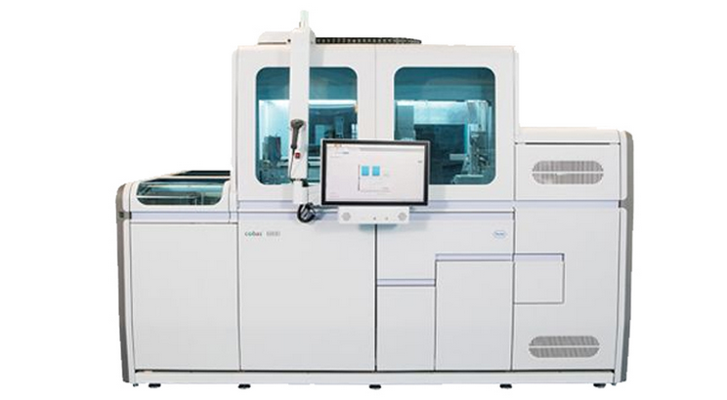
Reflex testing
HCV Antibody serology analyzer
HCV RNA molecular analyzer

Slide 5
HCV Antibody positive reflex testing
≥1000
POS
IND
NEG
Includes numeric viral load
RNA
1-999
Not Detected

Slide 6
6 Month review of reflex testing
Thompson et al., 2022 JAMMI

Slide 7
Follow-up for Indeterminate specimens
Thompson et al., 2022 JAMMI

Slide 8
Significantly decreased TAT

Slide 9
Can I order HCV Antibody for everyone and get HCV RNA?

Slide 10
HCV Utilization
HCVAB
Reflex
HCVRNA
1
2
X
HCVAB
Auto
PrevPos
This patient has previously tested positive for HCV RNA and will not be retested

Slide 11
Diagnosis
Monitoring
Treatment
HCVAB
HCV RNA
HCV RNA
All screened for HCVAB
Positives reflexed to HCVRNA
2 pre-treatment tests
Once HCV RNA + additional testing not needed until treatment application
During treatment and post-treatment testing
Continual exposure monitoring

Slide 12
I got a previously positive result, but I needed HCV RNA
Insurance?
Contact VOC to
re-instate
SVR, but
re-exposure?
Monitoring for continued exposure
SVR
Notes:
After a first positive all patients should have HCV RNA ordered only
VOC can be contacted by email or phone in Edmonton and Calgary sites
Need to put the reason

Slide 13
How do I make sure my test isn’t cancelled?

Slide 14
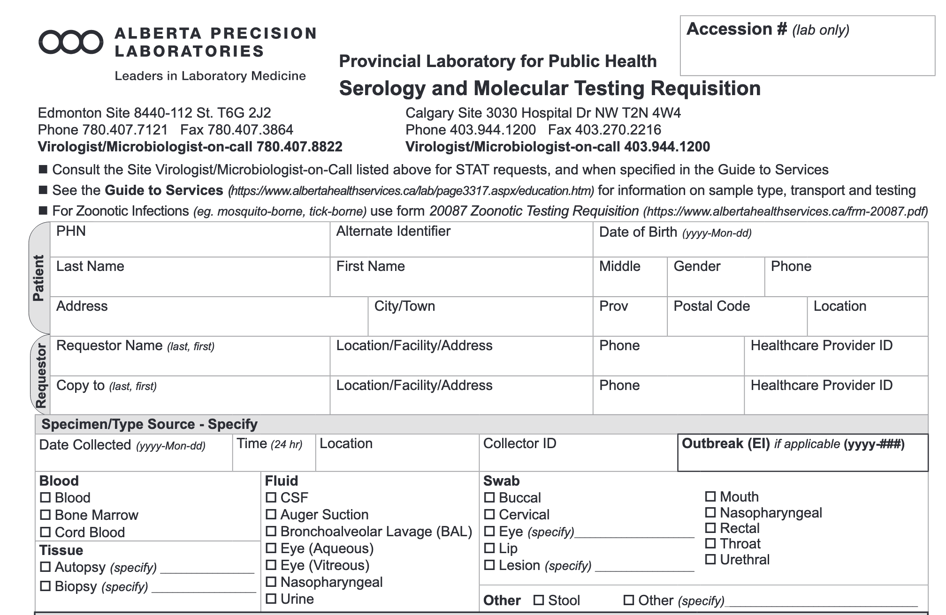

Slide 15
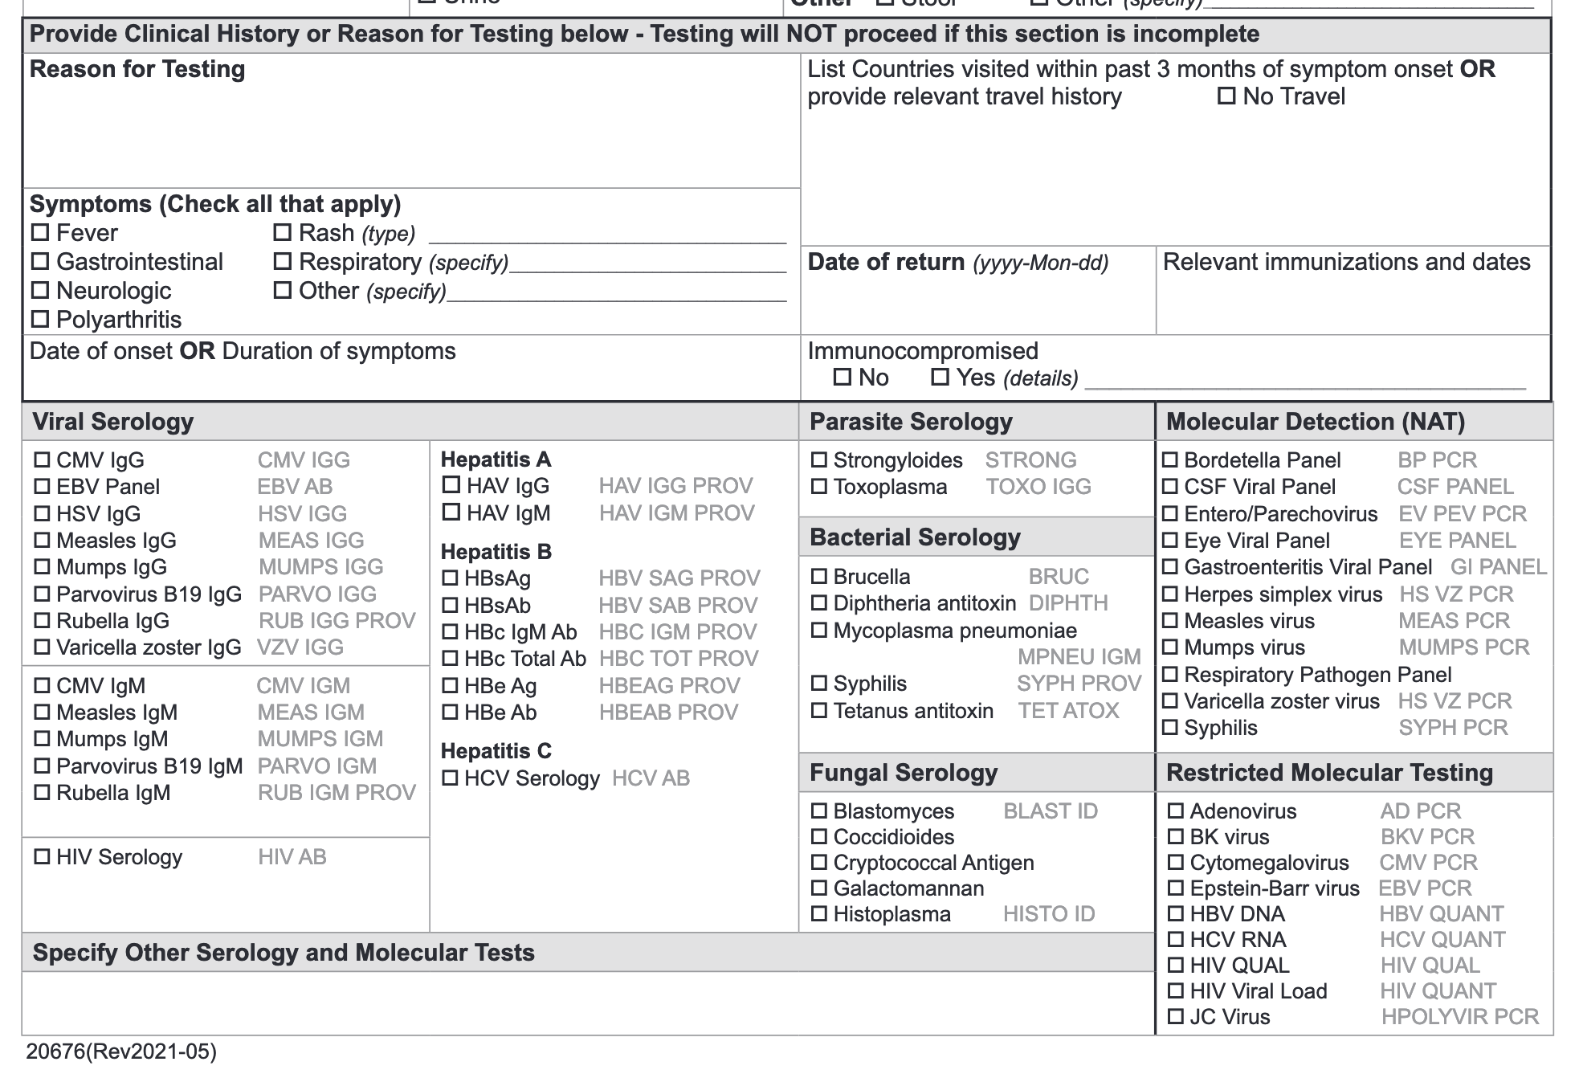
SVR, but re-exposure
Needed for starting treatment
X

Slide 16
HCV Ordering
HCV Antibody Screening
During and Post-Treatment HCV RNA
Monitoring for continued exposure
SVR
Positives reflex HCV RNA
Pre-treatment HCV RNA
Notes:
Need to order the right test at the right time.

Slide 17
Thank you!

