Slide 1
LiveR_{x} Study
Eradicating Hepatitis C in Alberta
Cari Egan, RN, BN, MSc, PhD
LiveRx Team

Slide 2
Disclosures
Commercial Support Disclosure
This program is a research program and has received financial and in-kind support from Abbvie and Gilead.

Slide 3
LiveR_{x} Study Overview
Objective: To evaluate the effect of a collaborative community pharmacy and community-based organization (CBO) case finding and intervention program on cure rates in patients living with HCV in Alberta
Population: Patients aged 18+ with positive HCV infection belonging to priority populations
Setting: Up to 100 community pharmacies, unlimited participation from CBOs
Why?
Pharmacists in Alberta have the largest pharmacist scope of practice in Canada and are the most accessible health care professional
Patients interact on average 10x more frequently with a pharmacist than their family physician, or may not have access to a family physician

Slide 4
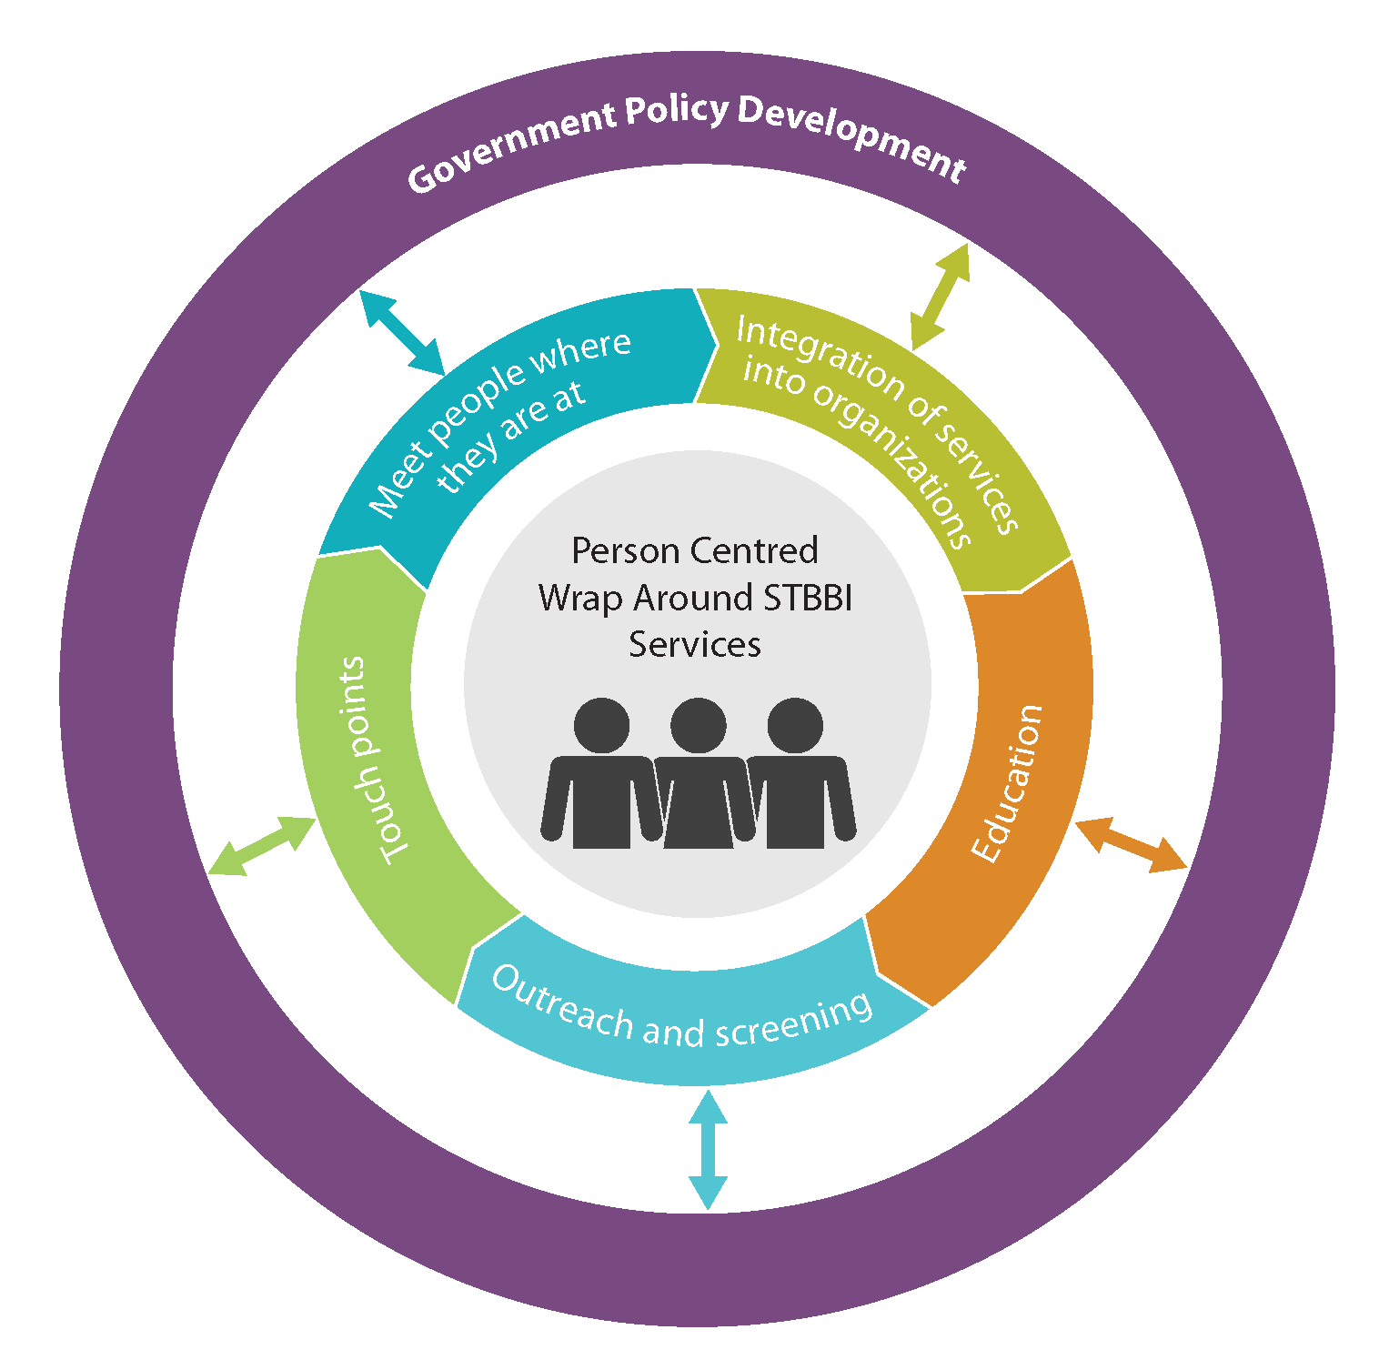

Slide 5
LiveR_{x}: HCV Eradication Initiative
Test
Assess
Treat
Cure
Low barrier access to healthcare through a collaboration between community pharmacists and community-based organizations
Leverage pharmacists’ expanded scope of practice in Alberta to increase HCV screening, diagnosis and linkage to care and cure through pharmacist prescribing authority for comprehensive HCV care (Alberta HCV primary care pathway and HCV specialist support – Dr Mark Swain)
Low barrier HCV screening
OraQuick point-of-care
Dried blood spot testing (training provided to community-based organization staff and pharmacists). Partnership with National HIV Services Reference Lab (Winnipeg) and Alberta Provincial Laboratory
Mobile phlebotomist where appropriate
Outreach peer support for screening events and retention in care
Strategies prioritized to optimize retention in care
Notes:
Patients who are positive who do not meet the inclusion criteria will be liaised with a Hepatologist for treatment through virtual care modalities.
Pharmacists will independently test for Hepatitis C infection with the OraQuick point-of-care device
If positive, pharmacists will offer dried blood spot testing to confirm HCV infection or provide a lab req for phlebotomy
Hepatitis C DBS testing Validated by Alberta Precision Labs
Partnership with National Lab
If confirmatory testing is positive, pharmacists will offer treatment for patients who meet the study inclusion criteria:
Treatment naïve without cirrhosis
No co-infection with HIV or Hepatitis B
Not pregnant or planning to become pregnant

Slide 6
LiveR_{x} Training
Robust LiveRx HCV training program developed in partnership with INHSU for pharmacists and community-based social service providers
Participating pharmacies and CBOs complete mandatory training including:
Online Hepatitis C infection and treatment modules developed in partnership with INHSU
Point-of-care training for both OraQuick and dried blood spot testing
Stigma and awareness training
Workshops
Community of practice

Slide 7
LiveR_{x} compared to ECHO
 | LiveR_{x} | ECHO
Population | Priority populations | Priority populations that have a primary care provider individuals
Setting | Community pharmacies and CBOs across Alberta | Rural community settings across Alberta
Participating HCP | Pharmacists | Primary care physicians, Nurse Practitioners, and community nurses
HCV testing available | POCT, DBS, phlebotomy | POCT, DBS, phlebotomy

Slide 8
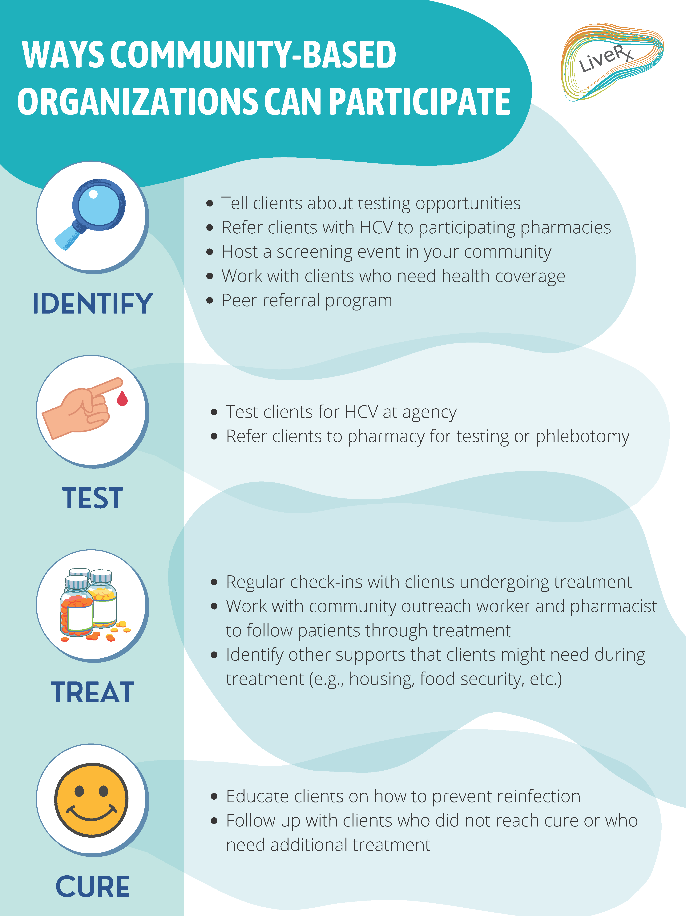

Slide 9
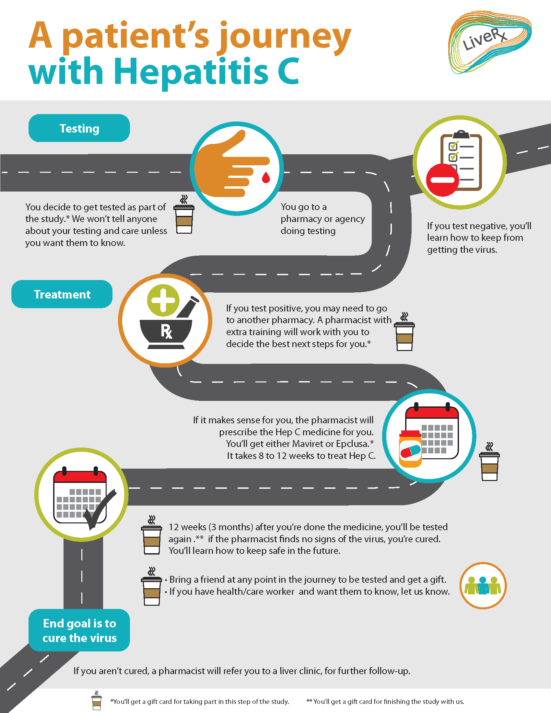

Slide 10
Implementation: Current Picture
LiveRx study enrolment began in spring 2022 and will continue for 2 years
Launched in Calgary to pilot process
16 pharmacies enrolled
33 pharmacists have completed the INHSU HCV training and dried blood spot testing training
LiveRx newsletter developed for pharmacists and emailed monthly (120 pharmacists currently in email list)
Community-based organization (CBO) recruitment and training in dried blood spot testing has been initiated with several CBOs, screening events scheduled
Expansion of LiveRx launch to pharmacies and CBOs in North Zone, Edmonton Zone, Central Zone and South Zone is the priority over the next few months.

Slide 11
We are Hiring!
Edmonton Outreach – potential to expand into the North
https://medicine.careers.ucalgary.ca/jobs/10725374-outreach-support-worker-in-edmonton-liverx-department-of-medicine-cumming-school-of-medicine
Implementation Support
Case Finding
Screening Events
Dried Blood Spot Training and Testing Events – train the trainer program
Liaise with peer support and outreach workers in participating organizations
Case management to optimize retention in care and treatment through to cure
Posting Closes November 2nd!

Slide 12
Acknowledgements
LiveR_{x} Study Team:
Dr. Mark Swain
Dr. Ross Tsuyuki
Alexandra Kanters
Dr. Stephanie Gysel
Dr. Yazid Al Harmaneh
Dr. Christine Hughes
Dr. Cari Egan
Dr. Kelly Mrklas
Dr. Jenny Godley
Dr. Fiona Clement
Dr. Stephen Congly
Dr. Hussain Usman
Leanne Reeb
Christopher Burnie
Dr. Abdel Aziz Shaheen
Dr. Sandra Johansen
April Calliou

Slide 13
Contact us
Email
liverx@ucalgary.ca
Website
https://www.epicore.ualberta.ca/liverx

