Slide 1
Help Us Spread the News
This presentation has been developed for your use:
Share and/or incorporate these slides as needed, simply source the Royal College
All text, images and logos contained herein are the property of Royal College of Physicians and Surgeons of Canada
Questions? Email cbd@royalcollege.ca

Slide 2
Why Competence by Design (CBD)? The Rationale

Slide 3
Why Change?
While Canada’s medical education system is exceptional overall, there are gaps and challenges within the current model that need to be addressed.

Slide 4
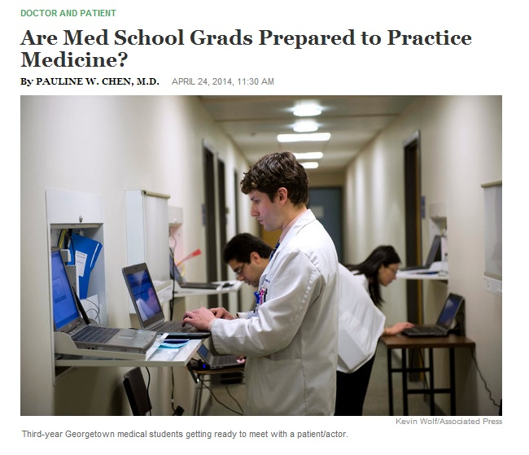
Drivers for Change
Potential for students to graduate with gaps in readiness-to-practice
Via: http://well.blogs.nytimes.com

Slide 5
Issues within Current System
New age of accountability
Image: www.rischiocalcolato.it

Slide 6
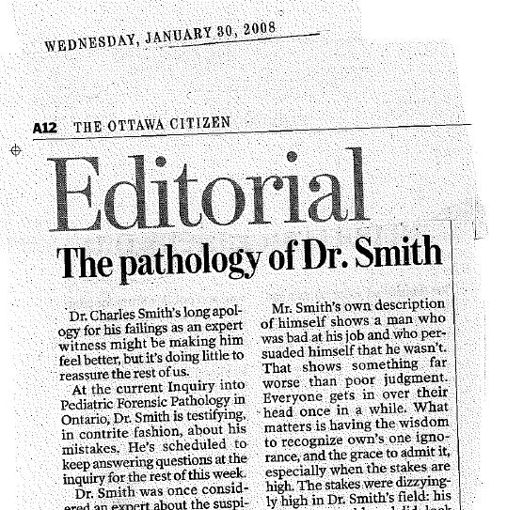
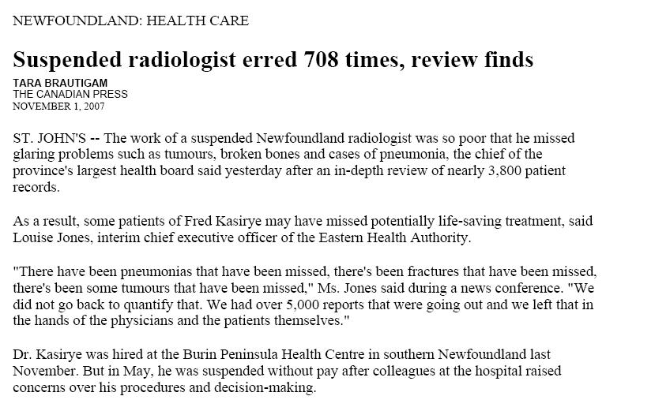
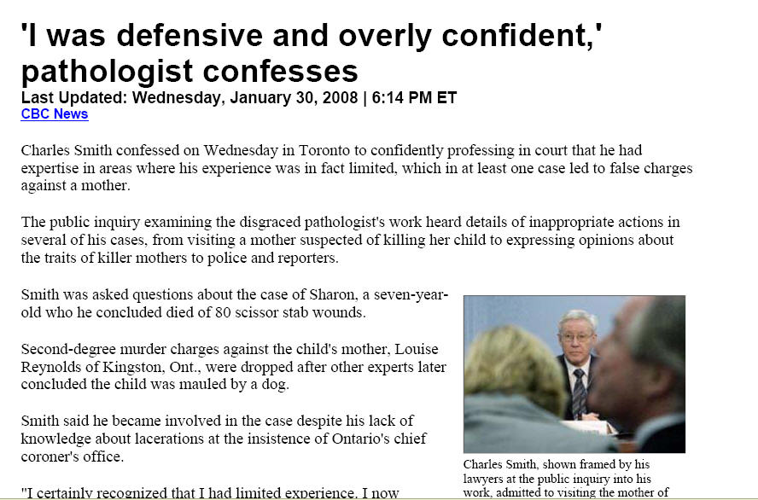
Drivers for Change
Increased public concern and need to demonstrate continuing competence

Slide 7
Drivers for Change
Prevalence of failure-to-fail culture
Image: http://www.lolntroll.com

Slide 8
Drivers for Change
Criticism around the ad-hoc nature of medical education
8

Slide 9
Drivers for Change
Process heavy nature of accreditation
Image: www.tallerdeprocesos.com

Slide 10
Drivers for Change
Increased focus on “clock-watching” rather than true learning
Image: www.bing.com/images

Slide 11
Drivers for Change
Concerns about the “tea-bag” model of education which credentials physicians based on the time spent in training, not based on their achievement of necessary abilities.
Image: www.dreamstime.com

Slide 12
Assessment Tensions in Current World
Residents can be disempowered
Great burden placed on faculty
Teacher-Learner exchange is corrupted
Failure to fail
Dichotomous judgements
Little direct observation
High stakes national exams

Slide 13
System Challenges in Current World
Learning judged by time spent, not ability
Trainees unprepared at stages
Variable workplace assessment/failure to fail
Concerns about patient harm
Missing content
Faculty overload & educational inefficiency
Resource imperatives
Lack of support for lifelong learning
Need for assessment for learning

Slide 14
MedEd Matters
Evidence suggests that where a physician trains determines the level of care that physician will provide throughout his/her career.
14

Slide 15
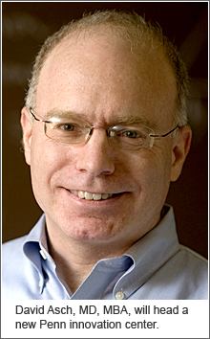

Slide 17
We Get Better With Time…but…

Slide 18
…Rates Are Predicted at Certification

Slide 19
Need for an Improved System
We need a system that:
Addresses changes to patient and societal needs;
Assesses competence, but teaches for excellence;
Ensures competencies in all domains evolve across the continuum of medical education (residency to retirement); and
Enables flexibility; allows physicians to identify when and how changes apply to practice.

Slide 20
Change is Underway…
CBD

Slide 21
New World: Competence by Design (CBD)
Competence is about performance –
the right thing, for the context, at the right time

Slide 22
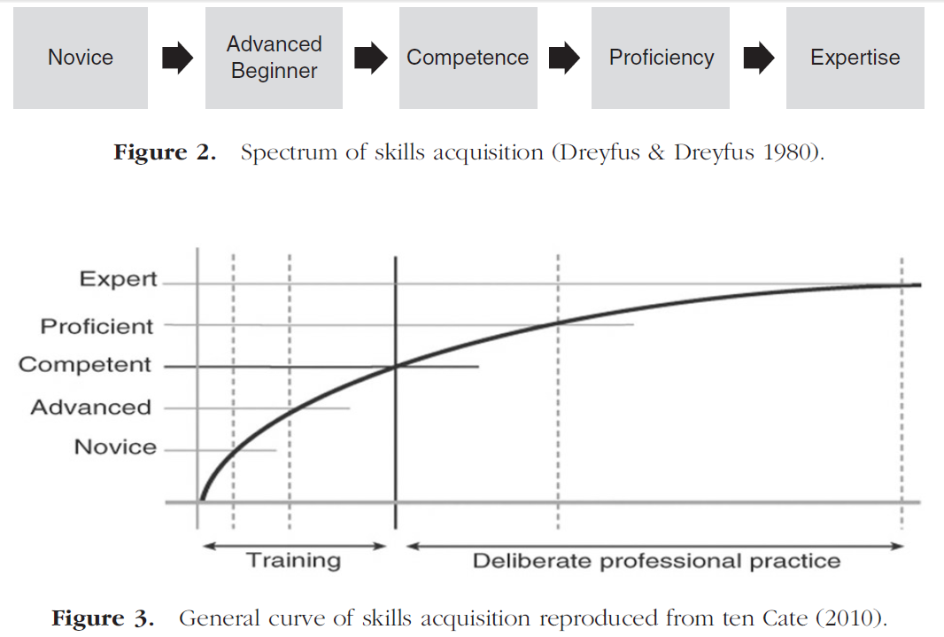
New World: Competence by Design (CBD)
Conceptual framework for performance assessment. Khan and Ramachandran, Medical Teacher 2012; 34: 920-928

Slide 23
What is CBD?
Multi-year, transformational change initiative in specialty medical education;
Focused on the learning continuum from the start of residency to retirement;
Based on a competency model of education and assessment; and
Designed to address societal health need and patient outcomes.

Slide 24
Why CBD? Why Now?
The CBD program will:
Support the development, implementation, and evaluation of competency-based, learner-focused education
Reflect, and respond to, the world-wide movement towards competency-based medical education.
Align with Future of Medical Education in Canada Postgraduate (FMEC-PG) project.

Slide 25
Why CBD? Why Now? con’t
By focusing on learning rather than time, CBD will enable our MedEd system to
Ensure competence, but teach for excellence;
Support physicians’ skills and abilities to evolve throughout practice—enhancing care;
Respond to changing patient and societal needs;
Address gaps in the current system, like the “failure to fail” culture of resident education;
Reduce burden on Faculties, promoting smoother credentialing and accreditation; and
Increase accountability and promote transparency in training.

Slide 26
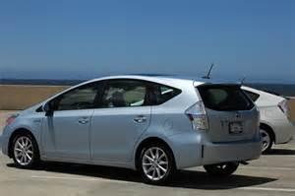
Hybrid Model of CBME
CBD will introduce a hybrid-model of competency-based medical education (CBME) to specialist education in Canada.
Time will be a resource, not a restriction.
Number of years needed to complete a residency program is not expected to change for the majority of residents.
Image: www.bing.com/images

Slide 27
CBD Competence Continuum

Slide 28
CBD Identified Initiatives
MAINPORT ePortfolio
For Residents
For Fellows
Assessment
In-Training Competency-Based Assessment
In-Practice Competency-Based Assessment
Change Exam Governance
Re-Engineer Exam Delivery
Develop Exam Content
Accreditation
CBME
Credentialing
Redesign Policy:
Outcome-Based Focus
Re-Engineer Accreditation Process
Redesign Policy: Competency-Based Focus
Re-Engineer Credentialing Process
Create Competency Framework & Milestones (Generic & Speciality-Specific)
CanMEDS 2015
Deliver Cohorted Roll-Out
Affirmation of Continued Competence
Faculty Development and Faculty/Education Support
Lifelong Learning

Slide 29
What New Value will CBD Bring?
MAINPORT ePortfolio for better planning, learning, tracking and assessment;
Milestones and Entrustable Professional Activities (EPAs) for improved teaching, learning and evaluation;
Increased support and faculty development tools and templates;
National curriculum framework;
Updated CanMEDS Framework focusing on key issues like patient safety; and
Integrated education across the continuum.

Slide 30
What will CBD Eliminate?
FITERs completed prior to the end of training
Inefficient assessment (like ITERs)
Awkward feedback
Assessing everything all the time
Teaching everything all the time

Slide 31
CBD: Improving the Resident’s Journey
Ultimately, a move to CBD is about a better way to train health professionals.

Slide 32
Your Input Matters
How can we improve the CBD Program? Let us know at:
cbd@royalcollege.ca
www.facebook.com/TheRoyalCollege
https://twitter.com/Royal_College
www.linkedin.com
For more information, visit our website:
www.royalcollege.ca/cbd

