Slide 1
Hospitalizations for acute respiratory diseases among children in Alberta, Canada, before and during the COVID-19 pandemic
Christine D. Lukac MD MPH, Brett Simms PhD, Grace P.S. Kwong PhD,
Jessalyn K. Holodinsky PhD, David W. Johnson MD FRCPC, James D. Kellner MD MSc FRCPC
National Pediatric Resident Research Competition
May 2, 2024
Notes:
Good afternoon, everyone. I am Christine Lukac, a 3rd year pediatrics resident at the University of Calgary
I am excited to share with you the result of my research on hospitalizations for acute respiratory diseases among children in Alberta
This work is supervised by Jim Kellner

Slide 2
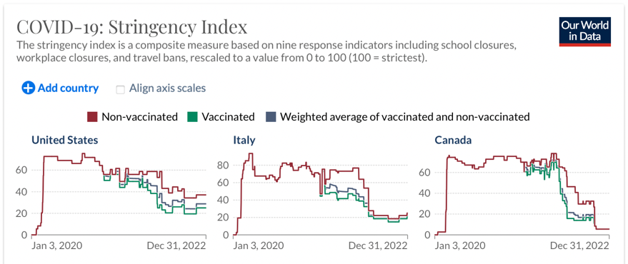
Background
Admissions for acute respiratory diseases (ARD) account for the majority of hospitalizations among children
ARD: Bronchiolitis, Influenza like illness, Pneumonia, Croup
The seasonal pattern of ARD was interrupted by two exposures
SARS-CoV-2
Public health policies also known as non-pharmaceutical intervention (NPI)
NPI can be measured with the Oxford Coronavirus Government Response Tracker (OxCGRT) Stringency Index
https://ourworldindata.org/covid-stringency-index
Notes:
Admissions for acute respiratory diseases account for the majority of hospitalizations among children, particularly during the winter months
When I refer to acute respiratory diseases, this includes Bronchiolitis, Influenza like illness, Pneumonia, and Croup
The seasonal pattern of acute respiratory diseases was interrupted by the novel coronavirus SARS-CoV-2 and public health policies also known as non-pharmaceutical interventions.
These non-pharmaceutical interventions can be measured with a Stringency Index

Slide 3
Study Design & Objectives & Research Questions
Study Design: Population based retrospective cohort study among all children in Alberta
Objective 1: Describe the seasonal pattern of ARD overall and for each ARD
Objective 2: Measure the impacts of SARS-CoV-2 and NPI on the seasonal pattern of ARD
Healthcare use
What was the impact on the weekly incidence of hospitalizations?
Clinical severity
What was the impact on the weekly percentage of PICU admissions?
Affected population
What was the impact on the average age at the time of discharge?
Notes:
We conducted a population based retrospective cohort study among all children in Alberta.
We had two research objectives
To describe the seasonal pattern of acute respiratory diseases overall and for each respiratory disease independently
To measure the impacts of SARS-CoV-2 and NPI on these seasonal patterns
We asked THREE specific questions
What was the impact on the weekly incidence of hospitalizations, to measure healthcare use?
What was the impact on the weekly percentage of PICU admissions, to measure clinical severity?
What was the average age at the time of discharge, to measure the affected population?

Slide 4
Why does it feel like residency got harder
over the last three years?
Notes:
In other words, why does it feel like residency got harder over the last three years
Specifically, during the 2022-2023 winter season?

Slide 5
Methods Objective 1: Describe the seasonal pattern of acute respiratory diseases
Data Source: Alberta Discharge Abstract Database Apr 2003 to Dec 2023 – (20 years and 9 months)
Healthcare use: Incidence of hospital discharges per 100,000 children
International Classification of Disease (ICD-10)
Bronchiolitis < 2 yo
Influenza like illness < 18 yo
Pneumonia < 18 yo
Croup < 6 yo
All acute respiratory diseases
Clinical severity: Percent PICU admissions (%) = PICU discharges / All hospital discharges x 100%
Affected population: Average age at the time of discharge (months) = discharge date – date of birth
Notes:
To meet our first objective, we accessed data via the Alberta Discharge Abstract Database over a 20 year and 9 months
Using international classification of disease codes
We identified all hospital discharges in Alberta for bronchiolitis, influenza like illness, pneumonia, and croup
Clinical severity was measured as the percentage of PICU admissions % of all hospitalizations
Affected population was measured as the age in months, taking the difference between discharge date and date of birth

Slide 6
Methods Objective 2: Impact of SARS-CoV-2 and Non-pharmaceutical interventions
Data Source: OxCGRT Stringency Index for Alberta from Jan 2020 to Dec 2022
The Stringency Index combines nine metrics (Table 1) Values closer to 100 indicate a stricter provincial public health response
Table 1. Non-pharmaceutical interventions
Stringency Index
Containment and closure
 | School closing
 | Workplace closing
 | Cancel public events
 | Restriction on gathering size
 | Close public transport
 | Stay-at-home requirements
 | Restrictions on internal movement
 | Restrictions on international travel
Health System
 | Public information campaign
https://ourworldindata.org/covid-stringency-index
Notes:
To quantify non-pharmaceutical interventions we used a Stringency Index developed by the Oxford Coronavirus Government Response Tracker.
This is an international organization that collected data on non-pharmaceutical interventions globally, including Canada and specifically the province of Alberta.
Then they developed a stringency index which incorporates 9 metrics into one index on a scale from 0 to 100, where 100 is most stringent.

Slide 7
Methods Objective 2: Impact of SARS-CoV-2 and Non-pharmaceutical interventions
Time Series Analysis with Seasonal AutoRegressive Integrated Moving Average (SARIMA) models
Measure impact of SARS-CoV-2 and NPI with ratios and percent change
Winter season defined as 13 weeks from Dec through Feb
Model building with data April 2003 to March 2020
17 years before SARS-CoV-2
Forecast over April 2020 to December 2023
3 years and 9 months after SARS-CoV-2
SARS-CoV-2
Notes:
To meet our second objective
I built time series models using 17 years of data prior to SARS-CoV-2, to forecast over 3 years and 9 months after SARS-CoV-2
The seasonal autoregressive integrated moving average models are different from most statistics which assumes independence between observations.
SARIMA models assume that the incidence of an infectious disease one week is associated with the incidence in subsequent weeks
By forecasting forward in time, we can depict the expected outcomes in the absence of SARS-CoV-2 and NPI (blue) and compare it with what was observed (pink)
Then we measured population impact during winter seasons with expected vs observed ratios and percent change

Slide 8
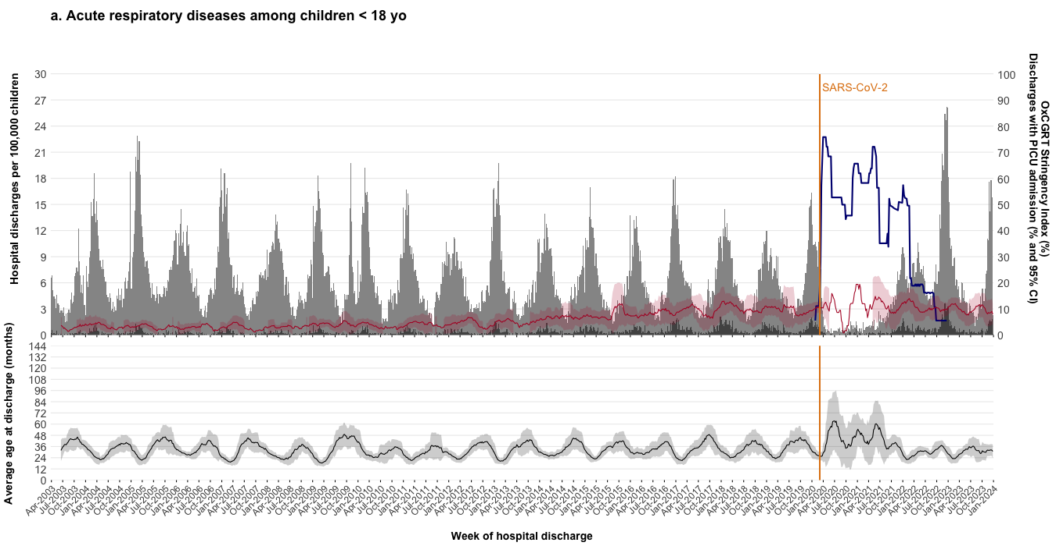
Results Objective 1: Describe the seasonal pattern of acute respiratory diseases
Healthcare use: There were 63,776 hospitalizations for ARD from Apr 2003 to Dec 2023
A biennial pattern emerged – peak incidence was highest every other winter season
As the stringency index increased, the incidence of hospitalizations for ARD among children decreased
Notes:
Onto the RESULTS for our first objective –
X axis – week of hospitalization from April 2003 to December 2023
Y1 axis – incidence of hospitalizations per 100,000 children in light grey, stacked on top of incidence of PICU admission in dark grey
Y2 axis – precent of PICU admission (RED)
Y2 axis – Stringency Index in Alberta (blue)
Y3 axis – average age at the time of discharge in months
Overall, there were 63,776 hospitalizations for acute respiratory diseases during the study period
Generally, a biennial pattern emerged, where the peak incidence was highest every other winter season – to help our eyes see the patterns I highlighted these high peak years over the series of figures.
After SARS-CoV-2, when the stringency index was highest, the incidence of hospitalizations was lowest
As the stringency index decreased, the incidence of hospitalizations increased

Slide 9
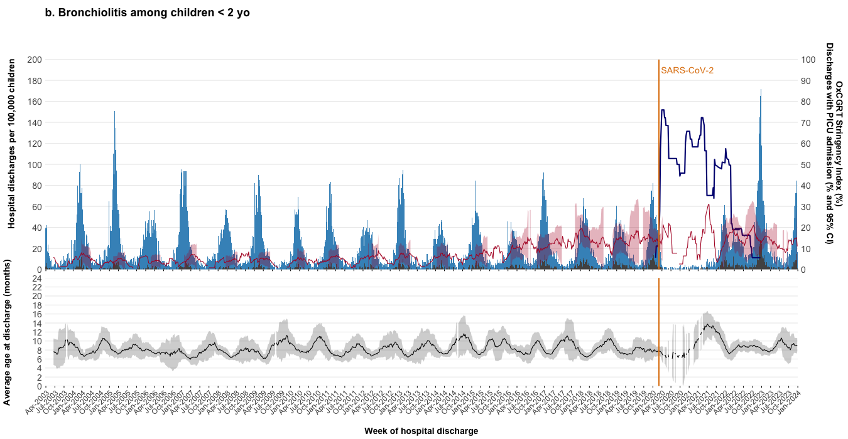
Results Objective 1: Describe the seasonal pattern of acute respiratory diseases
Healthcare use: Bronchiolitis accounted for 22,963 (36.01%) of hospitalizations
The biennial pattern is primarily driven by bronchiolitis – peak incidence was highest in Jan 2005, 2007, 2009, 2011, 2013…
Notes:
Bronchiolitis accounted for 36% of hospitalizations
And was the primary driver of the biennial pattern with peak incidence in January 2005, 2007, 2009 and so on …

Slide 10
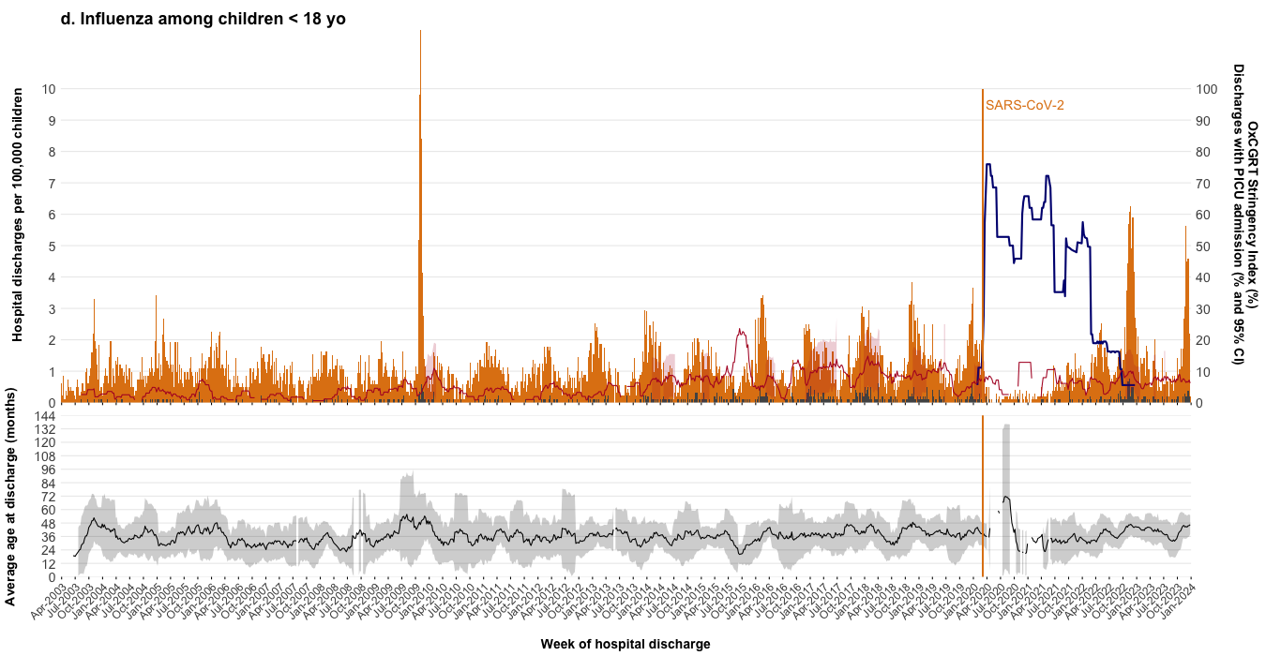
Results Objective 1: Describe the seasonal pattern of acute respiratory diseases
Healthcare use: Influenza like illness accounted for 10,833 (16.97%) of hospitalizations
An annual pattern with peak incidence each winter
H1N1 pandemic fall 2009
Notes:
17% of hospitalizations were for influenza like illness which had an annual winter season.
This graph captured the H1N1 pandemic in the fall of 2009

Slide 11
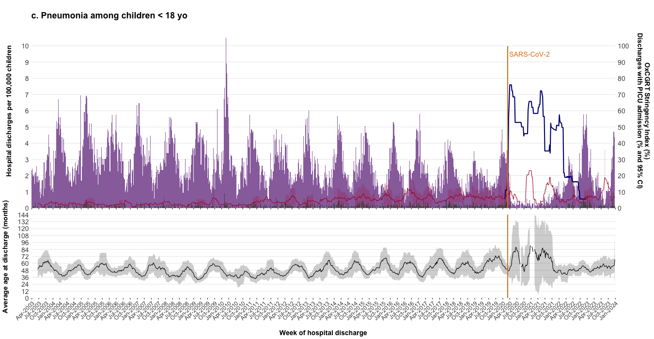
Results Objective 1: Describe the seasonal pattern of acute respiratory diseases
Healthcare use: Pneumonia accounted for 23,977 (37.44%) of hospitalizations
An annual pattern with broader peaks each winter – an earlier increase and later decreased in hospitalizations
Post H1N1 winter 2010
Notes:
37% of hospitalizations were for pneumonia which also has annual winter season
This graph captured the post H1N1 peak for hospitalizations for pneumonia in the winter of 2010

Slide 12
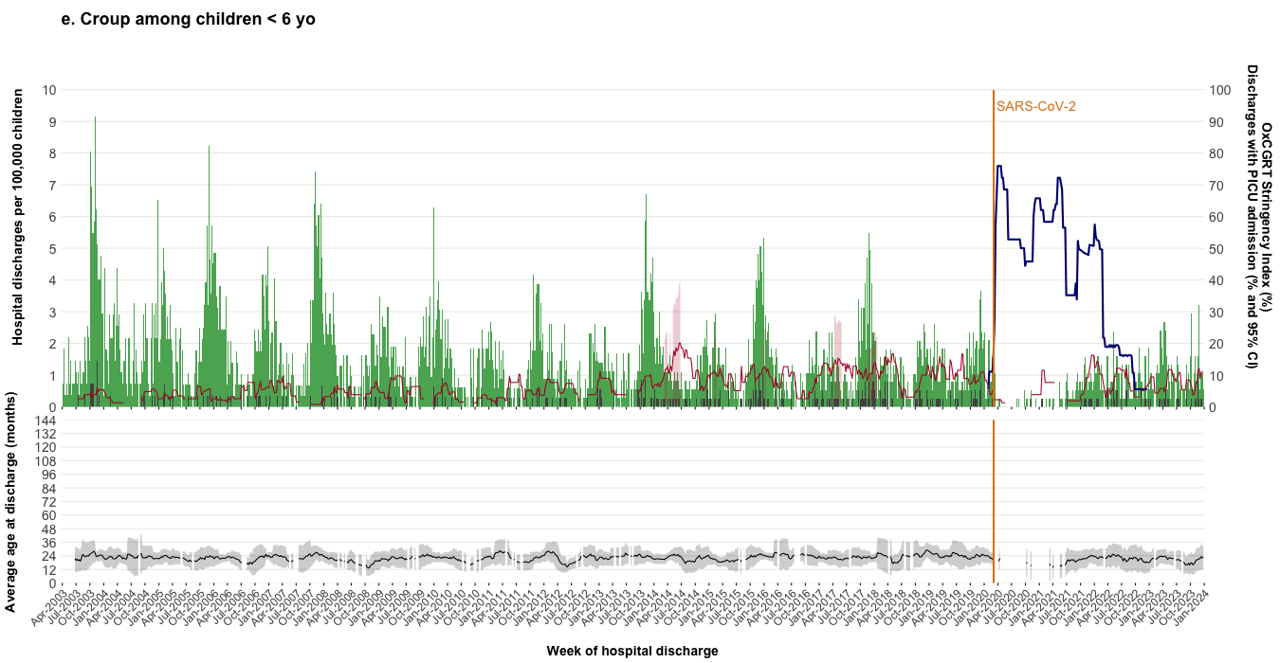
Results Objective 1: Describe the seasonal pattern of acute respiratory diseases
Healthcare use: Croup accounted for 4,984 (7.81%) of hospitalizations
The biennial pattern alternates with bronchiolitis – peak incidence was highest in Jan 2004, 2006, 2008, 2010, 2012…
Notes:
Finally, croup accounted for 7.8% of hospitalizations and had a biennial pattern alternating wit bronchiolitis - with peak incidence in 2004, 2006, 2008, and so on

Slide 13
Summary & Interpretation Objective 1: Describe the seasonal pattern of acute respiratory diseases
The weekly incidence of hospitalizations for ARD peaks annually during the winter season
All acute respiratory diseases – biennial pattern
Bronchiolitis – major driver of the biennial pattern
Influenza like illness – annual pattern with winter peak
Pneumonia – annual pattern with winter peak
Croup – biennial pattern alternating with bronchiolitis
As the stringency index increased, the incidence of hospitalizations for ARD among children decreased
Notes:
To summarize the results of our first objective…

Slide 14
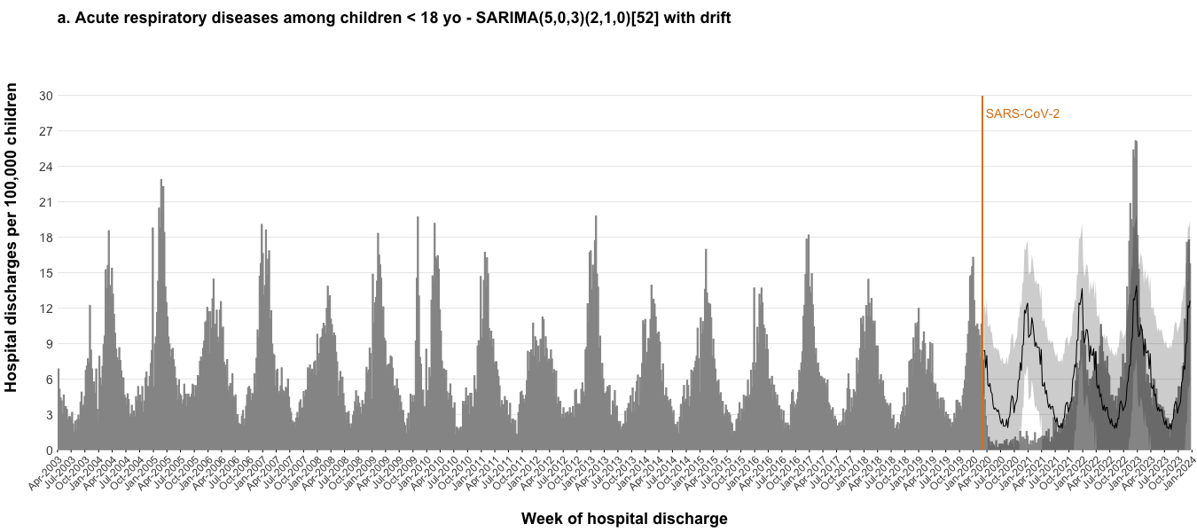
Results Objective 2: Measure the impacts of SARS-CoV-2 and NPI
There was a 50% increase in hospitalizations for ARD in Dec 2022 to Feb 2023
Healthcare use
 | Reference SARIMA - Expected |  |  | Observed | Impact
 | Avg | Low 95% | High 95% | Avg | Ratio | Percent change
Incidence of hospital discharges per 100,000 children
Dec 2020 - Feb 2021 | 10.42 | 5.11 | 15.73 | 0.82 | 0.08 | -92.09
Dec 2021 - Feb 2022 | 10.41 | 4.89 | 15.93 | 7.53 | 0.72 | -27.72
Dec 2022 - Feb 2023 | 10.77 | 4.71 | 16.83 | 16.28 | 1.51 | 51.23
Notes:
Onto the RESULTS for our second objective –
Here along the x axis is the week of hospitalization
And the y1 axis is the incidence of hospitalization
The SARIMA model predicts the expected pattern of hospitalizations for ARD if there were no exposures to SARS-CoV-2 or non-pharmaceutical interventions
During the winter of Dec 2020 through Feb 2021, we observed a 0.08 fold decrease, or 92% decrease in hospitalizations, compared with expected.
In contrast, the winter of Dec 2022 through Feb 2023, we observed a 1.51 fold increase, or 50% more hospitalizations compared with expected.

Slide 15
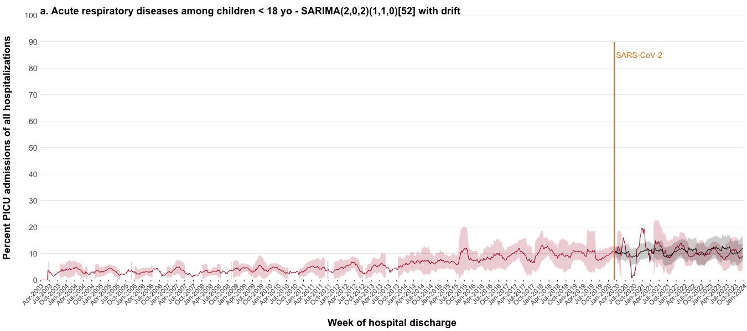
Results Objective 2: Measure the impacts of SARS-CoV-2 and NPI
There was no change in clinical severity of ARD after SARS-CoV-2
Clinical Severity: Of the 63,776 hospitalizations for ARD, 4,167 (6.53%) included a PICU admission
 | Reference SARIMA - Expected |  |  | Observed | Impact
 | Avg | Low 95% | High 95% | Avg | Ratio | Percent change
Average percent PICU admissions (%)
Dec 2020 - Feb 2021 | 10.88 | 7.83 | 13.93 | 12.03 | 1.11 | 10.56
Dec 2021 - Feb 2022 | 11.07 | 7.59 | 14.55 | 14.02 | 1.27 | 26.65
Dec 2022 - Feb 2023 | 11.68 | 7.49 | 15.87 | 11.86 | 1.02 | 1.53
Notes:
This figure shows clinical severity based on the average percent PICU admissions depicted in the red line - a 13 week moving average with 95% CI
Of the 63,776 hospitalizations for ARD, 4,167 (6.53%) included a PICU admission
The average percentage of PICU admissions steadily increased from
4.07% (95%CI 1.22%, 6.91%) in winter 2004 (Dec 2003-Feb 2004) to
10.48% (95%CI 8.36%, 12.60%) in winter 2020 (Dec 2019-Feb 2020).
Comparing expected – SARIMA model – with observed
There was no significant change in the percentage of PICU admissions during the period post SARS-CoV-2
12.03% in Dec 2020-Feb 2021
11.86% Dec 2022-Feb 2023

Slide 16
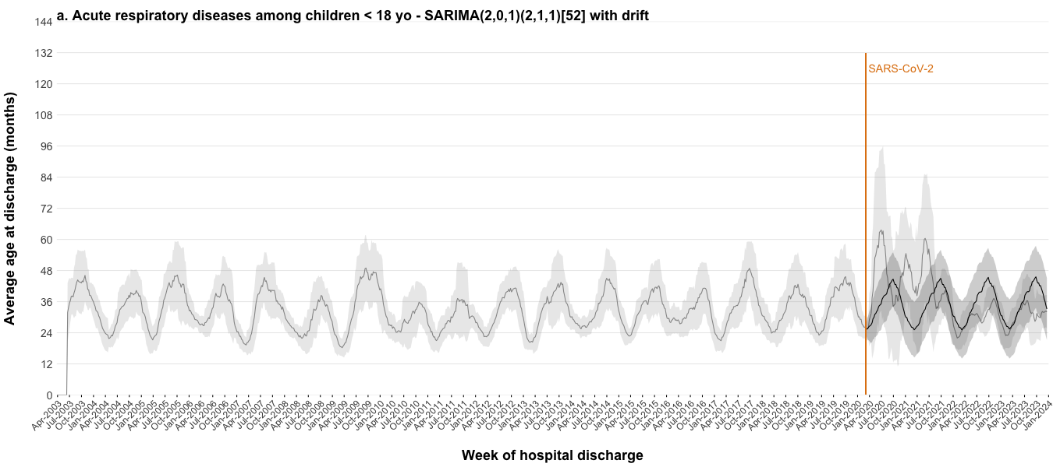
Results Objective 2: Measure the impacts of SARS-CoV-2 and NPI
There was no change in the affected population hospitalized with ARD after SARS-CoV-2
Affected Population
 | Reference SARIMA - Expected |  |  | Observed | Impact
 | Avg | Low 95% | High 95% | Avg | Ratio | Percent change
Average age at discharge (months)
Dec 2020 - Feb 2021 | 30.26 | 21.43 | 39.10 | 42.71 | 1.41 | 41.14
Dec 2021 - Feb 2022 | 30.29 | 20.98 | 39.61 | 22.85 | 0.75 | -24.58
Dec 2022 - Feb 2023 | 30.56 | 20.54 | 40.58 | 23.02 | 0.75 | -24.66
Notes:
This figure shows the affected population, based on the average age at discharge in months - 13 week moving average with confidence intervals
During each winter season, the average age at discharge decreased to 25.06 months (95%CI 19.19, 30.94).
In Dec 2020 to Feb 2021, the expected average age at discharge was 30 mo (21 - 39 mo).
The observed average age was significantly higher, 42 mo.
This was when the incidence of hospitalizations was 0.08 per 100,000 children
So, among the few children who were admitted for acute respiratory diseases, on average children were older.
In Dec 2022 to Feb 2023, the expected average age was 30.56 mo (20.54 mo – 40.58 mo).
The observed average age was 23 mo.
In other words, there was no change in the affected population hospitalized with acute respiratory diseases during the 2023 surge in hospitalizations.

Slide 17
Summary & Interpretation Objective 2: Measure the impacts of SARS-CoV-2 and NPI
During the Dec 2022 to Feb 2023 winter season…
Increased healthcare use
The average incidence of hospitalizations for ARD increased by 1.51-fold or 51.23% compared with expected
No difference in clinical severity
The percent of PICU admissions of all hospitalizations was 11.86%, no different than expected 11.68% (95%CI 7.49%, 15.87%)
No difference in affected population
The average age at discharge was 23 mo, no different than expected 30.56 mo (95%CI 20.54 mo, 40.58 mo)
Notes:
To summarize the results of our second objective,
In Alberta, during the Dec 2022 to Feb 2023 winter season
The average incidence of hospitalizations for acute respiratory diseases among children increased by 50%.
However, there was no change in clinical severity as measured by the percentage of PICU admissions.
There was no change in the affected population as measured by the average age at the time of discharge

Slide 18
Why does it feel like residency got harder
over the last three years?
During the 2023 winter season, we cared for 50% more children in hospital.
Of the hospitalized children, 12% required PICU admission and their average age was 23 months similar to prior years.
Notes:
In other words,

Slide 19
Thank you to my team!
Thank you for listening!
Brett Simms PhD
Grace P.S. Kwong PhD
Jessalyn K. Holodinsky PhD
David W. Johnson MD FRCPC
James D. Kellner MD MSc FRCPC
Questions christine.lukac@albertahealthservices.ca

