Slide 1
Study Design and Analysis: Diagnostic Studies 2023
Mary Dunbar MD MSc MSc FRCPC
Assistant Professor of Pediatrics, University of Calgary
Pediatric Neurologist, Alberta Children’s Hospital
Slide Credit: many slides taken from Dr. S. Greenaway’s lecture from two years ago

Slide 2
Objectives
Understand the issues in the evaluation of a diagnostic test
Appreciate components of evaluating test performance
precision and accuracy
sensitivity and specificity
likelihood ratio
positive and negative predictive values
receiver operating characteristic (ROC) curves
additional factors: cost, availability, acceptability, utility

Slide 3
Examples of Diagnostic Tests
Biochemical
electrolytes, urea, creatinine
Imaging
CXR, MRI
Genetic
karyotype, array, WES
Microbiological
blood culture
Physiological
PFTs, exercise test, GTT
Clinical
Lever sign to diagnose ACL tear
Patient-reported outcome measures
questionnaire of symptoms to diagnose IBD

Slide 4
Purpose of diagnostic tests
Diagnose a disease or condition
TSH
echocardiogram
Exclude a disease or condition
HbA1C
Troponin
Estimate prognosis
LDL cholesterol
BRCA1 mutation
Inform treatment decisions
PSA
karyotype

Slide 5
Factors Affecting Diagnostic Test Performance
Prevalence of the disease in the population
Spectrum of the disease
Often dependent on other factors
part of diagnostic pathway
test results may not be independent
often depend on prior knowledge
Gold standard
established test which confirms the diagnosis

Slide 6
Types of Studies to Evaluate a Diagnostic Test
Precision (reproducibility)
intra-observer (amount of variation for a single observer)
inter-observer (variation between 2 or more observers)
Accuracy
cohort
case-control
Costs, Risks and Acceptability
prospective
retrospective
Improvement of clinical outcome
RCT
case-control

Slide 7
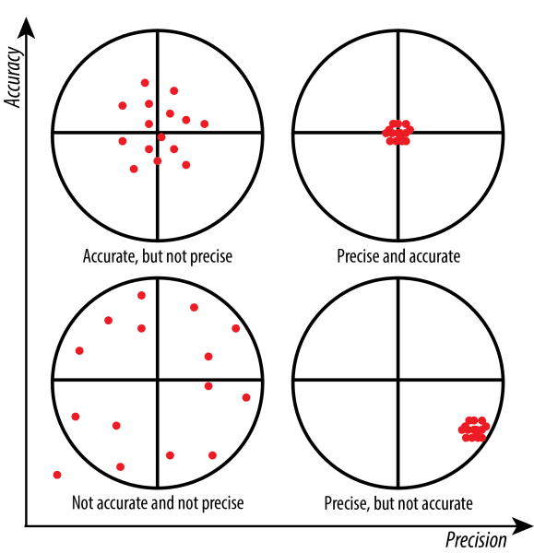
Precision
Reproducibility or repeatability
Agreement between repeated measures
Intra-observer variability
agreement with your previous interpretation
Inter-observer variability
agreement between observers

Slide 8
Accuracy
Closeness of measurements to a specific value
To what extent does the test give the right answer
Requires a gold standard (definitive assessment)
Measures of accuracy
Sensitivity and specificity
positive and negative predictive values
receiver operating characteristic (ROC) curve
likelihood ratio

Slide 9
https://www.google.com/url?sa=i&url=https%3A%2F%2Fwp.stolaf.edu%2Fit%2Fgis-precision-accuracy%2F&psig=AOvVaw1n_ExUOnO-v4UWNFEReZIr&ust=1667082302398000&source=images&cd=vfe&ved=0CAwQjRxqFwoTCJi63NP7g_sCFQAAAAAdAAAAABAX

Slide 10
Sensitivity & Specificity
Sensitivity
proportion of positive tests out of total disease
Given you have the disease, proportion that have a positive test (T+|D+)
correctly identified positives
true-positive rate
The probability that a person with the disease is classified correctly by the test
Specificity
proportion of negative tests out of total non-diseased
Given you don’t have the disease, proportion that have a negative test (T-|D-)
correctly identified negatives
true-negative rate
The probability that a person without the disease is classified correctly by the test

Slide 11
Dichotomous Outcome and Test Result 2x2 Contingency Table
 | Disease present | Disease absent
Positive test | True positive | False positive
Negative test | False negative | True negative

Slide 12
Calculating Sensitivity and Specificity
 | Disease present | Disease absent
Positive test | True positive | False positive
Negative test | False negative | True negative
 | Stroke | No stroke
CT = stroke | 56 | 3 | 59
CT = no stroke | 161 | 136 | 297
 | 217 | 139 | 356
Sensitivity: true positives/all stroke = 56/217 = 26%
Specificity: true negatives/all without stroke= 136/139 = 98%
Magnetic resonance imaging and computer tomography in emergency assessment of patients with suspected acute stroke: a prospective comparison.” Chalela J, Kidwell CS, Nentwich LM, Luby M, Butman JA, Demchuk AM, Hill MD, Patronas N, Latour L, Warach S. The Lancet, Vol. 369, January 27, 2007, pp. 293-298.

Slide 13
Sensitivity & Specificity: classification
Sensitivity and Specificity tell you about misclassification errors
Studies that display results as sensitivity and specificity are Validation Studies
Step 1: obtain a sample of people with and without a disease
Step 2: administer a test or procedure to classify them
Step 3: compare the results of the classification to a “gold standard” and construct a 4x4 table

Slide 14
Sensitivity and Specificity - Challenges
Never consider these two parameters separately
Trade off between sensitivity and specificity
As one increases, the other decreases
e.g. higher cutoff leads to increased specificity but decreased sensitivity
A highly sensitive test is prone to false-positives
incorrectly label someone as having the disease
A highly specific test is prone to false-negatives
fail to identify disease
What is important to you?
Avoid missing someone or avoid incorrectly labelling someone?

Slide 15
Trade off Between Sensitivity and Specificity

Slide 16
Trade off Between Sensitivity and Specificity

Slide 17
Sensitivity and Specificity - Challenges
Affected by severity of disease
results from a CXR for detection of lung cancer will depend on severity of illness and stage of the disease, size of the tumour etc.
Sensitivity and specificity describe how well a test performs
Don’t convey significance of the test result for an individual patient

Slide 18
Likelihood Ratio (Positive)
Assesses potential utility of a diagnostic test
Assesses how likely the patient with a positive test has the disease
Probability of positive test given disease relative to probability of positive test given no disease (true positives/false positives)
Answers question: How much more likely is a positive test result in the presence of disease compared with absence of disease?
LR = sensitivity/(1-specificity)
Answer is an odds

Slide 19
Negative Likelihood Ratio
Probability that a person with the disease tested negative/ probability that a person without the disease tested negative
1-Sensitivity (false negative rate)/Specificity (true negative rate)

Slide 20
Likelihood Ratio
Has predictive value and stable with changes in prevalence
Ranges from zero to infinity
The higher the value, the more likely the patient has the condition
0 - 1 = decreased evidence for disease
1 = no diagnostic value
>1 = increased evidence for disease

Slide 21
Likelihood Ratio Example

Slide 22
Liklihood ratio example
 | Stroke | No stroke
CT = stroke | 56 | 3 | 59
CT = no stroke | 161 | 136 | 297
 | 217 | 139 | 356
True positives/false positives = (56/217)/(3/139) = 0.258/0.0216 = 12
Sensitivity/(1-specificity) = (56/217)/(1-(136/139) = 0.258/(1-0.978) = 12

Slide 23
Prediction
Predictive values
Ability of a diagnostic test to make a diagnosis in the future
Positive predictive value (PPV)
proportion of diseased with positive test result
proportion of people with a positive test who have the disease
Negative predictive value (NPV)
proportion of healthy individuals with a negative test result
proportion of people with a negative test who are free of disease

Slide 24
Prediction
A test with a high positive predictive value makes the disease quite likely in a subject with a positive test
A test with a high negative predictive value makes the disease quite unlikely in a subject with a negative test
Positive predictive value (PPV) = true positive tests/all positive tests
Negative predictive value (NPV) = true negative tests/all negative tests

Slide 25
Prediction
 | Disease present | Disease absent
Positive test | True positive | False positive
Negative test | False negative | True negative
 | Stroke | No stroke
CT = stroke | 56 | 3 | 59
CT = no stroke | 161 | 136 | 297
 | 217 | 139 | 356
Positive predictive value (PPV) = true positive tests/all positive tests
Negative predictive value (NPV) = true negative tests/all negative tests
PPV (true positives/all positives)= 56/59 = 95%
NPV (true negatives/all negatives)= 136/297 = 46%
Magnetic resonance imaging and computer tomography in emergency assessment of patients with suspected acute stroke: a prospective comparison.” Chalela J, Kidwell CS, Nentwich LM, Luby M, Butman JA, Demchuk AM, Hill MD, Patronas N, Latour L, Warach S. The Lancet, Vol. 369, January 27, 2007, pp. 293-298.

Slide 26
Calculating Sensitivity and Specificity
 | Disease present | Disease absent
Positive test | True positive | False positive
Negative test | False negative | True negative
 | Stroke | No stroke
CT = stroke | 56 | 3 | 59
CT = no stroke | 161 | 136 | 297
 | 217 | 139 | 356
Sensitivity: true positives/all stroke = 56/217 = 26%
Specificity: true negatives/all without stroke= 136/139 = 98%
Magnetic resonance imaging and computer tomography in emergency assessment of patients with suspected acute stroke: a prospective comparison.” Chalela J, Kidwell CS, Nentwich LM, Luby M, Butman JA, Demchuk AM, Hill MD, Patronas N, Latour L, Warach S. The Lancet, Vol. 369, January 27, 2007, pp. 293-298.

Slide 27
SPin & SNout
SPecific tests that are POSITIVE rule IN disease
Low rate of false positives (true negative rate is high)
SeNsitive tests that are NEGATIVE rule OUT disease
Low rate of false negatives
 | Stroke | No stroke
CT = stroke | 56 | 3 | 59
CT = no stroke | 161 | 136 | 297
 | 217 | 139 | 356
Sensitivity: true positives/all stroke = 56/217 = 26%
Specificity: true negatives/all without stroke= 136/139 = 98%
PPV (true positives/all positives)= 56/59 = 95%
NPV (true negatives/all negatives)= 136/297 = 46%

Slide 28
Predictive values - Challenges
Cannot be used in case-control studies
used for random samples or cohorts where observed prevalence is equivalent to true prevalence
Affected by prevalence (proportion of subjects with disease)
high prevalence
PPV increases and NPV decreases
low prevalence
PPV decreases, NPV increases
Less portable from population to population
due to effect of prevalence

Slide 29
What are all these terms again?
Test | Numerator | Denominator | Goal
Sensitivity | Positive tests in those with disease (true positives) | All with disease | In those with disease, what proportion will test positive?
Specificity | Negative tests in those without disease (true negatives) | All without disease | In those without disease, what proportion test negative?
Likelihood ratio | Sensitivity (true pos rate) | 1-specificity (false pos rate) | How much more likely is disease if test is positive?
Positive predictive value | Positive tests in those with disease (true positives) | All positive tests | What proportion with a positive test actually have the disease?
Negative predictive value | Negative tests in those without disease | All negative tests | What proportion with a negative test don’t have the disease?

Slide 30
Effect of prevalence
Prevalence = 217/356 = 61%
 | Stroke | No stroke
CT = stroke | 56 | 3 | 59
CT = no stroke | 161 | 136 | 297
 | 217 | 139 | 356
Sensitivity (true positives/all stroke) = 56/217 = 26%
Specificity (true negatives/all without stroke)= 136/139 = 98%
PPV (true positives/all positives)= 56/59 = 95%
NPV (true negatives/all negatives)= 136/297 = 46%
Prevalence = 22/356 = 6%
 | Stroke | No stroke
CT = stroke | 6 | 7 | 13
CT = no stroke | 16 | 327 | 343
 | 22 | 334 | 356
Sensitivity (true positives/all stroke) = 6/22 = 26%
Specificity (true negatives/all without stroke)= 327/334 = 98%
PPV (true positives/all positives)= 6/13 = 46%
NPV (true negatives/all negatives)= 327/343 = 95%
 | Stroke | No stroke
CT = stroke | 83 | 1 | 84
CT = no stroke | 236 | 35 | 271
 | 320 | 36 | 356
Prevalence = 320/356 = 90%
Sensitivity (true positives/all stroke) = 83/320 = 26%
Specificity (true negatives/all without stroke)= 35/36 = 98%
PPV (true positives/all positives)= 83/84 = 99%
NPV (true negatives/all negatives)= 35/271 = 13%

Slide 31
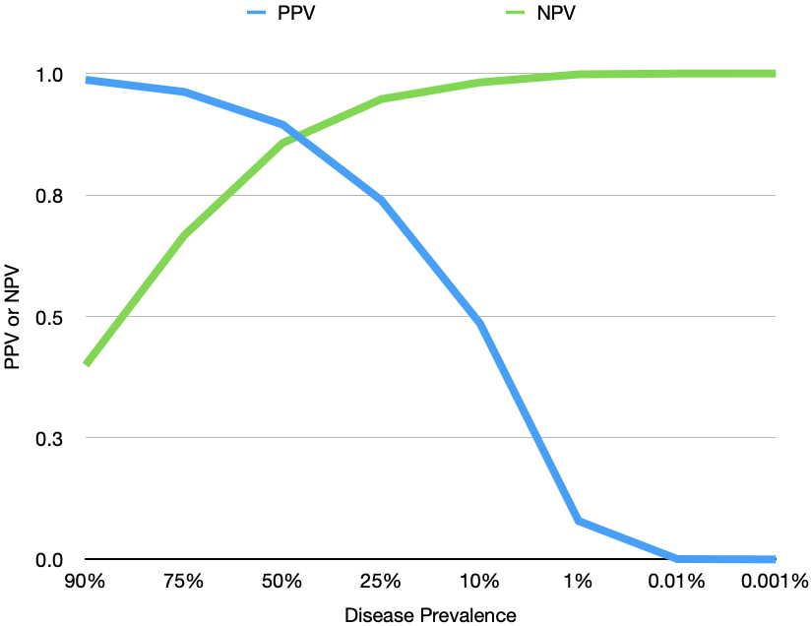
Effect of Prevalence on PPV and NPV
Prevalence | Sensitivity | Specificity | PPV | NPV
90% | 0.85 | 0.9 | 0.987097 | 0.400000
75% | 0.85 | 0.9 | 0.962264 | 0.666667
50% | 0.85 | 0.9 | 0.894737 | 0.857143
25% | 0.85 | 0.9 | 0.739130 | 0.947368
10% | 0.85 | 0.9 | 0.485714 | 0.981818
1% | 0.85 | 0.9 | 0.079070 | 0.998319
0.01% | 0.85 | 0.9 | 0.000849 | 0.999983
0.001% | 0.85 | 0.9 | 0.000085 | 0.999998
For a test with 85% sensitivity and 90% specificity

Slide 32
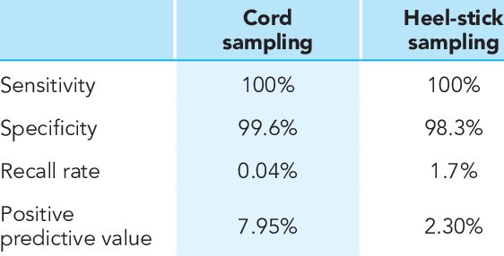
Effect of prevalence
Example of newborn screening for congenital hypothyroidism
Amazing test
But low prevalence = low PPV
https://www.researchgate.net/publication/336248581_Cord_blood_versus_heel-stick_sampling_for_measuring_thyroid_stimulating_hormone_for_newborn_screening_of_congenital_hypothyroidism/figures?lo=1

Slide 33
Prevalence and Diagnostic Tests
Diagnostic tests function best when prevalence is between 40-60%
Chose the right population to test
Function poorly at extremes of prevalence
“When you are already pretty sure that the patient either does or does not have the diagnosis in question, additional testing may not alter that probability very much”
e.g. ECHO for endocarditis or chest CT for pulmonary embolus

Slide 34
Summary of terms
Sensitivity and specificity
How good is the test compared to gold standard?
Likelihood ratio
How much more likely is a positive test result in the presence of disease compared with absence of disease? (true positives/false positives)
Predictive value
Given a test result, what is the probability of actually having the disease?

Slide 35
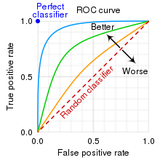
Receiver Operating Characteristic (ROC) Curves
Test result is not simply positive or negative
Continuous test results
Potentially multiple cutoffs
Sensitivity (Y-axis) vs. 1-specificity (X-axis)
Best cut-off maximizes sensitivity and specificity
1 = perfect test
0.5 = useless test (equivalent to random chance)
Quantifies information gain for a test
Provides summary estimate of the accuracy of the test

Slide 36
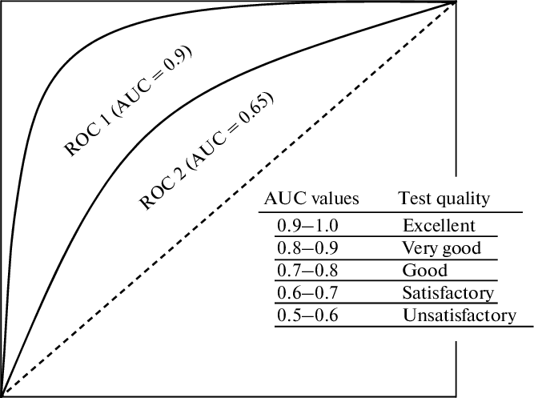
Area Under the ROC Curve (AUC)
Values between 0.0 and 1.0
perfectly inaccurate to perfectly accurate
0.5 = useless test

Slide 37
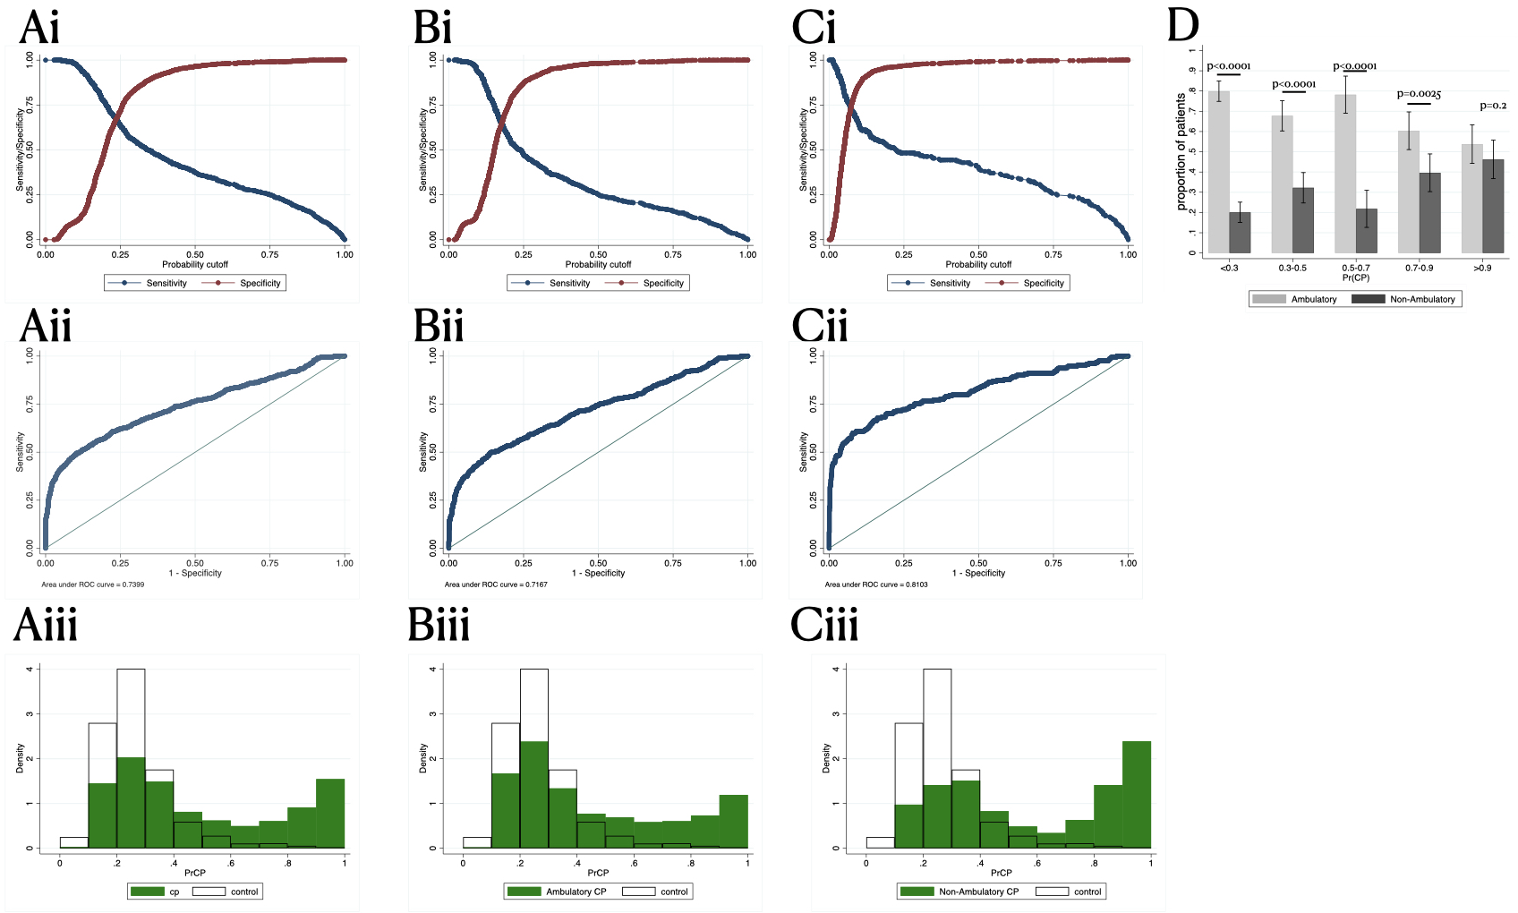
Examples of ROC Curves
All study subjects
Controls vs. mild CP
Controls vs. severe CP
0.74
0.72
0.81

Slide 38
Additional Considerations
Cost
Availability
Acceptability
i.e. invasive test with potentially serious complications
Clinical utility
ideally assessed using a RCT
assess outcomes
document adverse events
assess impact on decision-making
assess patient satisfaction and cost-effectiveness

Slide 39
Example

Slide 40
Why a new test?
Cerebral palsy is an impairment of motor development due to a static abnormality of the CNS that occurs before the age of 1 (ie, in development)
Affects ~1/500 children
CP is a clinical diagnosis
CP takes time to become apparent due to maturation of the CNS
Early interventions improve outcomes
How can we identify children at risk?
Term infants with encephalopathy at birth ~12% develop CP

Slide 41
Classic risk factors
Prematurity (~40%)
Bad delivery (~10-20%)
These children are easy to identify and follow
But these account for a minority of CP cases (~50%)
What about the rest?

Slide 42
Study
Canadian Cerebral Palsy registry = cases = 1265
APrON (Alberta Pregnancy Outcomes and Nutrition) = controls = 1985
Look a common elements and try to find ones specific to CP

Slide 43
 |  | Controls (n=1985) |  | CP (n=1265) |  | Univariable |  |  | Multivariable (45 multiple imputations)
 |  | Number (%) or median (IQR) | Missing (%) | Number (%) or median (IQR) | Missing (%) | OR | 95% CI | P-value | OR | 95% CI | Standardized dominance statistic (ranking)
Pregnancy and maternal characteristics | Maternal age (years) | 31 (29-34) n=1936 | 47 (2.4%) | 30 (26-33) n= 1246 | 19 (1.5%) | N/A |  |  | N/A
 | Number of pregnancies | 2 (1-3) n=1985 | 0 (0%) | 2 (1-3) n=1245 | 20 (1.6%) | 1.2 | 1.2-1.3 | <0.0001 | 1.4 | 1.3-1.5 | 0.041 (6)
 | History of miscarriage | 464/1985 (23.4%) | 0 (0%) | 308/1232 (25%) | 33 (2.5%) | 1.1 | 0.92-1.3 | 0.3 | Not significant
 | Number of miscarriages | 0 (0-0) n=1985 | 0 (0%) | 0 (0-0.5) n=1232 | 33 (2.6%) | 1.1 | 0.97-1.2 | 0.25 | 0.75 | 0.64-0.87 | 0.0075 (13)
 | Tobacco use | 110/1835 (6.0%) | 150 (7.6%) | 202/1128 (17.9%) | 137 (10.8%) | 3.1 | 2.4-4.0 | <0.0001 | 2.3 | 1.7-3.0 | 0.078 (4)
 | Alcohol use | 130/1802 (7.2%) | 183 (9.3%) | 143/1120 (12.8%) | 145 (11.5%) | 1.7 | 1.32-2.2 | <0.0001 | Not significant
 | Drug use | 14/1843 (0.8%) | 142 (7.2%) | 132/1224 (10.8%) | 41 (3.2%) | 15.8 | 9.0-29.8 | <0.0001 | 10.4 | 6.1-18.0 | 0.15 (3)
 | Diabetes | 104/1983 (5.2%) | 2 (0.1%) | 74/12330 (6.0%) | 35 (2.8%) | 2.4 | 1.7-3.3 | <0.0001 | 2.1 | 1.5-3.0 | 0.039 (7)
 | Pre-eclampsia | 13/1983 (0.7%) | 2 (0.1%) | 46/1173 (3.9%) | 92 (7.3%) | 6.2 | 3.3-12.6 | <0.0001 | 4.0 | 2.0-8.0 | 0.037 (9)
Labor and Delivery characteristics | Prolonged rupture of membranes (>18hrs) | 234/1976 (11.8%) | 9 (0.5%) | 90/1172 (7.7%) | 93 (7.4%) | 0.62 | 0.48-0.80 | 0.0002 | 0.5 | 0.37-0.69 | 0.053 (5)
 | Chorioamnionitis | 8/1985 (0.4%) | 0 (0%) | 79/808 (9.8%) | 457 (36.1%) | 26.8 | 12.9-64.4 | <0.0001 | 15.4 | 6.9-39.1 | 0.21 (2)
 | 5-minute Apgar Score | 9 (9-9) n=1981 | 4 (0.2%) | 9 (7-9) n=1159 | 106 (8.4%) | 0.63 | 0.59-0.67 | <0.0001 | 0.64 | 0.60-0.70 | 0.31 (1)
 | Cord pH | 7.26 (7.21-7.3) n=1691 | 294 (14.8%) | 7.25 (7.14-7.3) n= 810 | 455 (36.0%) | 0.03 | 0.014-0.61 | 0.0001 | Not significant
 | Maternal fever in labor | 77/1985 (3.9%) | 0 (0%) | 87/1049 (8.3%) | 216 (17.1%) | 2.2 | 1.6-3.1 | <0.0001 | Not significant
 | Emergency Caesarian section | 244/1985 (12.3%) | 0 (0%) | 300/461 (65%) | 804 (63.6%) | 13.3 | 10.5-16.9 | <0.0001 | N/A
Infant characteristics | Male sex | 1033/1985 (52%) | 0 (0%) | 719/1265 (56.8%) | 0 (0%) | 1.2 | 1.05-1.4 | 0.007 | 1.2 | 1.0-1.5 | 0.011 (12)
 | Gestational age (weeks) | 39.4 (38.7-40.1) n=1936 | 49 (2.4%) | 39 (38-40) n=1228 | 37 (2.9%) | 0.82 | 0.78-0.87 | <0.0001 | 0.89 | 0.83-0.97 | 0.037 (8)
 | Birth weight (kg) | 3.4 (3.1-3.69) n=1983 | 2 (0.1%) | 3.3 (2.98-3.65) n=1219 | 46 (3.6%) | 0.66 | 0.57-0.76 | <0.0001 | 0.11 | 0.02-0.59 | 0.17 (10)
 | Birth weight (kg²) |  |  |  |  |  |  |  | 1.3 | 1.04-1.66 | 0.014 (11)
 | Small for Gestational Age | 95/1934 (4.9%) | 51 (2.6%) | 126/1227 (10.3%) | 38 (3.0%) | 2.2 | 1.7-3.0 | <0.0001 | Not significant
 | Encephalopathy | 0/1985 (0%) | 0 (0%) | 335/1184 (28.3%) | 81 (6.4%) | *786.4 | 139-31160 | <0.0001 | N/A
 | Seizure | Not collected | 1987 (100%) | 289/1204 (24%) | 61 (4.8%) | N/A |  |  | N/A

Slide 44
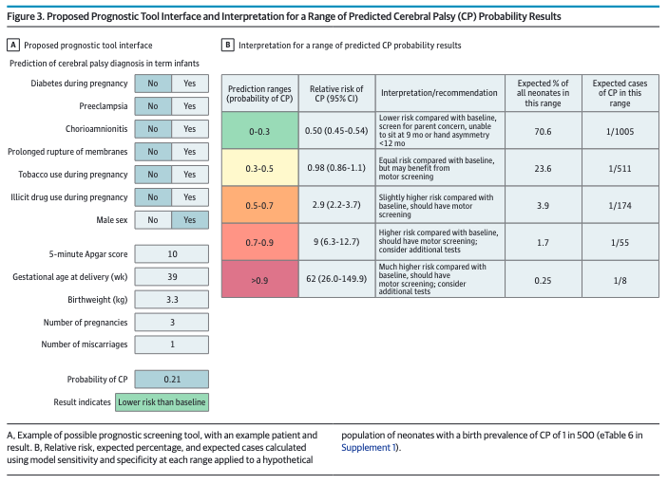

Slide 45
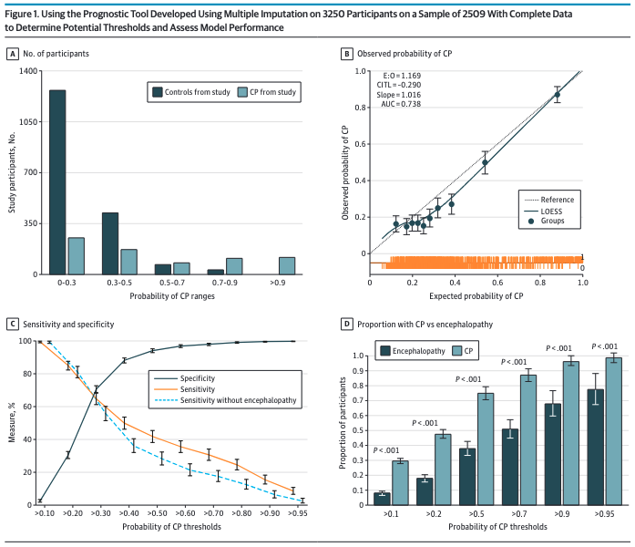

Slide 47
CAVEAT
The ”prevalence” of CP in our study is high! 38%
This means PPV and NPV are very misleading if we look at the general population! (~0.2%)
Recall the PPV and NPV should not be used in a case control study
(doesn’t stop the reviewers from asking for it)

Slide 48
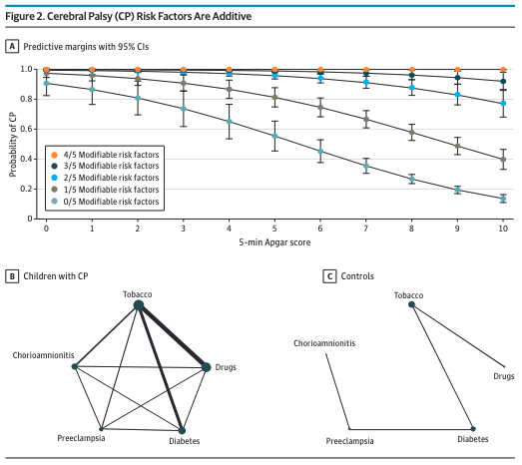

Slide 49
Dose-response

Slide 50
Is this acceptable??
Screening test – want high sensitivity, low specificity
But low specificity = worried parents, unnecessary tests
Acceptability: Screening is non-invasive (no blood, etc)
Availability: can be done by anyone, most variables will be known
Utility: does this actually identify additional cases of CP???
Cost: tool is free, but requires time; next level screening requires resources
Next level screening non-invasive (well baby check)
Tiny subset referred for more intensive screening such as Hammersmith Infant Neurological Examination, General Movements Assessment (can be administered by PTs)

Slide 51
Summary
Multiple metrics to evaluate a diagnostic test
Test performance
precision (reproducibility) and accuracy
sensitivity or specificity
likelihood ratio
Positive and negative predictive values
affected by disease prevalence
function poorly at the extremes
ROC curves
estimate accuracy of the test for different cutoff values
summarized with AUC
Impact and non-clinical factors

Slide 52
What you want to do | Test(s) | Numerator | Denominator | Sensitive to prevalence?
Evaluate a diagnostic test against another (given a disease, what proportion are correctly diagnosed) | Sensitivity Specificity | Cases correctly identified by test | All with (or without) disease | No
Know what a positive test result means for the patient | Likelihood ratio (positive) | Sensitivity (true positive rate) | 1-specificity (false positive rate) | No
Know what a negative test result means for the patient | Likelihood ratio (negative) | 1-sensitivity (false negative rate) | Specificity (true negative rate) | No
Given a test result, what proportion are correct? | Positive predictive value Negative predictive value | Cases correctly identified by test | All with positive (or negative) test | Yes
Accuracy of a test with continuous (not binary) results | Receiver operative characteristic | Sensitivity (true positive rate) | 1-specificity (fale positive rate) | No

Slide 53
Thanks!
Mary.Dunbar@ahs.ca

