Slide 1
Research Ethics Board Review
Requirements for CHREB approvals
Linda Longpre
Manager, Research Ethics and Compliance
Research Services Office

Slide 2
Learning Objectives
Practical session on how to submit an ethics application online using the IRISS platform
Overview of the process/requirements for obtaining approval to conduct research using AHS resources

Slide 3
IRISS: the platform
IRISS is Alberta’s highest volume ethics and animal care system with OVER 24,000 USERS and has capacity to scale exponentially.
Notable:
REB x 3 (CHREB, CFREB, HREBA)
ACC (3 committees)
Supports 196 board members (6 boards across REB and ACC)
Supports 23 staff (REB and ACC)
IRISS is the most integrated ethics platform in Canada
IRISS is Alberta’s highest volume ethics and animal care system with OVER 24,000 USERS and has capacity to scale exponentially.
Notable:
REB x 3 (CHREB, CFREB, HREBA)
ACC (3 committees)
Supports 196 board members (6 boards across REB and ACC)
Supports 23 staff (REB and ACC)
IRISS is the most integrated ethics platform in Canada

Slide 4
IRISS: integrations
Current Integrations:
REB Exchange - multi-site human ethics
AHS - operational approvals
Participate in Research + Be the Cure - recruitment
HREBA - Health Research Ethics Board of Alberta
CSM Legal Agreements – replaced SharePoint submissions
Biosafety - certifications
Peoplesoft - credential validation, project accounting
RMS - grant management
OnCore - clinical trial management

Slide 5
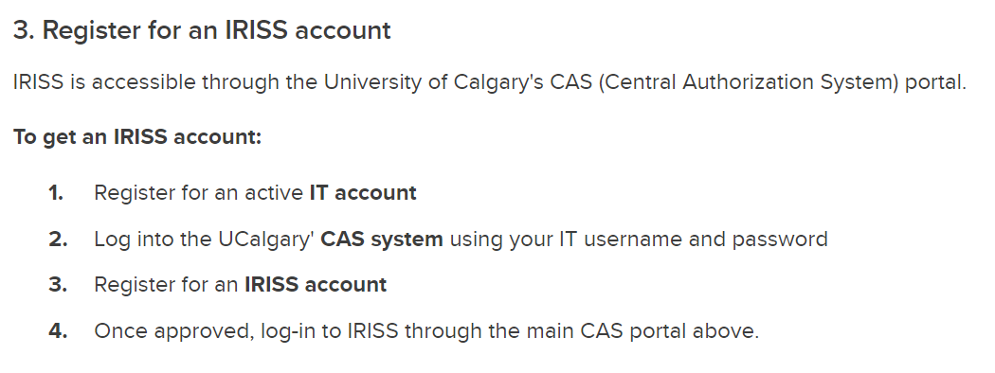
IRISS Registration
The same login process for REB, ACC, CSM Legal, and AHS
1
Please – do NOT register for more than one IRISS account. Register for IRISS with UCalgary.
If you need access to HREBA.CC, HREBA.CTC or HREBA.CHC; simply email iriss.support@ucalgary.ca and it will be added to your account.
Duplicate accounts will be closed.

Slide 6
Questions?
REB application/process questions
How to answer the application questions
What information does the REB require with the submission
What documentation is required?
Contact chreb@uclagary.ca
Technical Support
How to access IRISS
How to use IRISS (REB, ACC, REBX, AHS)
Navigation Assistance
Contact iriss.support@ucalgary.ca

Slide 7
Administrative Requirements
IRISS Researcher Profile
Upload your CV
The CHREB requires all members of the study team to have completed TCPS2 Core Tutorial or CITI Human Subjects Research Course (Biomedical or Social Behavioural-Educational module, whichever is most relevant to your discipline).
REB Application
Refer to REB consent/assent templates when creating consent forms
Department Head approval is uploaded in the application
All students, post docs, medical residents are listed on the application
Anyone who requires access to AHS systems MUST be listed on the ethics application
Refer to the CHREB Submission Checklist before hitting submit.
Every application requires a budget.
If you are working on a funded study, you can upload your detailed budget (grant or sponsor budget)
If you are working on an unfunded budget, use the Budget Summary form to list in kind hours for the study.

Slide 8
General Navigation: Personal Workspace
Click My Home to return to this page from any other page
Edit your Profile Information
Create new application
Shows information about study (e.g. expiry date)

Slide 9
General Navigation Cont.

Slide 10
Study Numbers and Types
All studies are given a number at the time of initiation, not at submission
Post approval submission:
REN – Means you are viewing a Renewal report
MOD – Means you are viewing a Modification (amendment)
RE – Means you are viewing a Reportable Event (serious adverse event, protocol violation)
CLOSE – Means you are viewing a Closure
Certification Number | Definition
REB23-1000 | UofC REB application ID
pSite-23-1000 | UofC REB Exchange ID
pSite00001000 | External REB Exchange ID
HREBA.CC-23-1000 | HREBA Cancer Committee application ID
AC23-1000 | UofC Animal Care application ID

Slide 11
SmartForm Navigation
Navigate to a study
Select the “Name” of the study to enter the workspace
Then click “Edit Study” (or “View Study”)

Slide 12
SmartForm Navigation
Navigating within the SmartForm
Click “Continue” to move to the next page of the form
Use the menu on the left-hand side to get to a specific section
Use “Exit” to close the SmartForm

Slide 13
Study Workspace Layout
State application is in

Slide 14
Steps to Create & Submit a New Study
Log in to IRISS
You will be directed to your personal workspace
From there, click on the “Research Ethics Board” button
Complete the SmartForm questions, and navigate the SmartForm as needed
Click “Continue” to go to the next page
Click on the section you are looking for on the left hand column (be sure to save before jumping to another page)
Click “Save” and then “Exit” to leave the application
Once the application is complete, the PI can submit
Important: The study is not submitted until the PI submits the study
(PI attestation is required)

Slide 15
After submission
The Research Ethics Analysts (REA) will conduct an admin review to ensure the application is complete enough for the REB members to review.
If anything is outstanding or clarification is required, they will send the application back to you to correct
Once complete, the REA will forward the application for REB Review (Delegated or Full Board)
Delegated review – minimal risk -Research in which the probability and magnitude of possible harms implied by participation in the research are no greater than those encountered by participants in those aspects of their everyday life that relate to the research.
Full Board Review – Any study the REB deems above minimal risk
Questions and requests for clarifications are sent back to study team
The REB could request further information or clarification if responses are unclear, or prompt further questions
Study is either approved or declined

Slide 16
Post Approval Submissions: Renewals
The REB cannot approve a study for longer than 1 year. It may however approve for a shorter period if deemed necessary.
The ability to submit a renewal only opens 30 days before the expiry date
Three renewal notifications will be sent automatically by IRISS
30 days, 15 days, and 7 days before study expires
If study expires, you will need to request Chair consideration.
If approved, you will have 7 days to submit your renewal
Once renewal is complete, click “Exit” or “Finish”. You will be redirected to the renewal workspace. If ready to submit, click “Submit Renewal” activity button on the left-side menu.

Slide 17
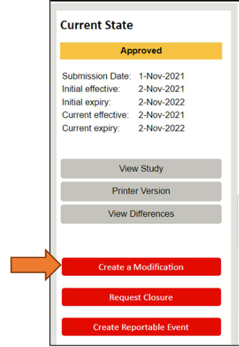
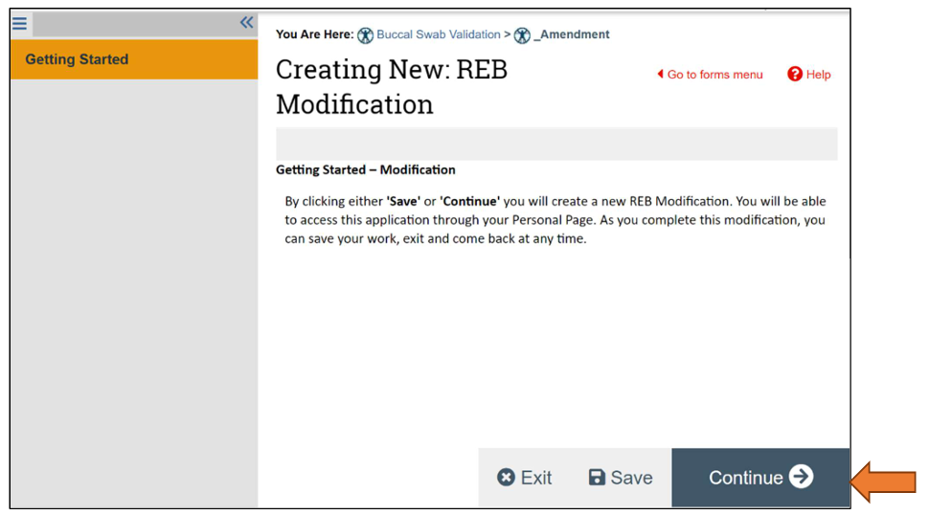
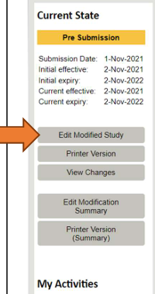
Post Approval Submissions: Modifications
Next Steps
“Edit Modified Study” opens the application for modification
Modify all required sections and upload any new/revised documents (track changes and clean versions.)
Once initiated, the Modification Summary form is created
Can be edited any time prior to submission (remember to click “Save” often)
“Save” and “Finish” DOES NOT submit the modification.
Modification summary + modified study = modification to be submitted to CHREB.

Slide 18
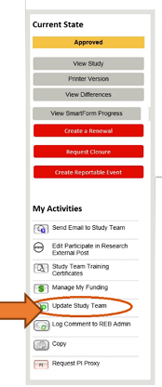
Post Approval Submissions: Update Study Team
For studies involving AHS systems, maintaining an accurate study team list is extremely important. Only those named in the IRISS application (PI, Co-Is, Student Co-Is, and Study Staff) will have access to AHS systems
This activity is available to any member of the study team.
The activity is available only when the study is in ‘Approved’, ‘Pending Expiry’ or ‘Expired’ state.
When a member of the study team is changed it will take effect immediately.
Note: A new approval certificate cannot be issued using the Update Study Team activity. If a new approval certificate is required, the PI must submit a modification to add the study team member. Please ensure that you indicate in the modification summary that an approval certificate is required.

Slide 19
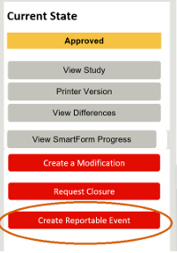
Post Approval Submissions: Reportable Events
Reportable Events include: Serious Adverse Events (SAEs), Adverse Events, Protocol Deviations, Protocol Violations, DSMB and other reports
For more information on Reportable Events, including detailed descriptions of each category and reporting criteria, visit the following: https://research.ucalgary.ca/research-services/ethics-compliance/ethics-resources

Slide 20
Things to Remember
REB approval does not mean you can go forward with your project. Any of the areas impacted by your research could not allow your research.
Ensure all sections in your IRISS application are complete and, in enough detail, to allow the CHREB to fully understand your study.
Refer to the CHREB Consent templates when creating your consents.
When unsure, ask.

Slide 21
A Harmonized Process
REB Exchange is a collaboration between Alberta institutions. The initiative is funded by Alberta Innovates, the University of Calgary, the University of Alberta, and Huron Consulting, with in-kind contributions from Alberta Health Services, to collectively support research ethics harmonization in Alberta.

Slide 22
REB Exchange: how it works
By connecting directly with institutional platforms, the REB Exchange:

Slide 23
REB Exchange: how it works
By connecting directly with institutional platforms, the REB Exchange:
By connecting directly with institutional platforms, the REB Exchange:
accepts both health AND non-health studies
streamlines processes across institutions
retains local compliance
saves time, money, and duplication of work
offers visibility into current status and turnaround times
integrates with other institutional systems

Slide 24
REB Exchange: how it works
Lead Site
Local pSite review
Determination

Slide 25
REB Exchange: how it works
Lead Site
RISe
The study is submitted through THE LEAD SITE’s REB platform.

Slide 26
REB Exchange: how it works
Lead Site
pSites
Using the REBX, the Lead Site invites PARTICIPATING SITES (pSites) to join the study.

Slide 27
REB Exchange: how it works
Lead Site
pSites
The pSites DOWNLOAD the study from REBX through their own REB platforms or portal.
IRISS
portal

Slide 28
REB Exchange: how it works
Lead Site
pSites
pSites will complete a LOCALIZED APPLICATION in accordance with their current local requirements and processes.
UCal
USask

Slide 29
REB Exchange: how it works
Lead Site
pSites
The pSite uploads SITE-SPECIFIC documents (ICF with contact information, logos, etc.).
UCal
USask

Slide 30
REB Exchange: how it works
Lead Site
pSites
UCal
USask
pSite REB coordinators review the pSite application and documents to ensure LOCAL and institutional requirements are met.

Slide 31
REB Exchange: how it works
Lead Site
pSites
Once reviewed locally, pSite documents are TRANSFERRED to the BoR for review through the Exchange.

Slide 32
REB Exchange: how it works
Lead Site
pSites
The Board of Record will review the pSite application and documents,

Slide 33
REB Exchange: how it works
Lead Site
pSites
The Board of Record will review the pSite application and documents,
ISSUE ETHICS DETERMINATION,

Slide 34
REB Exchange: how it works
Lead Site
pSites
The Board of Record will review the pSite application and documents,
ISSUE ETHICS DETERMINATION,
and share back through REBX.

Slide 35
REB Exchange: multi-site management
REB Exchange (REBX) connects enterprise systems for optimal efficiencies for multi-site human ethics applications.
University of Alberta
University of Calgary | HREBA
University of British Columbia
With OVER 25,000 active studies
ARISE
RISe

Slide 36
REB Exchange: pSite access
After a pSite has been invited to join your approved study, a new tab titled “Sites” will be listed in your study workspace.
To access, open the REB tab, and click on approved study name.
You will now see the “Sites” tab. This is where you can view and quickly see each pSite’s state of review.
Note: You can only see the pSite submissions once it has been sent by the host institution to the Board of Record (BOR).

Slide 37
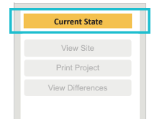
REB Exchange: States
Invitation Pending - BoR is in the process of approving the addition of a pSite. At this time the pSite workspace is not visible in the pSite’s institutional REB.
Awaiting Site Materials - The BoR has approved the pSite invitation and it is now with the pSite institution.
Pre-Review State - The pSite has been received by the BoR and will be assigned for ethics review.
Delegated/Board Review State – pSite ID - Once the application is received by the BoR, documents and the application for the pSite can be viewed by the Lead Site.
By going through the REBX and a common BoR for all site approvals:
communication and documentation is streamlined,
collaboration visible,
and required documentation is drastically reduced.
Timelines for participating site approvals are condensed because all additional applications are reviewed within the context of the Lead site’s approved application and shared documentation.
Active pSites - Once a pSite has been approved by the Board of Record, the state will change to ACTIVE and the certificate can be viewed by the Lead Site.

Slide 38
REB Exchange: workspace layout

Slide 39
REB Exchange: lead site vs. pSite responsibilities
For more information and resources, visit:
https://www.rebexchange.ca/

Slide 40
REB Exchange: Stats

Slide 41
AHS Module
AHS module is triggered by the AHS trigger question in the ethics application BUT is a completely independent submission. REBs have NO view access to AHS module and cannot assist with your submission!

Slide 42
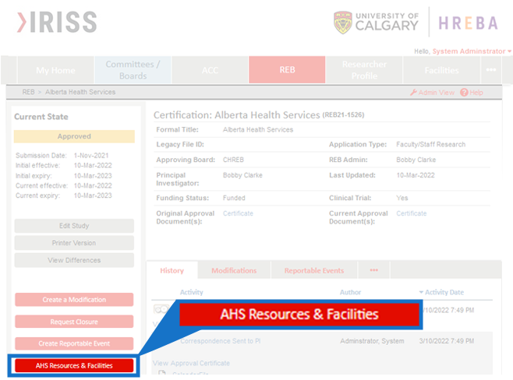
AHS Application – launched in IRISS April 2023
“THE” button

Slide 43
AHS Approval Process

Slide 44
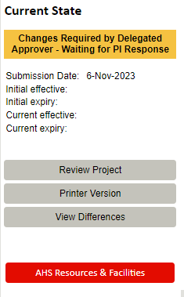
AHS Application
The AHS application process is triggered when you indicate you require AHS services or facilities in your ethics application. (Q2.0 Impacts and Operational Approvals)
The AHS button will appear in your main REB workspace sidebar menu as soon as you indicate AHS resources NOT visible to the REB.
Once initiated, a tab for AHS will appear in your home workspace. Use this tab to access your application

Slide 45
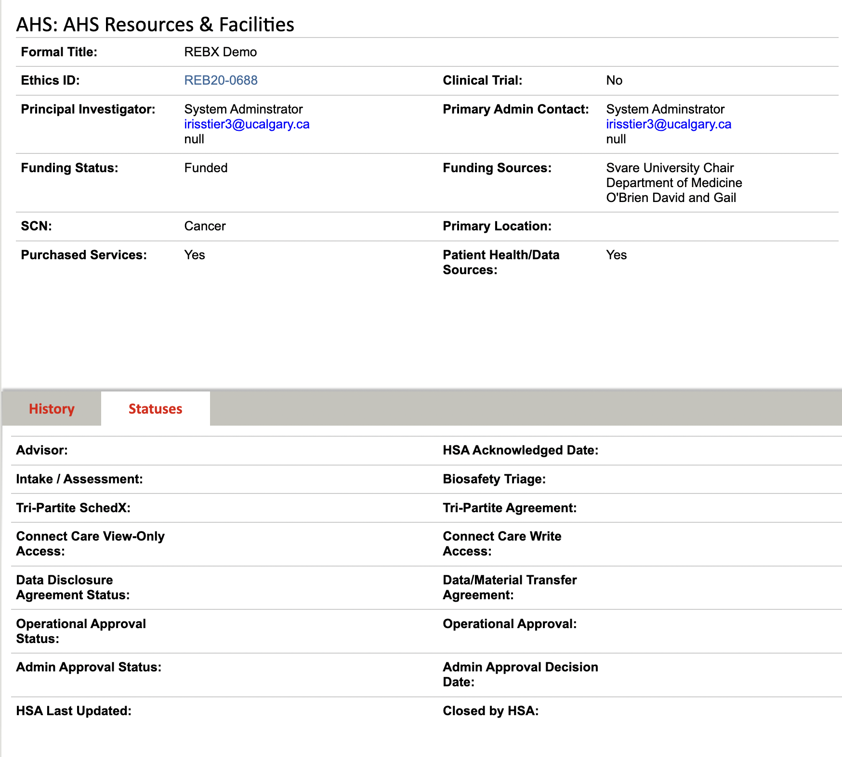
AHS: proven benefits
Data exchange allows for:
Automated system notifications and triggers
Record of submission
Nightly status updates from AHS
Updates to records are reconciled between systems without researcher involvement
Direct communication with AHS within IRISS
Eliminates the duplication of data entry for both administrators (EDGE) and researchers (SharePoint)
Validation of roles for study teams
Automated gates within ENCAPS for administrative approval
Extended dashboard capability
Web page with resources and FAQs to guide users
Tools to manage our business

Slide 46
AHS Module: looking forward
Alberta today:
More leverage to influence AHS and improve health processes ongoing
Alberta tomorrow:
Record of communication between AHS and researchers in IRISS
Better AHS application for non-clinical trials
Better submissions from researchers and processing from AHS
Operational approvals - improve process within facilities
Research Administration Research.Administration@ahs.ca
Iriss.support@ucalgary.ca
ENCAPS

Slide 47
Thank you for attending
chreb@ucalgary.ca
research.ucalgary.ca/iriss
Linda Longpré
Manager, Research Ethics and Compliance
linda.longpre@ucalgary.ca

