Slide 1
How to write a successful research paper
Khorshid Mohammad, MD, FRCPC( Neonatology)

Slide 2
Objectives
To review the specific prep-work required to get started on scientific manuscript writing
To conceptualize and structure the core components of scientific manuscripts including text and tables/figures
To build a transferable, fool-proof recipe for manuscript writing for people with multiple responsibilities (i.e. working parents) and little time

Slide 3
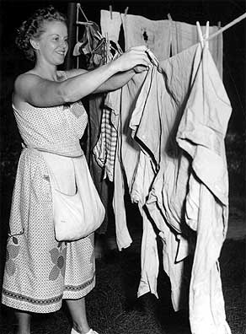
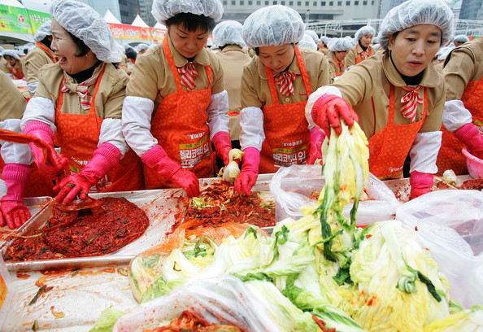
A housewife’s guide to paper writing
Susa Benseler
Section of Rheumatology
Alberta Children’s Hospital

Slide 4
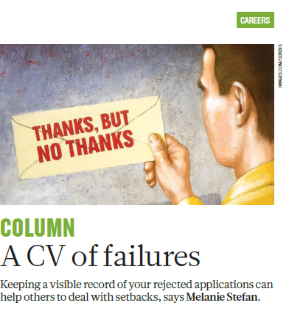
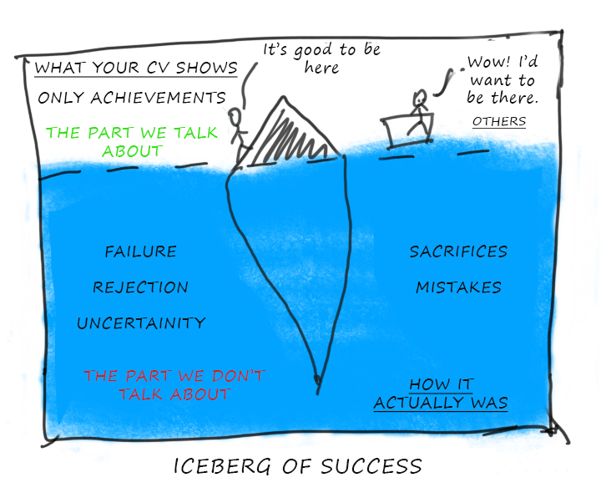
https://images.app.goo.gl/dMpTREm2624TXXo87

Slide 5
Objectives
Skills you need ( how to get your paper published and how to publish more)
What type of research should I do?
Authorship
Where to publish?
Break down of a research manuscript ?
Cover letter ?
Revisions from co-authors and reviewers?

Slide 6
Skills
https://images.app.goo.gl/Dqc1EJRKmUMspi2Q7

Slide 7
To get your paper published
Language
Topic expertise
Network
Statistics
Reference manger
Illustrations, formatting and graphic design

Slide 8
To get involved in more pulications
Language
Topic expertise
Network
Statistics
Reference manger
Illustrations, formatting and graphic design
Don’t fuss on authorship and help as much as you can without asking

Slide 9
What type of research should I do?

Slide 10
Authorship

Slide 11
https://images.app.goo.gl/2hihPAWqF9oHHYHL8

Slide 12
https://journalfinder.elsevier.com/
https://journalfinder.wiley.com/search?type=match
Journal Recommender (sagepub.com)
Taylor & Francis Journal Suggester (taylorandfrancis.com)

Slide 13
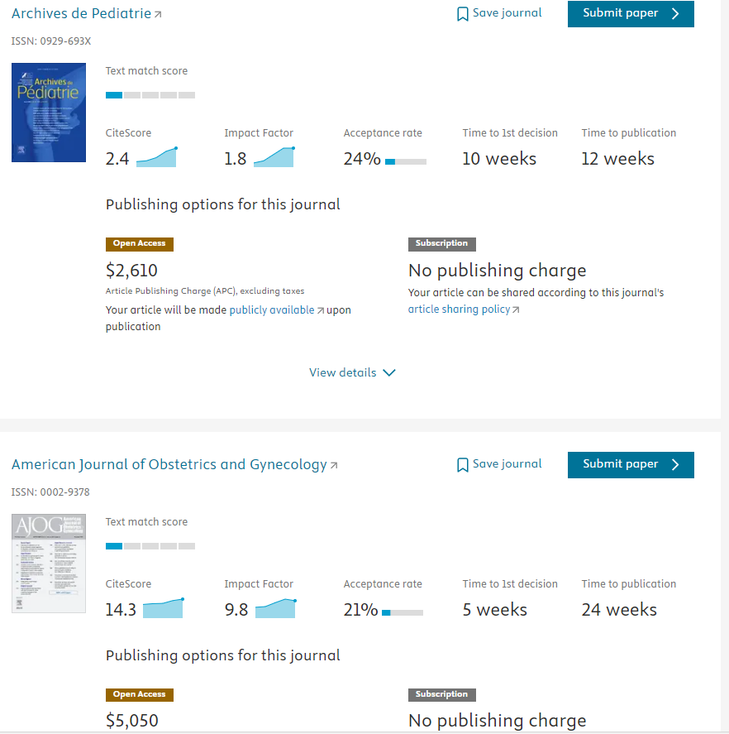

Slide 14
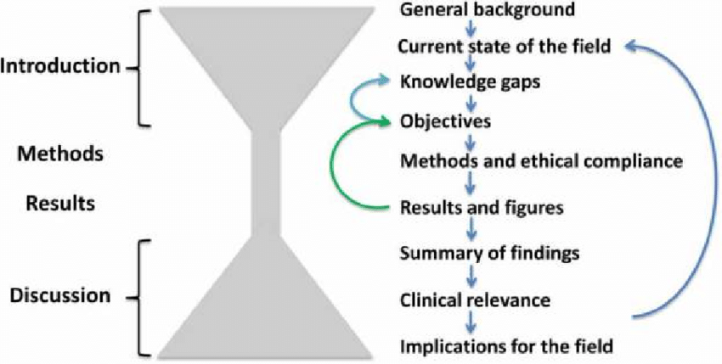
Break down of a research manuscript ?

Slide 15
Cover letter ?
https://images.app.goo.gl/1XZ1WpCtd5mBi9dbA

Slide 16
Revisions

Slide 17
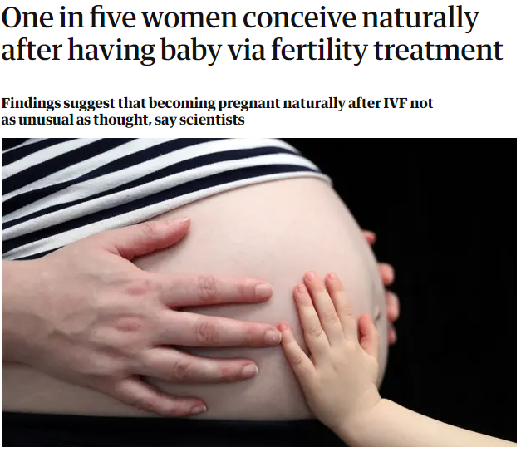
One in five women conceive naturally after having baby via fertility treatment | IVF | The Guardian

