Slide 1
Overview of Study Designs
Janet Aucoin
These lecture notes are based on others developed by Dr. Brent Hagel and myself
October 22, 2024

Slide 2
Learning Objectives
To provide an introduction to the major epidemiologic study designs
To distinguish the characteristics among major epidemiologic study designs

Slide 3

Resources

Slide 4
Understanding Epidemiologic Study Designs
Identification of study designs is a key step in the design and critical appraisal of research
  Bias can commonly be introduced due to study design defects
  Identifying the study design begins the process of thinking through a study’s vulnerability to error
Descriptive v. analytic
  Focus on goals, rather than design features
    Not always clear
  Risky starting point for study design classification.
Experimental vs non-experimental
  Experiment usually implies that the investigator manipulates the exposure assigned to the participants

Slide 5
Major Epidemiologic Study Designs
Descriptive
  Case report
  Case series
Analytic
  Randomized
  Non-Randomized
    Quasi-Experimental
    Cohort (Prospective/Retrospective)
    Case-Control
    Cross-Sectional
    Ecological
Adapted from Koepsell and Weiss. Epidemiologic Methods: Studying the Occurrence of Illness.
Oxford University Press 2003; P. 94

Slide 6
Determining the Study Design
  Is the unit of analysis individual people or groups?
  Is the study observational or interventional?
  Is the directionality forward or backward?
  Is the timing prospective or retrospective?
  Is the exposure randomly assigned?

Slide 7
Descriptive Studies
Undertaken without a specific hypothesis
Can often be viewed as Hypothesis Generating
Among the earliest studies on a new disease
  Characterize disease entity
  Quantify frequency and how it varies in relation to person, place, time

Slide 8
Descriptive Studies
Case reports
  “…careful, detailed report by one or more clinicians of the profile of a single patient.” (Hennekens & Buring. Epidemiology in Medicine. Little Brown and Company, 1987; P. 18)

Slide 9
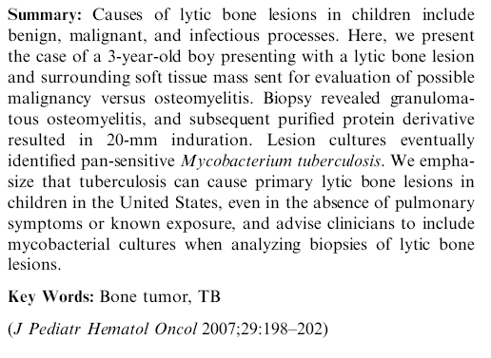

Slide 10
Descriptive Studies
Case series
  Characteristics of a group of individuals with a given clinical outcome

Slide 11
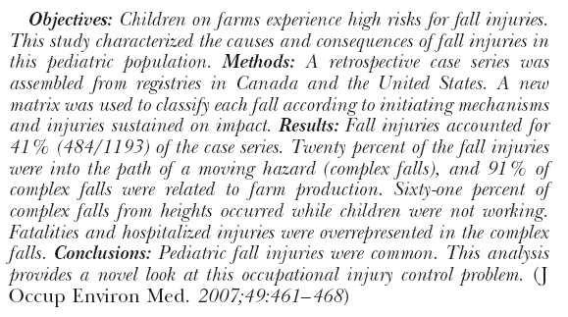
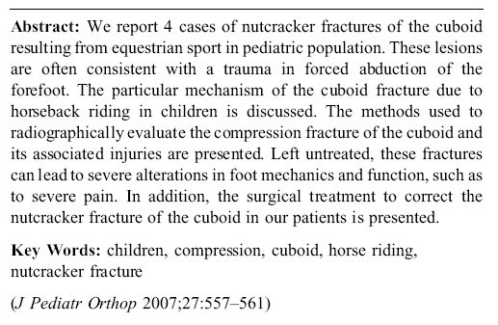

Slide 12
Analytic Studies
Often undertaken to test a hypothesis
Relate a health outcome to a potential determinant
  Genetic
  Environmental
  Behavioural
Does the determinant/exposure cause the outcome?

Slide 13
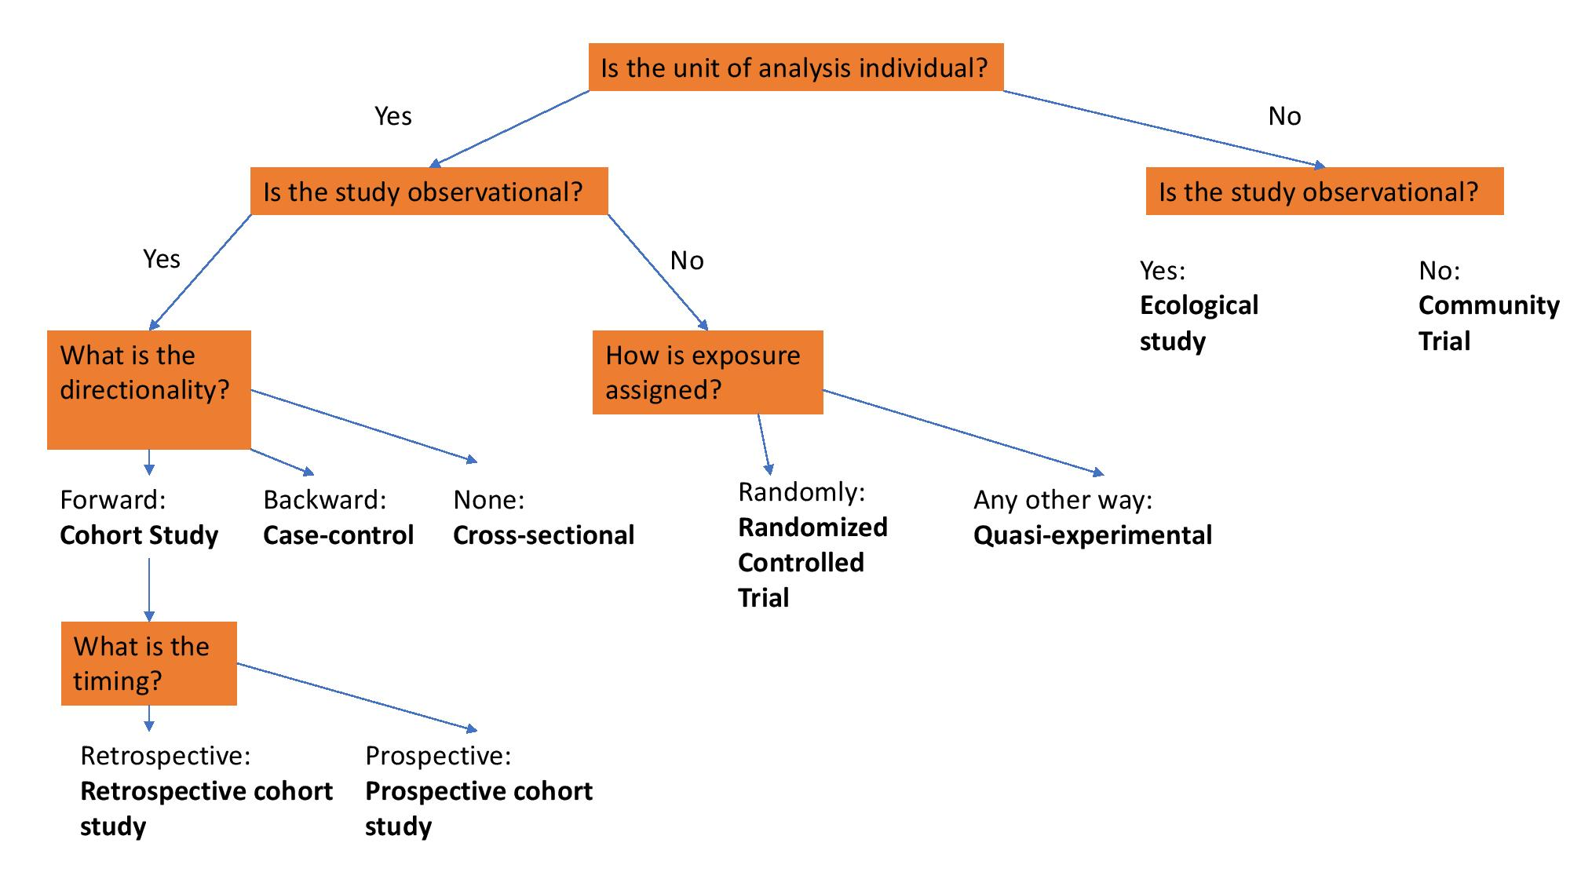
Analytic Studies

Slide 14
Randomized Controlled Trials
Source Population
Eligible
Ineligible
Consent to
Participate
Decline to
Participate
Random Assignment of Exposure
Experimental
Control
Good Outcome
Poor Outcome
Good Outcome
Poor Outcome
From Koepsell and Weiss. Epidemiologic Methods: Studying the Occurrence of Illness.
Oxford University Press 2003; P. 94

Slide 15
A Randomized Controlled Trial of Home Injury Hazard Reduction: The HOME Injury Study
Kieran J. Phelan, MD, MS; Jane Khoury, PhD; Yingying Xu, MS; et al
Abstract
Objective To test the efficacy of installing safety devices in the homes of young children on total injury rates and on injuries deemed a priori modifiable by the installation of these devices.
Design A nested, prospective, randomized controlled trial.
Setting Indoor environment of housing units.
Participants Mothers and their children from birth to 3 years old participating in the Home Observation and Measures of the Environment study. Among 8878 prenatal patients, 1263 (14.2%) were eligible, 413 (32.7%) agreed to participate, and 355 were randomly assigned to the intervention (n = 181) or control (n = 174) groups.
Intervention Installation of multiple passive measures (eg, stair gates, cabinet locks, and smoke detectors) to reduce exposure to injury hazards. Injury hazards were assessed at home visits by teams of trained research assistants using a validated survey.
Main Outcome Measure Modifiable and medically attended injury (ie, telephone calls, office visits, and emergency visits for injury).
Arch Pediatr Adolesc Med. 2011;165(4):339-345. doi:10.1001/archpediatrics.2011.29

Slide 16
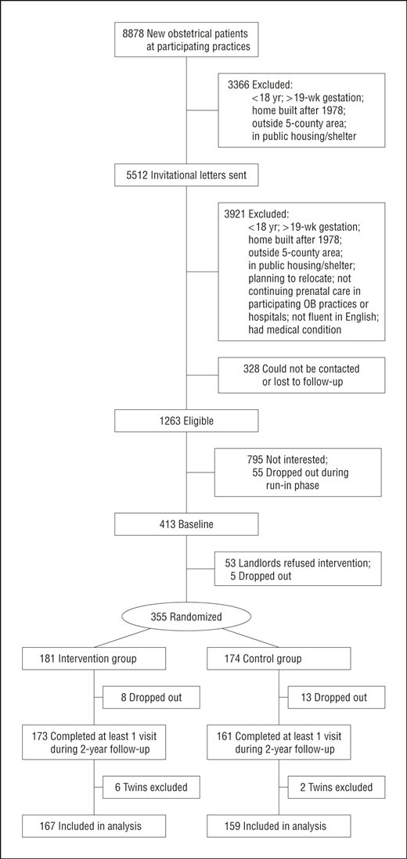
Results The mean age of children at intervention was 6.3 months. Injury hazards were reduced in the intervention homes but not in the control homes at 1 and 2 years (P < .004). There was no difference in the rate for all medically attended injuries in intervention children compared with controls: 14.3 injuries (95% confidence interval [CI], 9.7-21.1 injuries) vs 20.8 injuries (95% CI, 14.4-29.9 injuries) per 100 child-years (P = .17); but there was a significant reduction in the rate of modifiable medically attended injuries in intervention children compared with controls: 2.3 injuries (95% CI, 1.0-5.5 injuries) vs 7.7 injuries (95% CI, 4.2-14.2 injuries) per 100 child-years (P = .03).
Conclusion An intervention to reduce exposure to hazards in homes led to a 70% reduction in the rate of modifiable medically attended injury.
Arch Pediatr Adolesc Med. 2011;165(4):339-345. doi:10.1001/archpediatrics.2011.29

Slide 17
Non-Randomized Studies
Quasi Experimental
Cohort
  Retrospective
  Prospective
Case-control
Cross-sectional
Ecological

Slide 18
Quasi-Experimental
Source Population
Eligible
Ineligible
Consent to
Participate
Decline to
Participate
Non-Random Assignment of Exposure
Experimental
Control
Good Outcome
Poor Outcome
Good Outcome
Poor Outcome
Adapted from Koepsell and Weiss. Epidemiologic Methods: Studying the Occurrence of Illness.
Oxford University Press 2003; P. 94

Slide 20
Cohort Study
Study groups defined in terms of exposure and followed to determine frequency of outcome
Prospective or concurrent Cohort Study
Retrospective or historical Cohort Study
Studies can have both prospective and retrospective components
Exposure
Disease
?
?
Study Begins
Exposure
Disease
?
?
Study Begins
From Hennekens & Buring. Epidemiology in Medicine. Little Brown and Company, 1987; P. 24

Slide 21
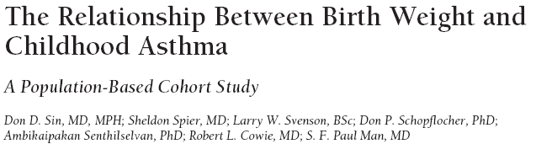
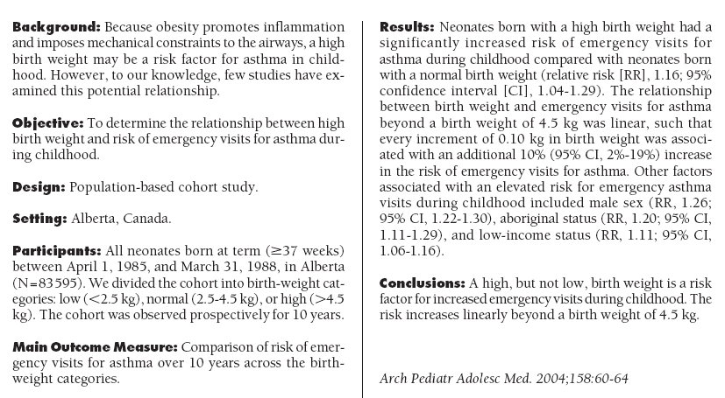

Slide 22
Case-control Studies
Subjects are selected on outcome status (disease / no disease)
Look back to determine exposure status
There can be prospective data collection in a case-control study
Exposure
Disease
?
Time
?
Study Begins
From Hennekens & Buring. Epidemiology in Medicine. Little Brown and Company, 1987; P. 24

Slide 23
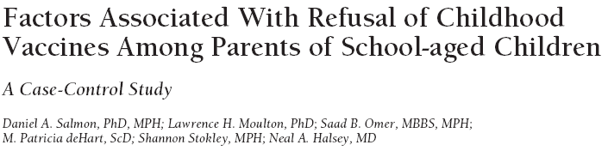
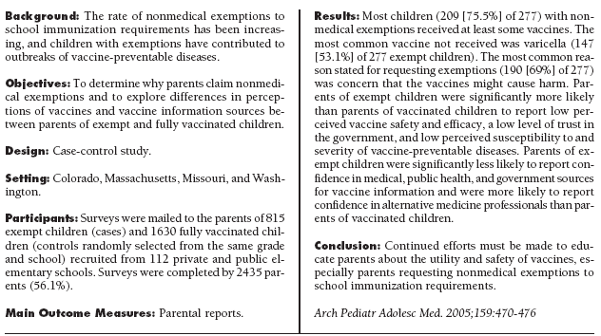

Slide 24
Case-Control Study
Exposure
Outcome
?
?
Prospective Cohort Study
Exposure
Outcome
?
?
Retrospective Cohort Study
Exposure
Outcome
?
?
Adapted from Hennekens & Buring. Epidemiology in Medicine. 1987
Notes:
-Filled dot is presence, open dot is absence - indicate the basis for which the groups are selected at beginning of study
-? Is parameter to be determined
-Smile is the investigator at the beginning of the study

Slide 25
Cross-sectional Study
Outcome and exposure status determined at same point in time
Participants selected without knowledge of exposure or outcome status
Outcome
Time
Exposure
From Koepsell and Weiss. Epidemiologic Methods: Studying the Occurrence of Illness.
Oxford University Press 2003; P. 94

Slide 26
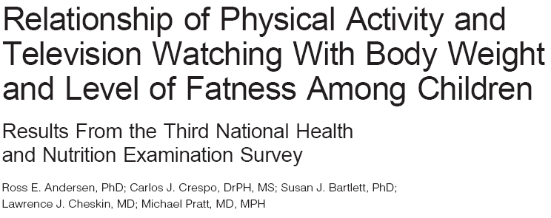
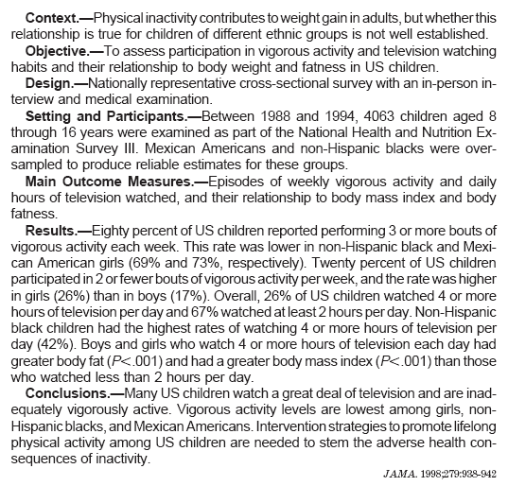

Slide 27
Ecological Study
Data from entire populations compared for outcome frequency
Joint distribution of exposure and disease not available

Slide 28
Ecological (correlation) Study
Figure. Suicide rate (Y, 10⁵/year) by proportion Protestant (X) for four groups of Prussian provinces, 1883-1890.
Morgenstern. “Ecologic Studies”, in Rothman and Greenland: Modern Epidemiology 1998, p. 467
Adapted from Durkheim E. Suicide: a Study in Sociology. New York: Free Press, 1951.

Slide 29
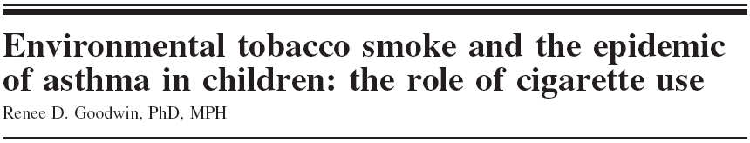
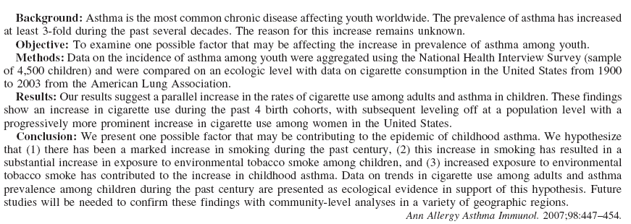

Slide 30
In-class Assignment
Assign one of the study designs outlined in class to each study description

Slide 31
Investigators are interested in the relationship between diet and heart disease. They obtain data from a number of countries on the average annual meat intake as well as each country’s administrative data on deaths from heart disease.
The relationship between alcohol consumption and the risk of injury is studied using data from the emergency department. The blood alcohol level of individuals who have an injury is determined. The investigators select a random sample of patients who do not have an injury, but are in the ED for another reason and, in turn, measure their BAC. The investigators then compare the prevalence of high vs. low BAC in the injured and uninjured group.
A number of soccer teams were assigned at random to receive a pre-season training program incorporating the use of a wobble board to increase balance and proprioception. The remaining teams received a standard pre-season fitness program. The rate of injuries in the wobble board group was compared with the standard fitness training group.

Slide 32
Investigators enrol a group of ice hockey athletes at the start of the season to determine what effect wearing a mouth guard has on dental injuries. At the end of the regular season, the rate of dental injuries in the mouth guard group is compared with the rate in the no mouth guard group.
Investigators select all patients presenting to an Emergency Department with a skiing injury and describe their characteristics and the type and nature of the injuries.
Investigators are interested in the relationship between obesity and asthma. They randomly call people and ask those with children if the child has asthma and the age, height and weight of the child.

Slide 33
In a study that began in 1965, a group of 5,000 adults in New York were asked about alcohol consumption. The occurrence of cancer was studied in this group between 1981 and 1995.
The personnel records from a number of insulation manufacturing plants were obtained for the period 1970-1975. During this time period, the number of lung cancer deaths was compared between this group of employees and a comparable group of employees not exposed to insulation manufacturing.

