Slide 1
Clinical Research Module: Introductory statistics
Lecture 1B
Gerry Giesbrecht, PhD, RPsych
These lecture notes based on others developed by Drs. Alberto Nettel-Aguirre, Peter Faris, Sarah Rose Luz Palacios-Derflingher and myself

Slide 2
Material Covered in this Lecture
Lecture 1B- Inference
—The logic and use of statistics
—Sampling Distributions
  The normal distribution
  Confidence intervals
—Estimation and Hypothesis testing
  Difference of Means
—Power and Sample Size

Slide 3
Lies, damn lies, and statistics
Statistics rely on assumptions and only provide approximate truths about the things that we really want to know about.
And that doesn’t even get into the quality of your data, their representativeness…

Slide 4
So why bother?
Because the alternatives are worse.
Because clinical wisdom/intuition is susceptible to chance and confirmation bias.
Because if we let the data speak, we will make new discoveries.
Because statistics help to separate the signal from the noise.

Slide 5
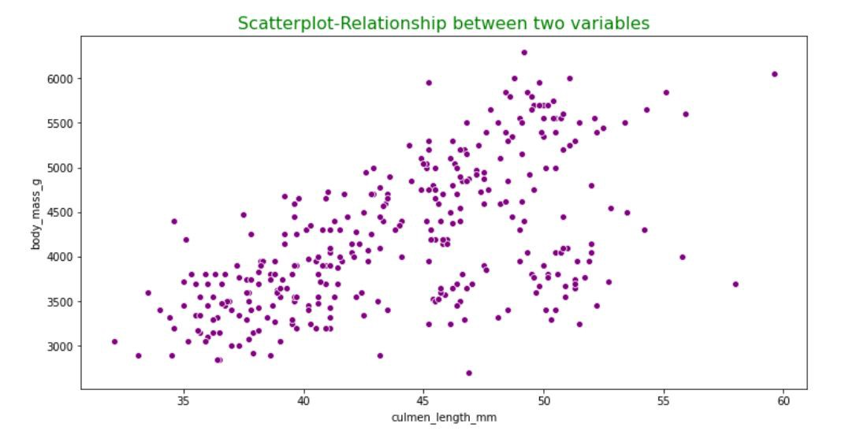
Example
Notes:
Here’s an example of a figure on the relation between body mass and culmen length in birds. Just by looking at it, you can somewhat see a positive relationship.
Culmen is the upper part of a bird’s beak.

Slide 6
Example
Notes:
But statistics help us see what we might otherwise not notice, which is that there are very different relations between body mass and culmen length in 2 different groups of birds. One group has a strongly positive relationship and the other has essentially no relationship.

Slide 7
Statistics make knowledge feasible
Most of what we want to know, is (practically) unknowable.
  E.g., what proportion of people who smoke for at least 2 years die of lung cancer?
Obtaining a sample of smokers and calculating the portion who die of lung cancer is feasible.
Notes:
It is not possible to obtain the records of every person who has smoked for at least 2 years. Obtaining a sample is feasible, but I’m not going to get into the challenges of selecting the right sample. That’s a different lecture.

Slide 8

Example Results
Int J Pediatr Endocrinol 2011 Nov 8;2011(1):15.
…No significant differences were seen in the mean HbA1c between control and intervention at 0 months [8.48(0.86) vs 8.57(1.13)], F(1, 209) = 1.67, p = 0.43 ….
J Bone Joint Surg Am. 2012 Oct 17;94(20):1853-60.
…at six weeks, the children who were allowed to bear weight as tolerated had better overall scores (95% CI = 2.34, 4.33) and better standing skills (95% CI = 7.29, 8.89) than those who were initially instructed to be non-weight-bearing
Jacob Cohen: The earth is round p < .05.
Notes:
Here are some example results that you might read in a manuscript on a topic that is related to your clinical practice.
One of the goals of today’s lecture is to help you understand what statements like these mean and what they don’t mean.

Slide 9
The bottom line…
The two most important things to understand from the first part of this lecture:
What is the best estimate for an effect (i.e., the point estimate)
How much error is in the estimate (i.e., the confidence interval)
Notes:
What we are going to do next is dive into some statistical theory to give you a background on 2 things that you should understand. The two things are pretty simple: they are the best estimate of an effect, and the confidence that we have in that effect.

Slide 10
Material Covered in the Biostatistics
Lectures
Lecture 1B- Inference
—The logic and use of statistics
—Sampling Distributions
  The normal distribution
  Confidence intervals
—Estimation and Hypothesis testing
  Difference of Means
—Power and Sample Size

Slide 11
Theoretical concepts
This might get a bit theoretical…
To understand statistics, we need to understand how the data we collect and the numbers we generate using statistics help us make sense of what is going on.
This requires some theory and theoretical concepts.
Notes:
Today I’m only able to provide you an introduction to statistical testing, not a ‘how to’ of methods. I’m going to give lots of practical examples, but first we need to understand the concept of what we are trying to do.

Slide 12
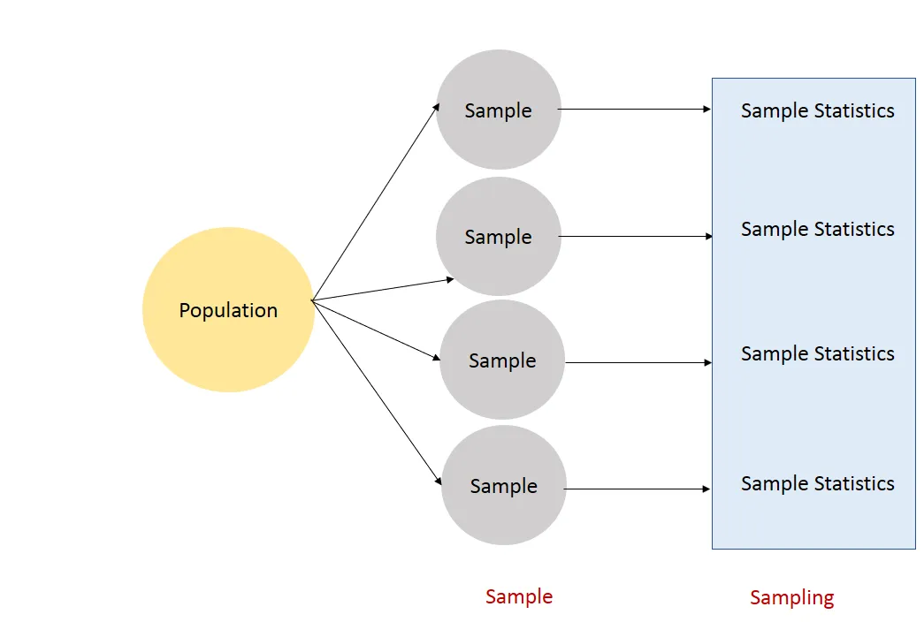
Sampling Distributions
For any estimate, the sampling distribution is the distribution of that estimate calculated for all possible samples of size n drawn from a population.
Notes:
For any estimate of a population parameter, for example the average height of men, the sampling distribution is a theoretical construct that is composed of all the estimates calculated for all possible sample of size n (lets say for argument 100) drawn from a population.

Slide 13
Sampling Distributions (example)
For any estimate, the sampling distribution is the distribution of that estimate calculated for all possible samples of size n drawn from a population.
176 cm
Adult Males
N = 100
230 cm
N = 100
114 cm
N = 100
176 cm
N = 100
Notes:
For any estimate of a population parameter, for example the average height of men, the sampling distribution is a theoretical construct that is composed of all the estimates calculated for all possible sample of size n (lets say for argument 100) drawn from a population.

Slide 14
Sampling Distributions (example)
For any estimate, the sampling distribution is the distribution of that estimate calculated for all possible samples of size n drawn from a population.
Your study
176 cm
Adult Males
N = 100
230 cm
N = 100
114 cm
N = 100
176 cm
N = 100
Notes:
I want to make a clear distinction between what you will do in your study, and the logic and theory that will allow you to make an interference about the data that you obtain in your study.
You will collect one sample, the remainder of the samples are theoretical.

Slide 15
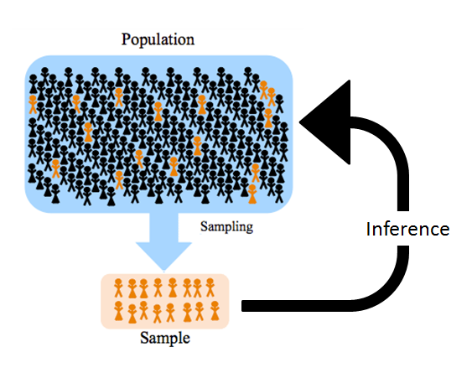
Sampling Distributions
Sampling distributions can be used to make inferences about the true parameter of a population
Notes:
Because measuring a variable in an entire population is not tractable, we solve this problem by taking a sample and making inferences about the true value of that variable in the population.

Slide 16
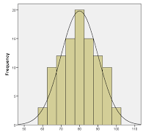
Sampling Distributions
If you repeatedly take samples from a population, you will get a variety of different means, but some will be repeated.
Adult Males
N = 100
176 cm
230 cm
N = 100
114 cm
N = 100
176 cm
N = 100
Notes:
Because height in men within the population is quite variable from person to person, if we measure a group of 100 men, the mean of that group will differ somewhat from another group of 100 men that we could have sampled.

Slide 17
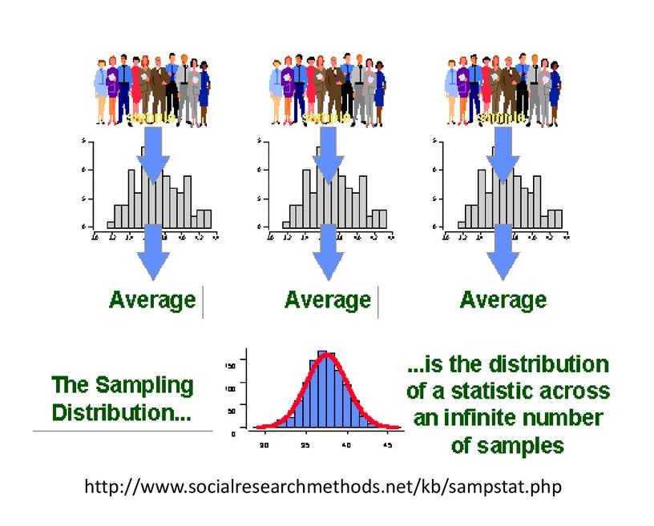
Sampling Distributions
If we repeatedly calculate the mean of randomly drawn samples from a population, and then collect them all together, we get a sampling distribution, which we can use to estimate the population mean.
Notes:
The means from each individual sample now become the ‘data’ that contribute to our sampling distribution.

Slide 18
Sampling Distributions
You might be wondering, how will we know where the mean we collected falls within the sampling distribution?
Notes:
The individual sample mean that we collected is probably not going to be identical to the population mean. In other words, there will be some error between our sample mean and the population mean. The red arrow depicts the error difference between our sample mean and the true population mean. We can calculate this error for every possible sample mean and use that error to help us estimate the population mean. But first we need to understand some very useful properties of sampling distributions.

Slide 19
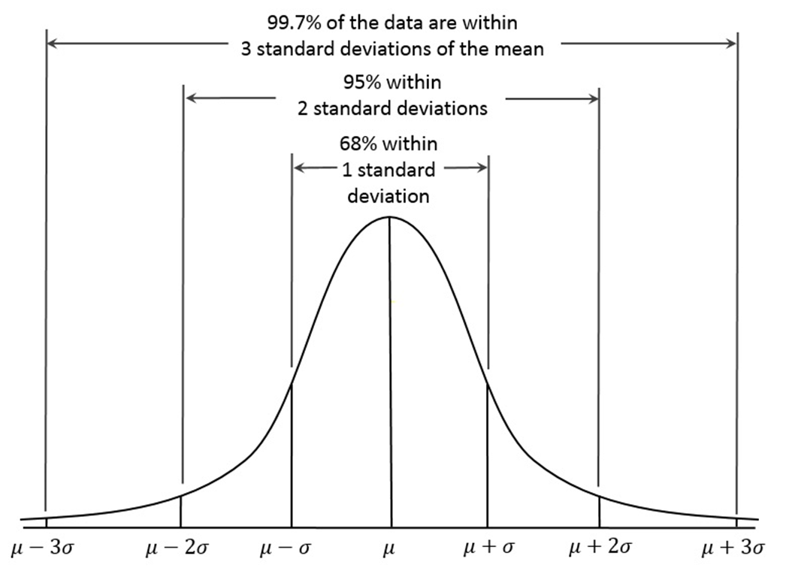
The sampling distribution is ‘normal’
The normal distribution
  Central limit theorem: Means of random variables tend to be normally distributed.
  As the number of observations in sample approaches infinity, sampling distribution of the mean will approach the normal distribution.
  Great, but what does ‘normal’ mean?
Notes:
It turns out that sampling distributions have some very useful properties that we can exploit.
The bell-shaped figure on the right is what we mean by the normal distribution.

Slide 20
N = 1; ◻ = 22.3; SE = 21
Original data, μ=22.2
n= 5; μ = 22.3; SE = 9.6
2500
500
0
0 20 40 60 80
X
2000 3000
Frequency
1000
0
0
50 100 150 200
X
n= 30; μ = 22.2; SE = 4.7
500
0
10 15 20 25 30 35 40 45
X
n= 100; μ = 22.2; SE = 2 .1
1000
500
0
15 20 25 30
X
Notes:
We can use an example to illustrate the normal distribution.
For the purpose of this illustration, lets imagine that what we are measuring here is antibodies to the SARS CoV 2 virus.
What you see here is a frequency distribution of raw data. You see that the most frequent observation is actually zero, and this is a very skewed distribution.
In the next panel is a sampling distribution of means randomly drawn in groups of 5 from the original population. Notice that the mean of 22.3 is almost identical to the actual population mean of 22.2.
Even with very small sample sizes, we can accurately estimate the population mean. When we use samples of size 30 or 100, we get a normal distribution of the means and a very accurate estimate of the true population mean.
This has been referred to as the law of large numbers. The means of samples will tend to be normally distributed even if the population that it is sampled from is not normally distributed.

Slide 21
Sampling Distributions
Implication:
So we know that we can pretty accurately estimate a population parameter using a sample, as long as the sample is ‘big enough’
Practical Application:
Larger sample sizes help you accurately estimate what is going on in the population.
What is ‘big enough’? In theory, about 30 should get you there, but in practice 100 is generally considered big enough.

Slide 22
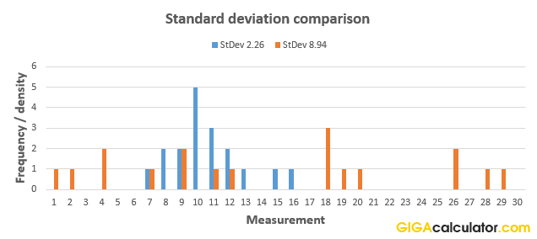
Estimating Error
We can calculate the variability within our sample by adding up the differences between the individual values and the sample mean. This is called the standard deviation.
Notes:
In order to exploit our normal distribution, we need to understand the concept of error.
The red dashed line illustrates the mean. The red arrows represents individual deviations from the mean. If we add up all the differences, and divide by the number of people in our sample (in other words we calculate a mean of the deviations), then we get a standard deviation.

Slide 23
Estimating Error
We can also calculate the variability within our sampling distribution. That is, we calculate all the deviations of the sample means from the population mean. This is called the standard error.
Notes:
In order to exploit our normal distribution, we need to understand the concept of error.
The red arrow again represents the difference between our mean and the population mean. If we add up all the differences, and divide by the number of sample means that we collected, then we get a standard deviation.

Slide 24
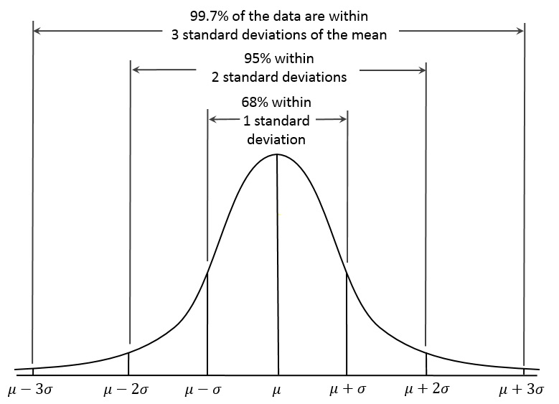
Standard Error
The standard error of the mean (SE) is the standard deviation of these sample means
Sampling distributions can be used to make inferences about the true mean of a population
Notes:
The error, or difference between all the sample means and the population mean, depicted here by mu, has some very predictable properties. For example, if our sample size is about 30 or more, then we can expect a normal distribution, and about 68% of the sample means will fall within 1 standard deviation of the mean. 95% of the samples will fall within 2 SD of the mean. This is where the concept of the 95% CI come from.

Slide 25
Inferences about the mean
Usually standard deviation of population unknown
Use SD of sample (S) as estimate of population’s
With sample S, estimate the SE as SE = SD / √n
As n increases SE decreases
This means that if we use our sample mean as an estimate of the population mean, our estimate will be more accurate as our sample size increases

Slide 26
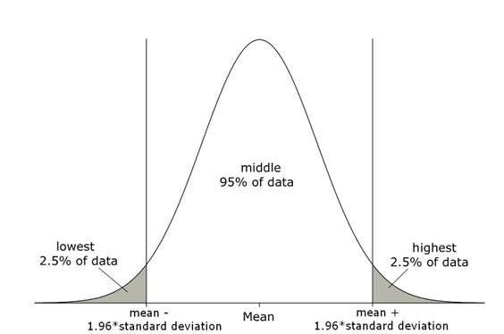
Confidence Intervals
Given the normal sampling distribution of the means, 95% of sample means will fall within
1.96 standard errors of the sample mean.
Because there is error in our estimate of the mean, we can use the normal distribution to create a confidence interval.
Notes:
So here we are going to put some of the concepts we been talking about together so that we can use them.
It turns out that we can also apply the concepts of sample distribution and error to our sample, which is very useful because typically we only have our sample, not the entire population of data.

Slide 27
Confidence Intervals
Example: A researcher reports a mean systolic blood pressure of 129 with a 95% confidence interval of [125 - 133]. What does this mean?
Because of the properties of the normal distribution, we are confident that the true mean systolic blood pressure is between 125 and 133.
In fact, there is only a 5% chance that our CI does not contain the true population mean.
Confidence intervals give a sense of the precision of the estimate.
  Wide confidence intervals indicate a less precise estimate than narrow CIs.
How did we obtain the CI?
  We used the SD of our sample to estimate the SE of the population.
  We multiplied the SE by 1.96 (95% interval)
  We added this ‘error’ (= 4 in this case) to the mean.

Slide 28
Confidence Intervals
Example: A researcher reports a mean systolic blood pressure of 129 with a 95% confidence interval of [125 - 133]. What does this mean?
How did we obtain the CI?
  We used the SD of our sample to estimate the SE of the population.
    SE = 20/ √ 100 = 2
  We multiplied the SE by 1.96 (95% interval)
    2*1.96 = ~4
  We added this ‘error’ to the mean.
    129+4 = 133; 129-4=125

Slide 29
Material Covered in the Biostatistics
Lectures
Lecture 1B- Inference
—The logic and use of statistics
—Sampling Distributions
  The normal distribution
  Confidence intervals
—Estimation and Hypothesis testing
  Difference of Means
—Power and Sample Size

Slide 30
Hypothesis Testing: Difference in means
Interested in comparisons between groups or associations among variables.
  Does the BP of 2 groups actually differ?
  Is folate really associated with neural tube defects?
Humans vary in their response to treatments, exposures etc.
How do we know that observed effects can be
attributed to the “treatment” or “grouping”?

Slide 31
Hypothesis Testing: Difference in means
When comparing two measures of interest (e.g. means), we compare the observed difference in these to the distribution of differences we would expect to occur under the assumptions of null hypothesis.
H₀ : We refer to the hypothesis of no difference or no effect as the null hypothesis.
H_{A} : We specify an alternative hypothesis.

Slide 32
Example-Two independent groups
Researchers want to compare the 24-hour total energy intake in two populations using two samples: lean and obese people
Let μ_{L} = mean energy intake for the population of lean people
Let μ_{O}= mean energy intake for the population of obese people
H₀: μ_{L} = μ_{O}
H_{A}: μ_{L} ≠ μ_{O}

Slide 33
Hypothesis tests
Most of the tests we will see in this course will have the form of:
_{test statistic =} Observed − hypothesized
standard error of observed
“observed” comes from sample, x, (sample mean), or differences of means between groups.
“Standard error of the observed” will take different formulations but will still refer to variability in the estimation of the parameter of interest.

Slide 34
Hypothesis tests
Most of the tests we will see in this course will have the form of:
_{test statistic =} Observed − hypothesized
standard error of observed
“hypothesized” – here we are going to do a little trick to make the problem tractable.
By making the null our hypothesized result, it is by definition zero, and we can drop this part of the equation.
_{test statistic =} Observed
standard error of observed

Slide 35

t-tests cont…
Because we don’t know the population standard deviation (the standard error), we estimate the population standard deviation using data from the sample.
Notes:
We don’t have a sampling distribution because we only have our one sample. Remember, what we are getting here is just an estimate of how much, on average, each sample in our sampling distribution differs from the population mean.

Slide 36
Example: 24h energy expenditure
24 hour total energy expenditure (MJ/day) in groups of lean and obese people (Prentice et al, 1986)
 | Lean (n=13) | Obese (n=9)
 | 6.13 | 8.79
 | 7.05 | 9.19
 | 7.48 | 9.21
 | 7.48 | 9.68
 | 7.53 | 9.69
 | 7.58 | 9.97
 | 7.90 | 11.51
 | 8.08 | 11.85
 | 8.09 | 12.79
 | 8.11
 | 8.40
 | 10.15
 | 10.88
Mean | 8.07 | 10.30
SD | 1.24 | 1.40
Data from Altman, 1995, Practical Statistics for Medical Research, Table 9.4, p. 193
Notes:
Getting back to our example of energy expenditure in lean and obese people, here is our data table, with sample size, mean and our SD.
We can actually see that the means are different from each other, but the question is whether these differences are real or not.

Slide 37
Independent groups t-test
H₀: True mean of Lean (μ_{L}) = True mean of obese (μ_{O} )
H_{A}: True mean of Lean (μ_{L}) ≠ True mean of
obese (μ_{O} )
₌ Observed difference − Hypothesized difference
t
(n_{O} +n _{L} −2)
Error
Observed difference: 10.3 - 8.07 = 2.23
Hypothesized difference: 0
Standard Error = 0.5656 (pooled from the 2 samples)
t = 2.23 – 0/0.5656 = = 3.94
Compare our obtained value of t to the critical value of t (the value of t associated with our alpha level (two-tailed)).
Notes:
At the bottom you see the formula, which seems complicated, but the first thing we are going to do is toss some things out because our hypothsized difference is zero, so we can lose part of our numerator. The rest is very simple math.

Slide 38
t-tests cont…
We can then use the t-distribution to make inferences about differences between our sample means.

Slide 39
Independent groups t-test (cont)
Values above 2.086 are unlikely in the t distribution when there are 20 df.
Conclusion: Reject the null hypothesis of no difference in energy expenditure. Instead, we believe there is evidence to suggest a difference in the 24-hour total energy expenditure between lean and obese people.
There is less than 5% chance that we would have obtained this difference in energy expenditure if there were no differences between lean and obese people.
0.4
0.3
Rejection region
Rejection
region
0.2
0.0
-4
-2.086
-2
0
2
2.086
4
t-values
3.94

Slide 40
Confidence Limits
Point estimates are great (simple) but you should always report the range of estimates that are plausible, given your data.
This requires creating a confidence interval (CI).
95% CI = sample mean_{O}– sample mean_{L} ± (t_{(critical)}*SE_{difference})
  For a 95% CI the critical value is 2.086
  The mean difference between groups is 2.23
  The SE of the difference is 0.5656
2.23 ± 2.086*0.5656
95% CI is 1.05 to 3.41

Slide 41
Confidence Limits
Interpretation: The likely range of the true difference in population can be as small as
1.05 or as big as 3.41.
That is, that the mean for obese is at least 1.05 units larger and up to 3.41 units larger
Relationship between statistical test at alpha level of 5% and 95% confidence interval
  A CI that includes 0 has a p-value > 0.05
Notes:
The CI helps us think about clinical significance. Are you concerned if the true population value is as small as 1.05? At what point would you become concerned?

Slide 42
Advice
You aren’t expected to know a lot of detail about statistical tests.
Familiarize yourself with the basics of hypothesis testing…this will be very helpful for your understanding of literature and a bit of effort will serve you well in the future.
If you have a significant p value – you reject the null, which means that there is reason to doubt that the true effect is zero.
If you have a non-significant p value – you fail to reject the null, which means that you cannot distinguish the effect from zero
Report confidence intervals!

Slide 43
Material Covered in the Biostatistics
Lectures
Lecture 1B- Inference
—The logic and use of statistics
—Sampling Distributions
  The normal distribution
—Estimation and Hypothesis testing
  Confidence intervals
  Difference of Means
  Types of error
—Power and Sample Size

Slide 44
Statistical Power
Statistical power (1-beta) is the probability of rejecting the null hypothesis when it is false in the population
— (i.e. it is the probability of correctly concluding there is evidence of a difference).
Studies with small sample sizes may not have adequate power to detect clinically meaningful effects.
  These studies are sometimes referred to as being underpowered.
  What is the difference between clinical and statistical significance?

Slide 45
Sample Size/Power Calculations:
—Background: What are they and why do them?
—Typically we are interested in calculating a sample size for a study that is ‘adequately powered’.
- Adequate is usually defined as at least 80%.

Slide 46
Sample Size Estimates: Inference
Inference
  In research, can’t measure everyone.
  Make inferences on “true” or underlying characteristics of a population on the basis of data collected from a sample.
  The more subjects measured, the more accurate our estimates will be. (bias?)
  Measure too many, waste resources.
  Measure too few, won’t be able to detect effects of interest.
  But how many patients?

Slide 47
How Many Subjects?
This depends on several things
  The kind of statistical tests to be used.
  Choice of study design.
  The variability of the values in the population.
  The alpha level (probability of concluding that there is an effect or difference, when in truth, there is no effect).
  The statistical power (the probability that we will conclude there is an effect, given that the true effect is of a given size).
  The magnitude of the hypothesized effect. (e.g. What is a clinically relevant difference in means?)
  The number of drop-outs or non-responders.

Slide 48
Hypothesis based estimates cont…
Power can only be specified for explicit alternative hypotheses
e.g. H_{A}: μ₁ = 90; μ₂ =110, or alternatively H_{A}: μ₂ - μ₁ = 20
For hypothesis-based sample size calculations, have to state the size of the treatment effect that we wish to be able to detect.
This difference is usually taken to be one that has clinical relevance.
— (i.e. what is the smallest difference that would be considered clinically meaningful?).
Notes:
In this example, imagine that 20 represents a clinically meaningful difference between groups in BP.
Whether or not 20 is clinically meaningful depends on consensus among clinicians.

Slide 49
Example: Comparing Means
Researchers would like to do a clinical trial comparing methods of treating dorsal wrist pain. Treatments will be typical physiotherapy (control group) vs physiotherapy plus shock wave therapy (treatment group).
They will use the PRWE, a validated measure with a maximum score of 100, to evaluate pain and function.
Their outcome will be the change in the PRWE from the pre-treatment baseline score to the 6- month follow-up score.

Slide 50
What do we need for calculations?
Variability of the outcome: Because they are studying change in PRWE, they need to know the variability of 6-month changes in the PRWE.
From the medical literature and correspondence with the developer of the PRWE, they established that the range of the SD of the differences was between 17 and 22.
Clinically relevant improvement: Based on other studies, the researchers propose that a clinically relevant difference in change would be 20 points.
Alpha Level: 0.05
Power: 80%
Dropout rates: They anticipate a 10% dropout rate in each group.
Sample size calculators:
— http://www.cs.uiowa.edu/~rlenth/Power/

Slide 51


0 Russ Lenth's power and sample-size page - Mozilla Firefox
Eile !;_dit iew §.o ookmarks Iools t:J.elp
[RJ
Go Ila
tt : www,cs,uiowa, edu ~rlenth Power
Calgary Health Region [] iweb [] Science Grid This Week
Note: This software was recently revised, and apparently some users are having trouble with it running properly. If that happens to you, here is a link to the old version If you do have problems, I'd appreciate your reporting to me (russell-lenth@uiowa edu) the following information: (1) which web browser you use and its version number; (2) what version ofJ ava you have installed.. One way to get the latter is to get to a terminal window (e.g. in Windows, [Start] I [Run...] "cmd"), and type the command j ava -version . Thank you
lliit.,_ Java applets for power and sample size
 | This software is intended to be useful in planning statistical studies. It is not intended to be used for analysis of data that have already been collected. Each selection provides a graphical interface for studying the power of one or more tests. They include sliders (convertible to number-entry fields) for varying parameters, and a simple provision for graphing one variable against another. Each dialog window also offers a Help menu Please read the Help menus before contacting me with questions. The "Balanced ANOVA" selection provides another dialog with a list of several popular experimental designs, plus a provision for specifying your own model. Note: The dialogs open in separate windows. If you're running this on an Apple Macintosh, the applets' menus are added to the screen menubar -- so, for example, you'll have two "Help" menus there! You may also download this software to run it on your own PC.
Sele ct the analysis to he use cl in your study:
Cl for one proportion Test of one proportion Test comparing two proportions Cl for one mean One-sample t test (or paired t) Two-sample t test (pooled or Satterthwaite) Linear regression Balanced ANOVA (any model) R-square (multiple correlation) Generic chi-square test Generic Poisson test Pilot study
 | I Run selection I
Note: These require a web browser capable of running Java applets (version 1.1 or higher). If you do not see a selection list above, chances are that you either have disabled Java, your
Applet rvl.piface,apps,PiPicker started
v
t rt
I oi\MIU"fCU\t'.1'11 \f">IU.,. I ·a EN •<)
-
,. . .. - . - 4
L" cur"-"-nn,_," c,.,. - Russ Lenths power a.. ,
11:22

Slide 52
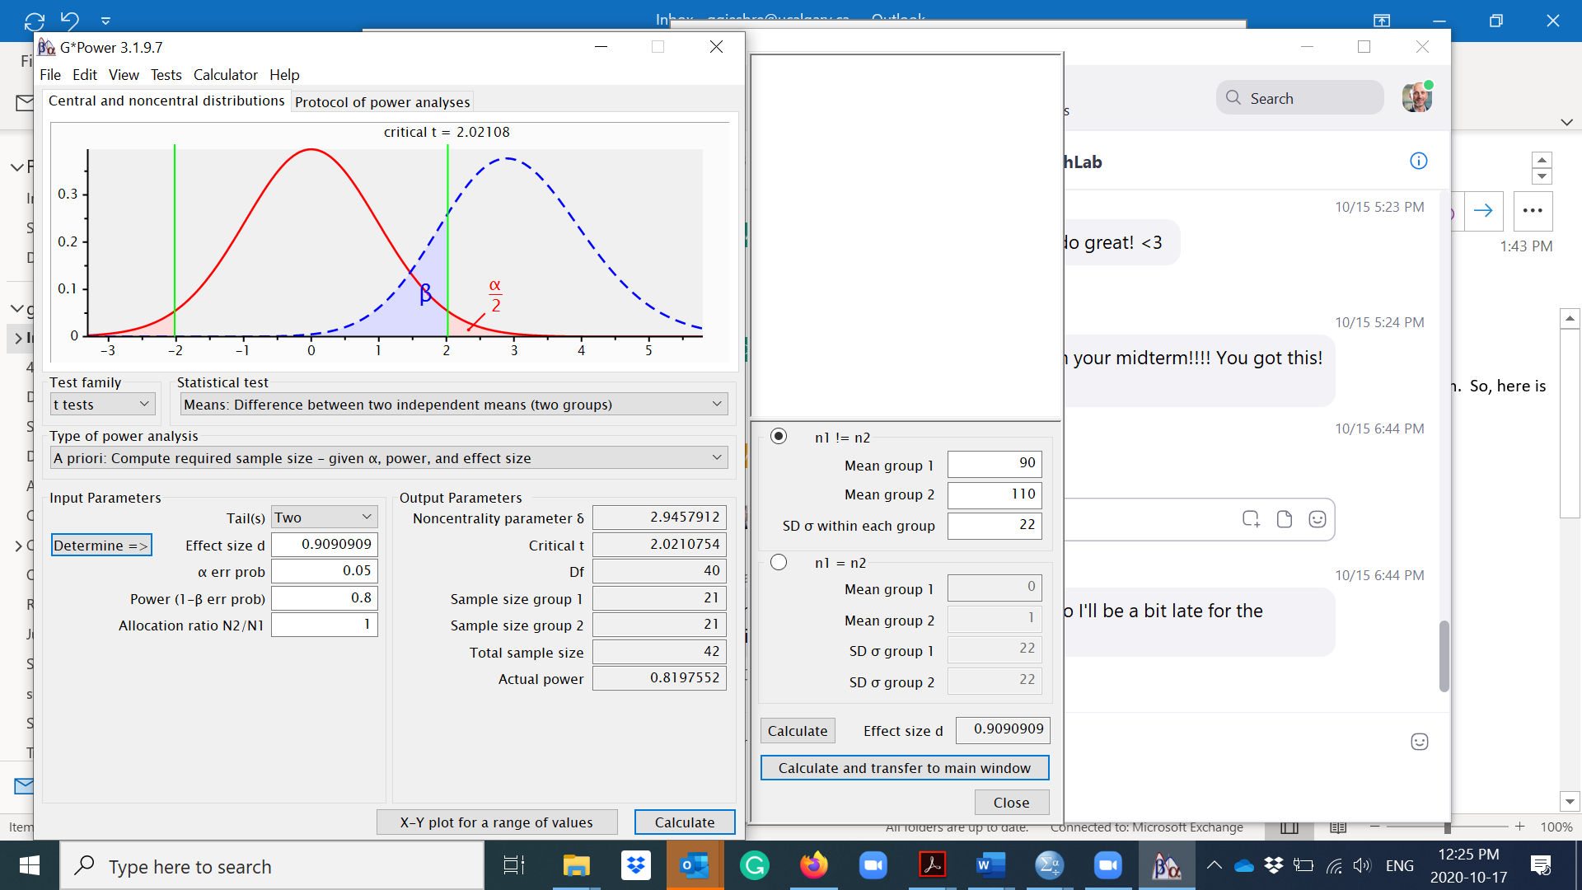
G*Power sample size calculation
Notes:
Here the SD of 22 is based on the largest SD that was identified in the medical literature (i.e., ‘worst’ case scenario).

Slide 53
Example cont…
From this example, will need 21 per group before dropouts.
Expect 90% of patients to complete the trial, will need 21/.9 = 23 per group.

Slide 54
Effects of sample size on power

Slide 55
Some sample size resources
G*Power (http://www.gpower.hhu.de/en.html) (free)
PS Power (http://biostat.mc.vanderbilt.edu/wiki/Main/PowerSample Size) also free
Russ Lenth’s page: http://www.cs.uiowa.edu/~rlenth/Power/
Within R-project for statistical computing, packages: power, pwr, Hmisc, EpiR, etc. (Free)
Within Stata: power (and endless options)

