Slide 1
Residents & Fellows Research course
2024

Slide 2
Land acknowledgement
We respectfully acknowledge and pay tribute to the traditional territories of the peoples of Treaty 7, which include the Blackfoot Confederacy (comprised of the Siksika, the Piikani, and the Kainai First Nations), the Tsuut’ina First Nation, and the Stoney Nakoda (including Chiniki, Bearspaw, and Goodstoney First Nations). The City of Calgary is also home to the Métis Nation of Alberta Region 3.

Slide 3
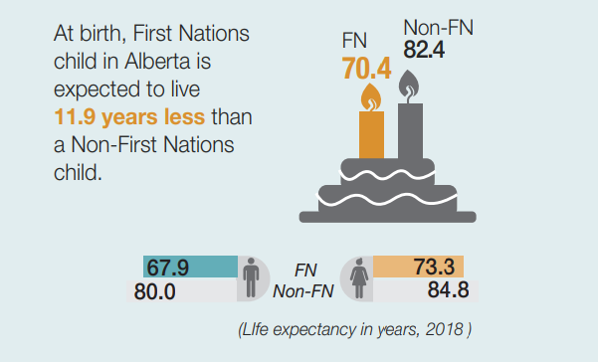
Notes:
Blackfoot Confederacy (Siksika, Piikani, Kainai): Traditional stewards of the northern Great Plains, used Calgary as a meeting and trade site.
Tsuut’ina Nation: Originally from further west, settled southwest of Calgary. Known for their buffalo hunting and distinct language and culture.
Stoney Nakoda Nations (Chiniki, Bearspaw, Wesley): Lived in the foothills and Rockies, used Calgary’s land for hunting and traveling.
Métis Nation (Region III): Prominent fur traders and buffalo hunters, lived and worked throughout Calgary along the trade routes.
The Blackfoot language, or Siksiká (as it's called in Blackfoot), is a central aspect of Blackfoot identity and culture. It belongs to the Algonquian language family and is spoken by the Blackfoot Confederacy, which includes the Siksika, Piikani, and Kainai Nations. The word "Oki" (ᓱᑯᒼ in Blackfoot syllabics) is more than just a greeting; it is an expression of hospitality, respect, and recognition of another person’s presence.

Slide 4
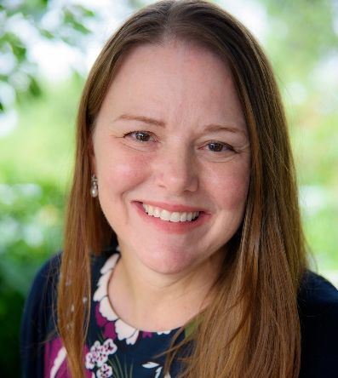
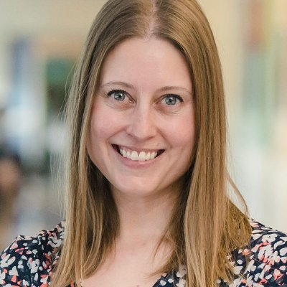
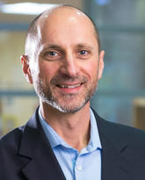
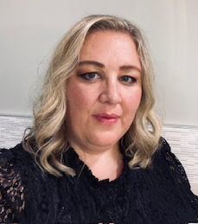
Who are we? Course Committee
Dr. Jennifer Thull-Freedman
Dr. Serena Orr
Dr. Gerry Giesbrecht
Course Coordinator: Jolene Haddad
(jolene.haddad@ahs.ca)

Slide 5
Why do we have a research course?
It’s fun! Seriously. We will convince you if you don’t already agree.
We want to lower any stress you may have about starting your project.
Our aim is to deepen your understanding of research and evaluation so that you can:
Understand evidence, so that you know when and when not to apply it to your patients, and be able to guide them in shared decision-making
Have a foundation for understanding how to design research and quality improvement projects
See options for integrating academic interests into your career

Slide 6
Our course Format
About half of the time will be spent in presentations and small group sessions. The rest is available for project work.
The presentations will give you just enough of a foundation to understand basic content, to know what you don’t know, and know when to seek additional expertise.
Your help is essential in small groups. You and your peers will develop your projects together with a physician and a scientist supervisor. Even if you have no research experience, you can help your peers develop the “story” of their project into something that is interesting, worth doing and sharing, and feasible to execute.
At the end of the course, you will have the opportunity to present your work at the Resident Research Day.
Notes:
TO KNOW WHAT YOU DON’T KNOW: to be able to remember that there's a preferred way to go about doing things. Like if they want to make a survey, they shouldn't just wing it, but they should follow established best practices. I don't care if they remember the best practices, I just want them to remember that they exist so that they look them up before they create a survey for research.

Slide 7
How do I prepare for the course?
✓
Identify an area of interest
Identify and confirm a project supervisor and set up a meeting
With your supervisor, construct your research question or QI project aim
Research or QI? Is the purpose of your project to answer a question or to achieve an aim?
Discuss with your supervisor whether funding will be required and how it will be secured
Schedule at least two meetings with your supervisor during the research course and at least one in the month following the research course
✓
✓
✓

Slide 8
Course Lectures
Defining your research question or project aim
Choosing the right study design
Searching the medical literature
Defining your aims, hypotheses, and outcome measures
Analyzing your data: Intro to biostatistics
Qualitative research; Health economics; Human simulation
Quality improvement and QI workshop
Research and QI Ethics: process for scientific and ethical review
Systematic Review/Meta-Analysis
Notes:
We are holding the EPIQ workshop this year on October 28th. This is a full day workshop led by the Neonatology Group on Evidence-Based Quality Improvement. Registration has been completed on your behalf. Lunch will be provided

Slide 9
Course Expectations
Daily attendance & evaluations: Complete One45 forms
Minimize your call and time away
Submit assignments to Jolene, small group leaders, and supervisor
Meet with your supervisor regularly (at least twice during the course)
Develop full research or QI proposal through a series of assignments
Present poster on Research Day that includes background and project design
Participate in Research Day (Thursday, Nov 14th)
Notes:
These expectations were detailed in the Course Expectations handout. We suggest that you meet with your supervisor at least once prior to the course and then a few times throughout the course so that they can help guide your project along with your Small Group. Assignments are due on Monday’s at 5pm.

Slide 10
Funding opportunities
Your supervisor may have access to funding through an existing grant if your project aligns with their work
Research course participants from the Department of Pediatrics with unfunded projects can apply for up to $1000 of funding through the resident research course small grant program (applications must be included with final assignment submission at the end of the course)
The University of Calgary Clinical Research Unit (CRU) will provide up to $2000 value in project support (statistical analysis, REDCap support, etc.) for patient-oriented research. Further details will be available during the course.
AbSPORU has funding for patient-oriented research
Notes:
The AbSPORU and CRU contact information is on the Research Course website

Slide 11
Format
Is a hybrid model
Final schedule has been sent out
Zoom etiquette:
Mute your microphone when you’re not talking
If you have a question, please use the raise hand function or put your question in the chat box
Notes:
JOLENE TO TAKE OVER
The final schedule has been sent out along with meeting invites. If you haven’t received them, please let Jolene know.
Etiquette – As I’m sure all of you are quite familiar with Zoom by now, here are a couple of reminders. Mute your mic when not talking, please use the chat box or the raise hand function if you have a question. Please turn on your camera, especially when it is something interactive. It can be discouraging to have a sea of only names when talking.

Slide 12
Assignment Review
Due Date | Assignment | Details
October 1, 2024 | Intake Form Research Question/Project Aim Name of Supervisor and email | Email to Jolene
October 28, 2024 | Assignment 1 | Research Question/Project Aim (revised from original if needed) Hypothesis Objectives
November 4, 2024 | Assignment 2 | Background Methods Outcome Measures
 | TCPS2 Ethics certificate | Needed for Ethics lecture on November 5
November 6, 2024 | Poster title | Required to prepare program for Research Day and distribute
November 8, 2024 | Assignment 3 | Sample size considerations Statistical analysis
November 13, 2024 | Digital Poster | Required to preload and organize prior to Research Day
November 15, 2024 | Final Research Proposal | Ready for submission to ethics board
Notes:
Assignments are due by 5pm, and yes I do check all of them off. As for the poster deadline, this is for me to prepare one single presentation of all posters for each group for research day to make the transition from presentation to presentation seamless. Please refer to the assignment guide for further details regarding assignments

Slide 13
Research Day
Time | Event | Presenter
8:45 am | Clinician Investigator Program Intro
 | ACHRI Trainee Association Intro
 | ENRICH Program Intro
9:30 am | Keynote Presentation | Dr. Adam Cheng
10:40 am | Poster Presentations Session 1 | Research Course Residents
11:45 am | Poster Presentations Session 2 | Research Course Residents
1:45 pm | Poster Presentations Session 3 | Senior Residents
3:00 pm | Oral Presentations | Senior Residents
Notes:
There will be lunch provided for this day.

Slide 14
Timeline for Pediatric Residents
Aim: Complete a research project during your training
R1 year
Submit a complete proposal & applications for scientific/ethics review
Initiate project remainder of this year
R2 year
Conduct your research during this year
Present your progress (poster) at Research Day
R3/R4 year
Complete your research project
Submit and present an abstract for the Oral Presentation Competition
Required to present your project (oral or poster) at Research Day
QI projects may be also be presented at ACH Quality Forum
Notes:
These were mandated by the Scholarly Oversight Committee. For your R2-4 year, if you are unable to attend Research Day, there is an opportunity to present in the Spring, but the preference is to present at Research Day

Slide 15
Timeline for Subspecialty Residents
Aim: Complete a research project during your training
Each resident has requirements specific to their individual training programs. Other academic project types such as Quality Improvement may also meet program requirements. These requirements should be discussed with your program director in advance of you formulating your research question/project as the specifications and timelines may vary with each program.
Sub-specialty residents who have completed the Research Course in their first year of training are welcome to present at the annual Research day (either a poster presentation or oral format), but are not required to.

Slide 16
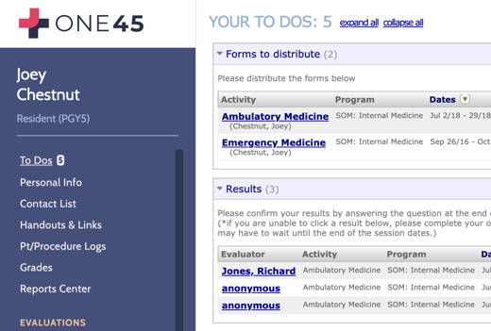
One45
Used to collect feedback on lectures and track attendance
Will receive an evaluation to complete for:
Each lecture
Cumulative for Small Group Sessions for both residents and leaders
Overall Course evaluation
Notes:
As previously mentioned, we will be using One45 to gather evaluations for each lecture and to track attendance. Each evaluation will be sent out the day of the lecture, while the cumulative evaluations will be sent out near the end of the course. If you have not accessed One45 yet, please contact your program admin as they need to create your account.

Slide 17
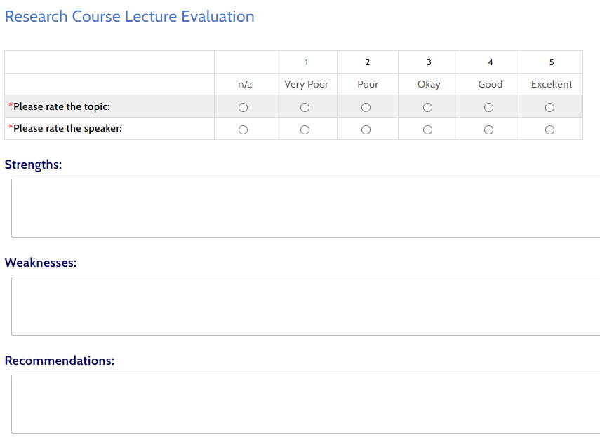
Notes:
Please remember to enter your attendance for each lecture. Once you’ve marked your attendance, the eval will show up in your To-Do’s. They will also only be available for 2 days after the lecture so please take 2 minutes at the end of each lecture to complete the evaluation. These evals do impact the changes that are made for the next year’s course so even just inputting the likert scale answers is valuable. All evaluations are anonymous and are collected cumulatively. If you’d rather, I can deselect the button that says to email you so you don’t receive an email for every lecture. ICRE session….

Slide 18
Accountability
All trainees will be required to:
Submit research question and supervisor contact info before start of course
Attend all lectures and small groups
Complete all assignments
Complete TCPS2 research ethics online course, submit certificate
Attend and present on Research Day
Submit Final Research proposal
✓
Notes:
The final evaluation will consist of the number of assignments handed in, the attendance rate of lectures and the summary score of your presentation and content for your poster presentation on Research Day. Finally, it will be pass/fail for the course. This final evaluation will be completed after the course by me, once the final research proposals have been submitted.

Slide 19
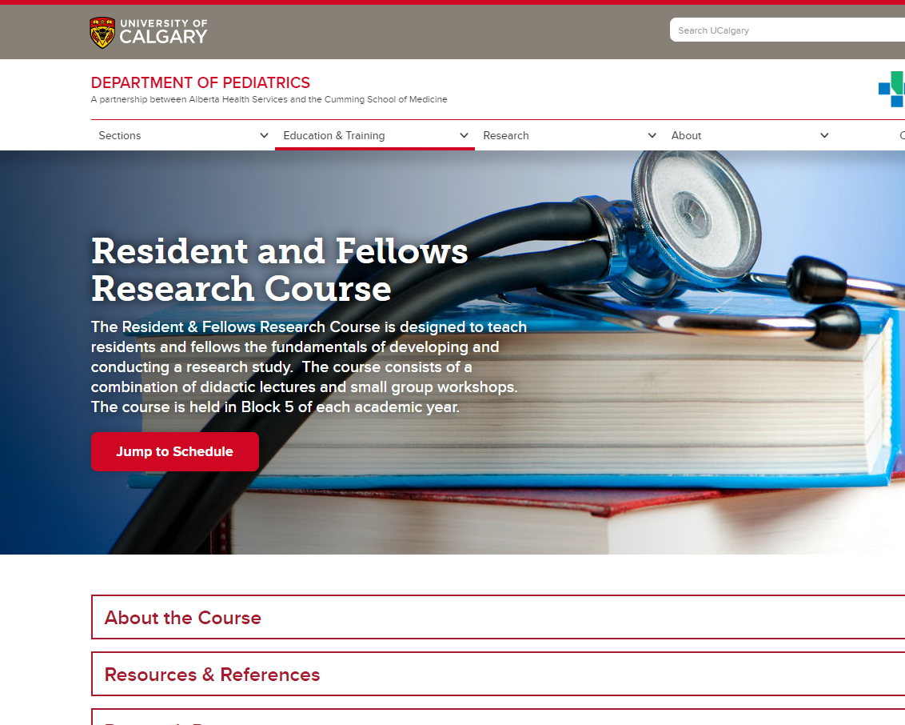
Website
https://cumming.ucalgary.ca > Paediatrics > Education & Training > Resident and Fellows Research Course
Each lecture will be recorded, but not available on the website
Notes:
I will be posting lecture slides on the website the morning of each day that has classes, usually by 9am. As I’m sure some of you have already explored, the resources included on the expectations document are posted there year-round as well as the most up to date schedule. As for recordings, if you are absent, you will need to contact me to access the recordings for the sessions that you missed.

Slide 20
Questions?

Slide 21
Researcher Panel
Dr. Jennifer Thull-Freedman, Dr. Serena Orr & Dr. Mary Dunbar
Moderator: Dr. Gerry Giesbrecht

